Slide 1
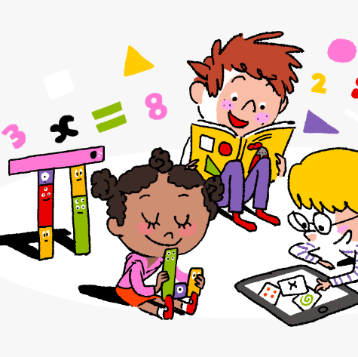
Primary 3/4 Weekly Learning Update 26/2/24

Slide 2
Primary 4 Active Literacy
P4 are working on individual common/ tricky words. Try to bring your homework jotters to school regularly so your new words can be added.
This week P4 are learning to recognise and use different representations of the phoneme ow to read and spell.
ou | ow | ough
sound mouse louse shout playground mountain aloud lounge | crowd downward coward powder allowed scowling browse prowl | drought bough plough
Note: Some learners may only be focussing on the ‘ou’ and ‘ow’ representations.
Confident spellers may wish to look at the range of representations.

Slide 3
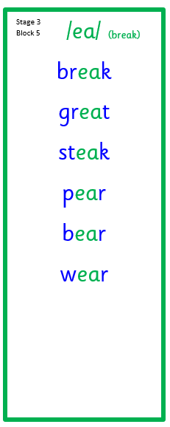
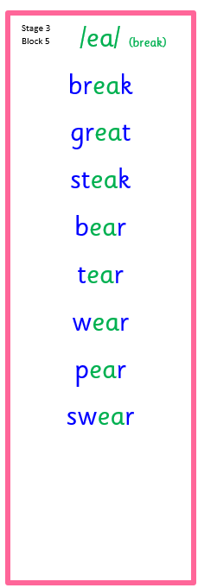
Primary 3 Active Literacy
This week P3 are learning to recognise and use the ea (break) phoneme.
Common Words
carry
always

Slide 4
Numeracy
This week we will be looking at times tables.
Practise as often as possible at home.

Slide 6
Homework
Active Literacy Spelling
P3: Choose 3 of the ‘ea’ words and write sentences for them. Choose a spelling activity card to practise the words from the list.
P4: Choose 2-3 words to ‘grow’ by adding a prefix (a group of letters added to the beginning of a word) or a suffix (a group of letters added to the end of a word). e.g. unpopular and fewer. Continue to work through your individual targets on Nessy. Secret word: RELIEVEDARCH
Reading
Aim to read your library book for 10 minutes each night. Remember to quiz yourself on any book(s) you read! Or if you prefer, log into MyON and pick a book to read for pleasure. You can read the story yourself or have it read to you.
Numeracy
Follow the link to Topmarks: Hit the Button and practise your times tables. We are looking at the 5 and 10x table at the moment.
Work through the Rigour Calendar for February at your own pace. Don’t worry if there are questions you don’t understand, we just maybe haven’t covered this topic yet.

Slide 7
P3/4 Learning Update
Please visit the blog for photos and information about activities taking place in class.
If you have any questions, please do not hesitate to contact me, alana.black@eastayrshire.org.uk

