Slide 1
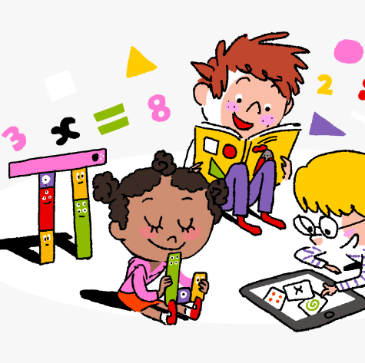
Primary 3/4 Weekly Learning Update 22/1/24

Slide 2
Primary 4 Active Literacy
P4 are working on individual common/ tricky words. Try to bring your homework jotters to school regularly so your new words can be added.
This week P4 are continuing to recognise and use different representations of the phoneme g to read and spell.
g | gg | gu | gh | x | gue
again goes gone agony Glasgow | dagger juggle giggle wriggle stagger | guitar guess guilt guy guide | ghost ghoul ghastly gherkin spaghetti | exam examine exact example exotic | league plague vague dialogue analogue
Note: Some learners may only be focussing on the ‘g’ and ‘gg’ representations.
Confident spellers may wish to look at the range of representations.

Slide 3
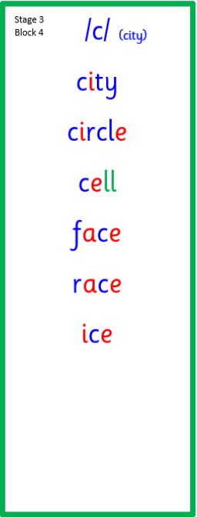
Primary 3 Active Literacy
This week P3 are learning to recognise and use the c (city) phoneme.
Common Words
goes
upon
once

Slide 4
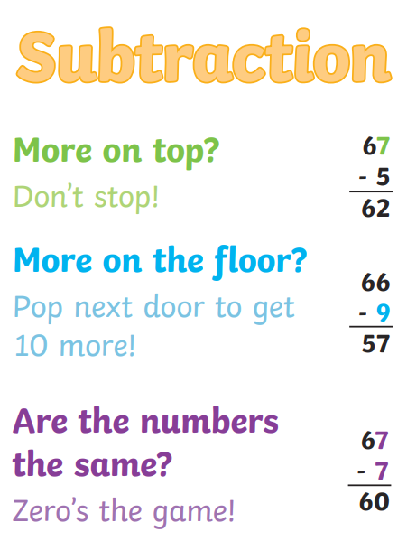
Numeracy
This week we will be looking at subtracting, and subtracting with exchanging.

Slide 5
Homework
Active Literacy Spelling
P3: Choose 3 of the ‘c’ words and write sentences for them. Aim to use some of the connectives we have been working on in class (and, but, because, so).
P4: Choose 3 words and find out their meanings. Then write a sentence containing each word. Log on to Nessy to work through your individual spelling & reading targets.
Reading
Aim to read your library book for 10 minutes each night. Remember to quiz yourself on any book(s) you read! Or if you prefer, log into MyON and pick a book to read for pleasure. You can read the story yourself or have it read to you.
Numeracy
Follow the link to Topmarks, and choose an activity on Subtraction.
Work through the Rigour Calendar for January at your own pace. Don’t worry if there are questions you don’t understand, we just maybe haven’t covered this topic yet.
PLPs and Wider Achievement
If you haven’t already done so, please try to return PLPs by Friday.
Children should keep there Wider Achievement checklist at home and add to this as and when required. Time will be set aside in class to share and celebrate achievements.

Slide 7
P3/4 Learning Update
Please visit the blog for photos and information about activities taking place in class.
If you have any questions, please do not hesitate to contact me, alana.black@eastayrshire.org.uk

