Slide 1
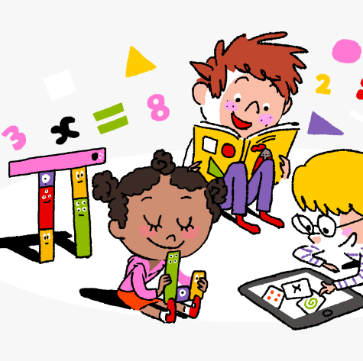
Primary 3/4 Weekly Learning Update 15/01/24

Slide 2
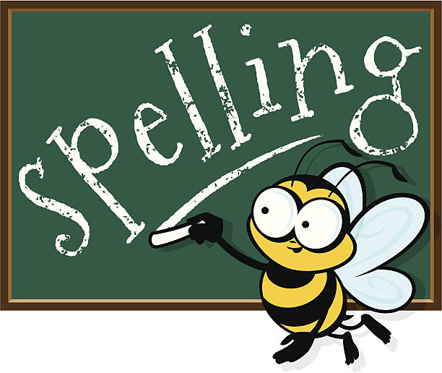
Primary 4 Active Literacy
P4 are working on individual common/ tricky words. These can be found in their homework jotters.
This week P4 are learning to recognise and use different representations of the phoneme f to read and spell.
f | ff | ph | gh
forest frozen final life freeze | staff office official raffle caffeine | phone phoneme philosopher elephant photograph | tough rough enough cough laugh

Slide 3
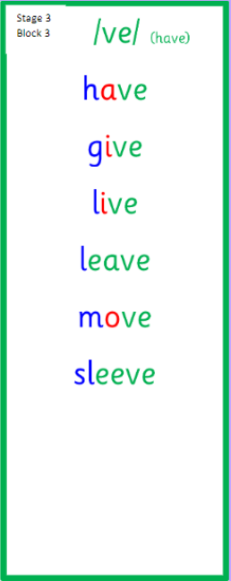
Primary 3 Active Literacy
This week P3 are learning to recognise and use the ve (have) phoneme.
Common Words
love
first
girl
bird

Slide 4
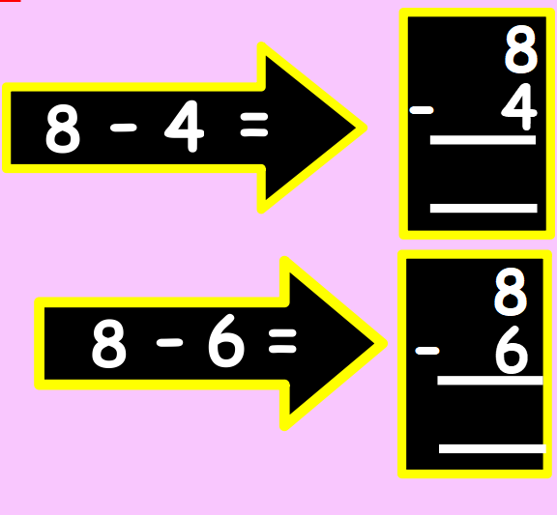
Numeracy
This week we will be working on subtraction using formal methods.

Slide 5
Homework
Active Literacy Spelling
P4- Can you add some words to the ‘f’ phoneme chart? Choose 2-3 words from the chart and find out their meanings.
Continue to work on your individual spelling targets on Nessy.
P3- Choose a spelling activity card to practise the ‘ve’ phoneme words.
Can you write a sentence for each common word?
Reading
Aim to read your library book for 10 minutes each night. Remember to quiz yourself on any book(s) you read! Or if you prefer, log into MyON and pick a book to read for pleasure. You can read the story yourself or have it read to you.
Scots Poem- Please continue to practise your Scots poem.
Numeracy
Log on to Active Learn and complete ‘Starfish Strike’. Have your homework jotters at the ready to use for workings!
Work through the Rigour Calendar for January at your own pace. Don’t worry if there are questions you don’t understand, we just maybe haven’t covered this topic yet.

Slide 6
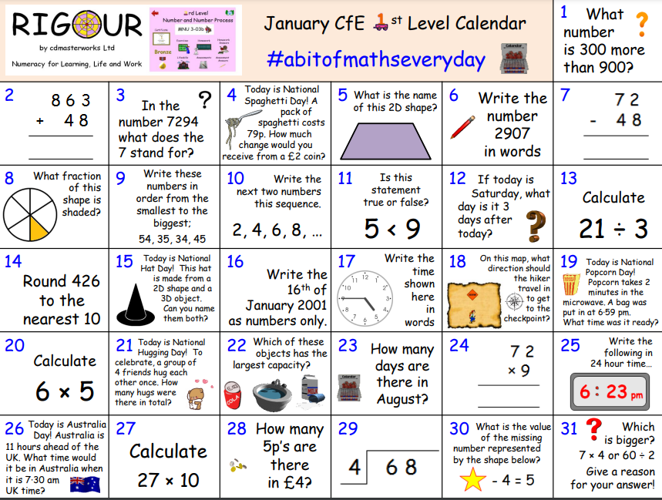

Slide 7
P3/4 Learning Update
Please visit the blog for photos and information about activities taking place in class.
If you have any questions, please do not hesitate to contact me, alana.black@eastayrshire.org.uk

