Slide 1
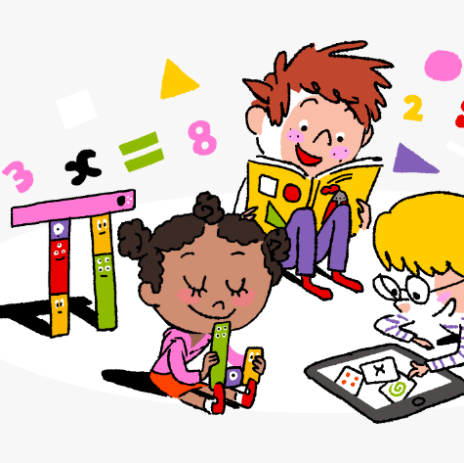
Primary 3/4 Weekly Learning Update 27/11/23

Slide 2
Primary 4 Active Literacy
P4 are working on individual common/ tricky words. These can be found in their homework jotters.
This week P4 are continuing to recognise and use different representations of the phoneme yoo to read and spell.
u | u_e | ew | ue | eu
tutor unit unicorn manual popular | use Duke reduce refuse fortune | few nephew fewer view newt | argue venue value statue issue | Euro Europe feud

Slide 3
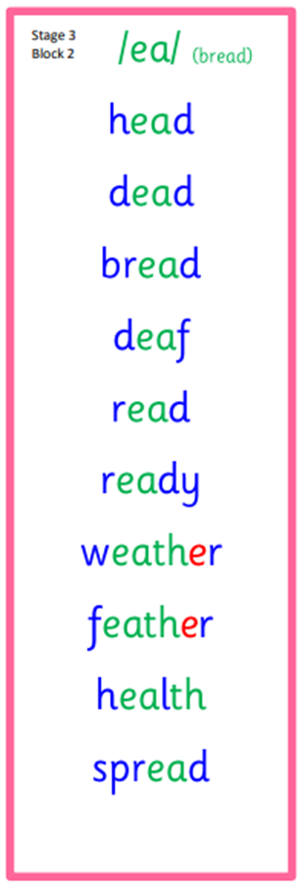
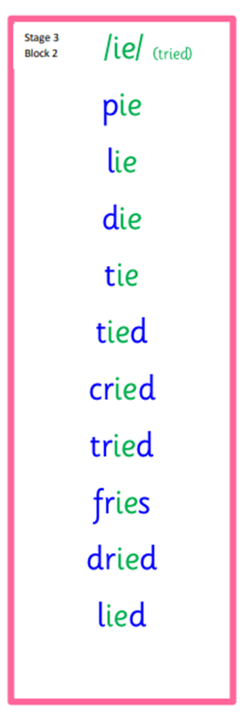
Primary 3 Active Literacy
This week P3 are revising previously taught phonemes: ea (bread),‘ie (tried) and u (push & unit).
Common Words
head
pretty
another
Common Words
together
buy
eye
Common Words
call
fall
talk
also

Slide 4
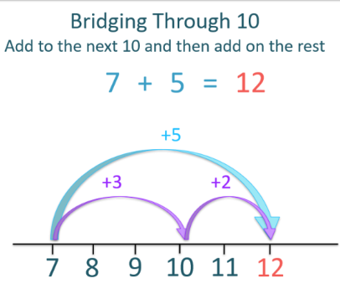
Numeracy
This week we will be looking at new strategies for addition and subtraction.

Slide 5
Homework
Active Literacy Spelling
P4- Choose 2-3 words to ‘grow’ by adding a prefix (a group of letters added to the beginning of a word) or a suffix (a group of letters added to the end of a word). e.g. unpopular and fewer.
Choose 1-2 spelling challenge cards to practise your common words.
P3- Practise all 3 sounds (ea, ie and u). You may want to ‘Look, Cover, Write & Check’, or use a spelling challenge card.
Reading
Aim to read your library book for 10 minutes each night. Remember to quiz yourself on any book(s) you read! Or if you prefer, log into MyON and pick a book to read for pleasure. You can read the story yourself or have it read to you.
Numeracy
Continue to practise your number bonds to 10 and 20.
Follow the link to Topmarks- Daily 10 and select Level 2 or 3- Addition or Subtraction- 2 digit numbers.
Work through the Rigour Calendar for November at your own pace. Don’t worry if there are questions you don’t understand, we just maybe haven’t covered this topic yet.

Slide 7
P3/4 Learning Update
Please visit the blog for photos and information about activities taking place in class.
If you have any questions, please do not hesitate to contact me, alana.black@eastayrshire.org.uk

