Slide 1
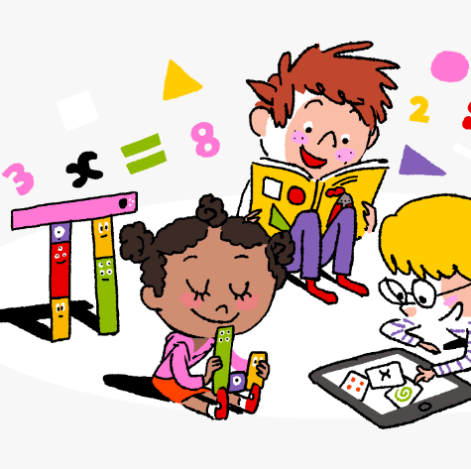
Primary 3/4 Weekly Learning Update 20/11/23

Slide 2
Primary 4 Active Literacy
P4 are working on individual common/ tricky words. These can be found in their homework jotters.
This week P4 are learning to recognise and use different representations of the phoneme yoo to read and spell.
u | u_e | ew | ue | eu
tutor unit unicorn manual popular | use Duke reduce refuse fortune | few nephew fewer fewest newt | argue venue value statue issue | Euro Europe feud

Slide 3
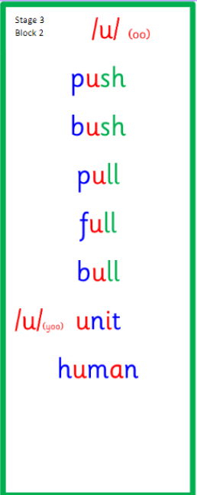
Primary 3 Active Literacy
This week P3 are learning to recognise and use the u (push) and (unit) phoneme.
Common Words
call
fall
talk
also

Slide 4
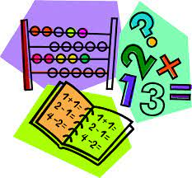
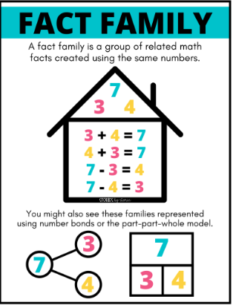
Numeracy
This week we will be looking at the link between addition and subtraction.
We will focus on fact families, and counting on and back.
Follow the link to BBC Bitesize for short videos and activities on fact families.

Slide 5
Homework
Active Literacy Spelling
P4- Can you add some words to the ‘yoo’ phoneme chart? Choose 2-3 words from the chart and find out their meanings.
Continue to work on your individual spelling targets on Nessy.
P3- Choose a spelling activity card to practise the ‘u’ phoneme words.
Can you write a sentence for each common word?
Reading
Aim to read your library book for 10 minutes each night. Remember to quiz yourself on any book(s) you read! Or if you prefer, log into MyON and pick a book to read for pleasure. You can read the story yourself or have it read to you.
Numeracy
Practise your number bonds to 10 and 20.
Work through the Rigour Calendar for November at your own pace. Don’t worry if there are questions you don’t understand, we just maybe haven’t covered this topic yet.

Slide 7
P3/4 Learning Update
Please visit the blog for photos and information about activities taking place in class.
If you have any questions, please do not hesitate to contact me, alana.black@eastayrshire.org.uk

