Slide 1
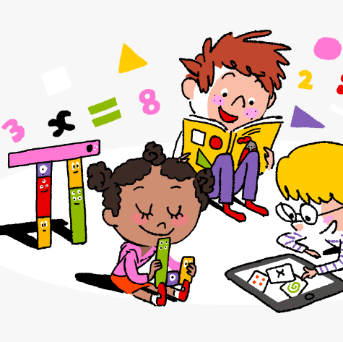
Primary 3/4 Weekly Learning Update 13/11/23

Slide 2
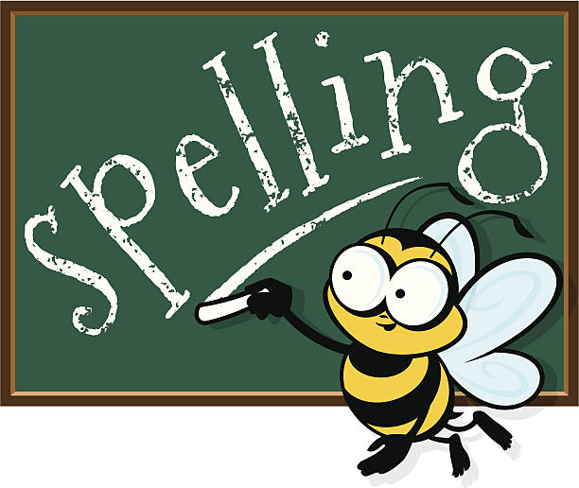
Primary 4 Active Literacy
P4 are working on individual common/ tricky words. These can be found in their homework jotters.
This week P4 are continuing to recognise and use different representations of the phoneme oo to read and spell.
oo | u_e | ew | ue | u
school swoop tooth shook | tune June flute chute | few nephew grew threw | rescue clueless true continue | mindful instrument bull pull

Slide 3
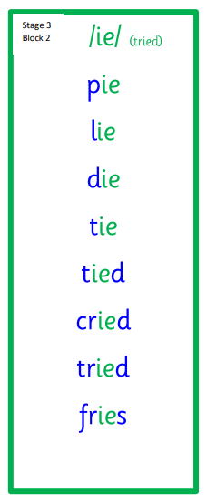
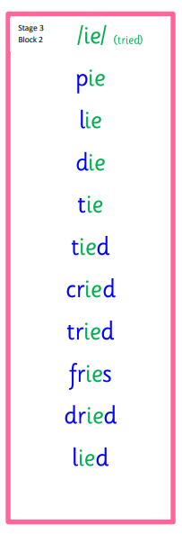
Primary 3 Active Literacy
This week P3 are learning to recognise and use the ie (tried) phoneme.
Common Words
together
buy
eye

Slide 4
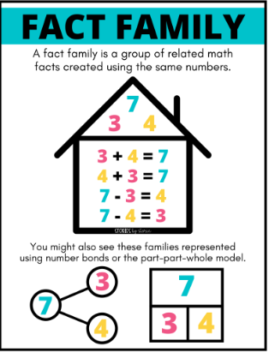
Numeracy
This week we will be looking at the link between addition and subtraction.
We will focus on fact families, and counting on and back.
Follow the link to BBC Bitesize for short videos and activities on fact families.

Slide 5
Homework
Active Literacy Spelling
P4- Choose 3-4 words from the phoneme chart and create sentences for them. Aim to start each sentence differently and use connectives (and, but, so, because, while).
Choose a spelling activity card to practise your common words.
P3- Choose 3-4 of the ‘ie’ phoneme words and create a sentence for each one. Do your best to start each sentence differently.
Choose a spelling activity card to practise your phoneme and tricky words.
Reading
Aim to read your library book for 10 minutes each night. Remember to quiz yourself on any book(s) you read! Or if you prefer, log into MyON and pick a book to read for pleasure. You can read the story yourself or have it read to you.
Numeracy
Practise your number bonds to 10 and 20.
Work through the Rigour Calendar for November at your own pace. Don’t worry if there are questions you don’t understand, we just maybe haven’t covered this topic yet.

Slide 7
P3/4 Learning Update
Please visit the blog for photos and information about activities taking place in class.
If you have any questions, please do not hesitate to contact me, alana.black@eastayrshire.org.uk

