Slide 1
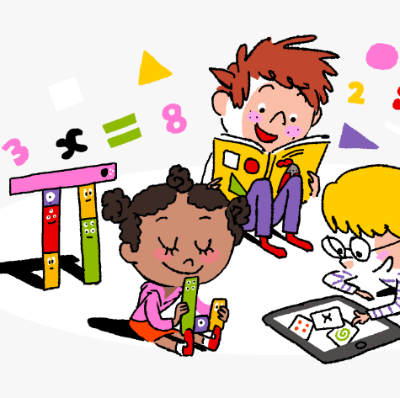
Primary 3/4 Weekly Learning Update 6/11/23

Slide 2
Primary 4 Active Literacy
P4 are working on individual common/ tricky words. These can be found in their homework jotters.
This week P4 are learning to recognise and use different representations of the phoneme oo to read and spell.
oo | u_e | ew | ue | u
school swoop tooth shook | tune June flute chute | few nephew grew threw | rescue clueless true continue | mindful instrument bull pull

Slide 3
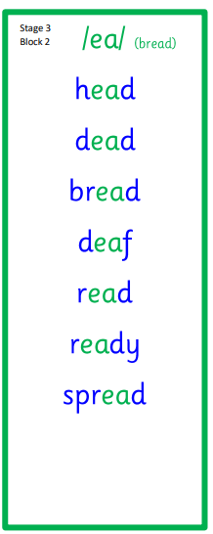
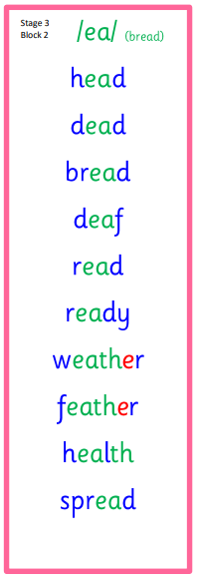
Primary 3 Active Literacy
This week P3 are learning to recognise and use the ea (bread) phoneme.
Common Words
head
pretty
another

Slide 4
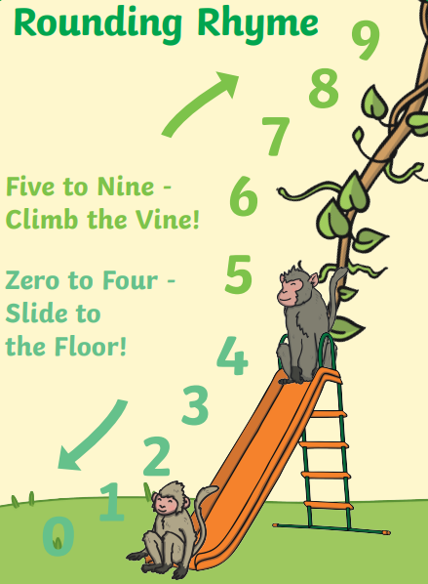
Numeracy
Can you make 5 numbers and round them to the nearest 10?
You can choose if you want your numbers to be 2, 3 or 4 digits.
We have been learning to round to the nearest 10 and 100.
Watch the short YouTube clip below to remind you how to round.
Round to 10 song

Slide 5
Homework
Active Literacy Spelling
P4- Can you add words to the phoneme chart? Choose a word to ‘grow’ by adding a prefix (a group of letters added to the beginning of a word) or a suffix (a group of letters added to the end of a word). e.g. preschool or fewer.
Choose a spelling activity card to practise your common words.
P3- Can you create sentences using your ‘ea’ phoneme words?
Choose a spelling activity card to practise your phoneme and tricky words.
Reading
Aim to read your library book for 10 minutes each night. Remember to quiz yourself on any book(s) you read! Or if you prefer, log into MyON and pick a book to read for pleasure. You can read the story yourself or have it read to you.
Numeracy
Follow the link to Topmarks- Daily 10
Choose ‘level 4’ and ‘Rounding’.
Work through the Rigour Calendar for November at your own pace. Don’t worry if there are questions you don’t understand, we just maybe haven’t covered this topic yet.

Slide 7
P3/4 Learning Update
Please visit the blog for photos and information about activities taking place in class.
If you have any questions, please do not hesitate to contact me, alana.black@eastayrshire.org.uk

