Slide 1
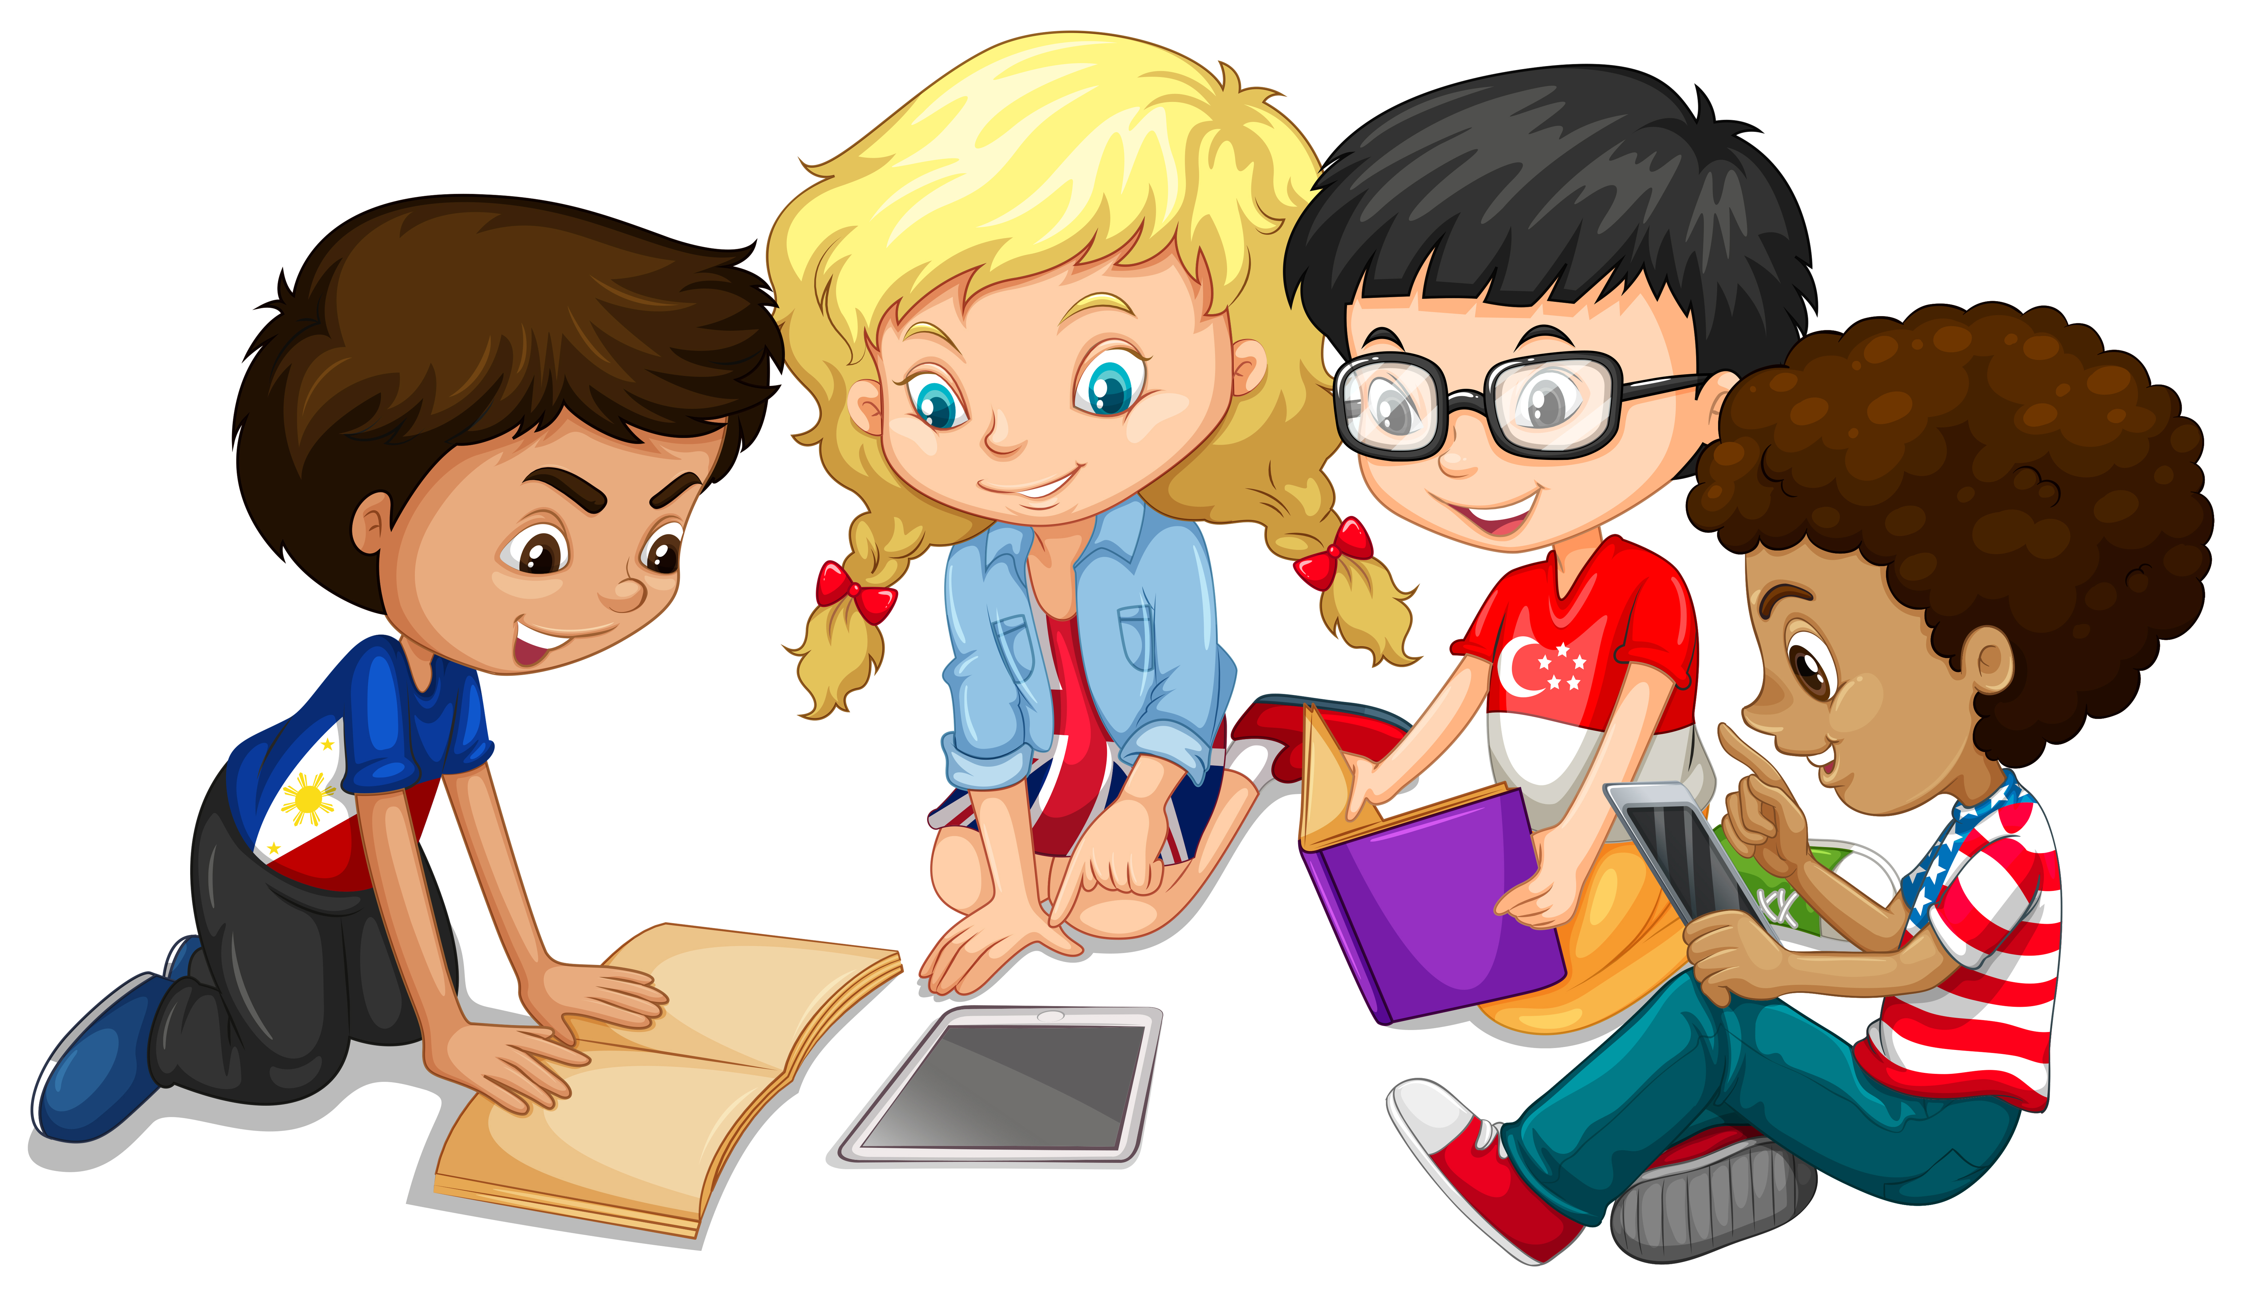
Primary 3 Weekly Learning
Monday 9th December, 2024

Slide 2
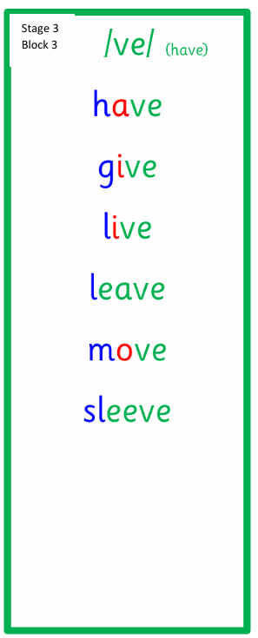
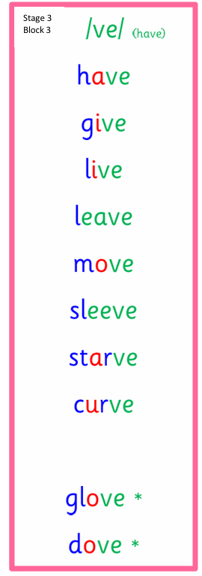
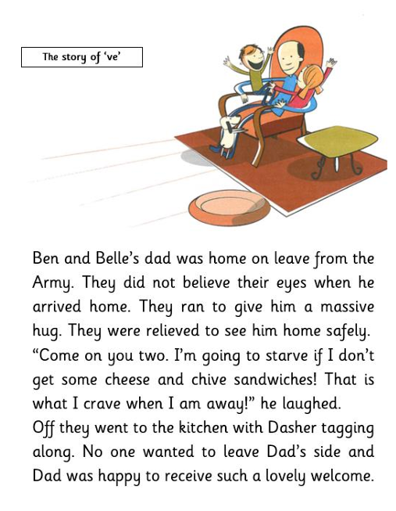
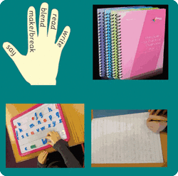
Active Literacy This week P3 are learning to read, spell and write words with the ”ve” sound as in have. Can you add any more “ve” words to our list?

Slide 3
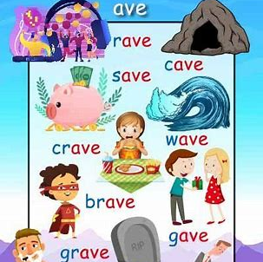
This week, P3 are learning to read, write and spell these tricky words: love, give and live.
Watch Mr Thorne to help you with ve words:
https://youtu.be/CYYI0NSe9ls
There is an advert at the start that you can skip.
Can you read the ave words on the right?

Slide 4
Here are some suggested activities to use with P3 Active Litercy Words to help you learn to read, spell and write them. Use the activity/activities you think will help you and complete in your Home Learning jotter.

Slide 5
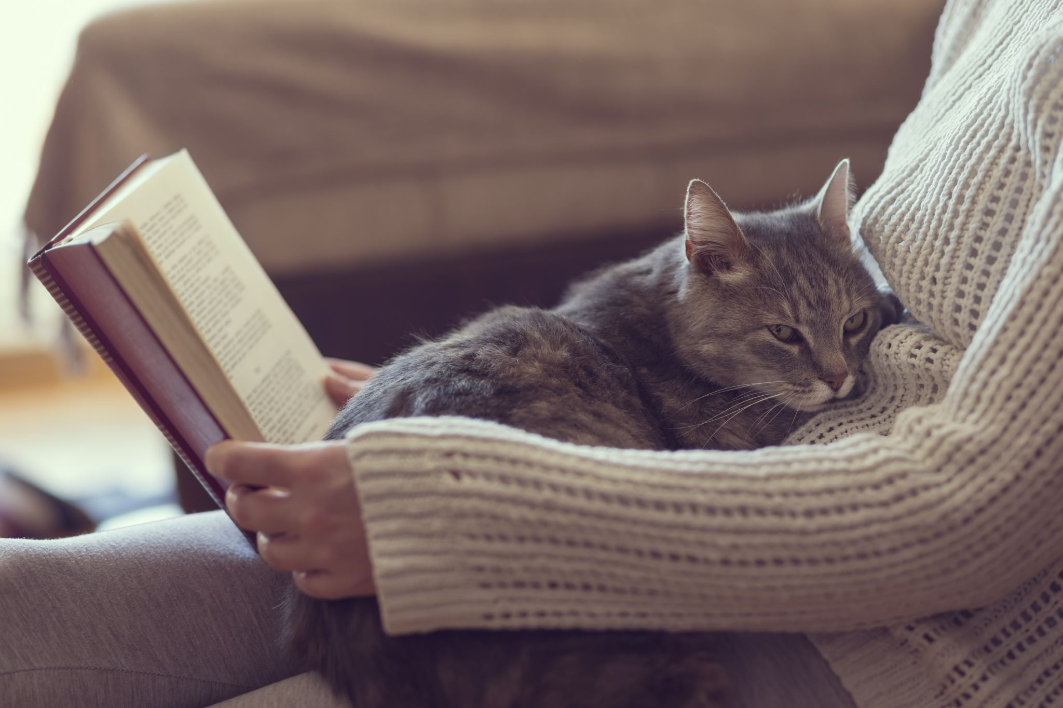
Reading & Writing
Log on to MyOn and choose a book to read for pleasure.
You can read the book to yourself (or your dog, cat or wee brother or sister) or have it read to you...you choose!
Perhaps you would like to read a book to find out more about a hobby you do or would like to do. Whatever you choose, enjoy!
Use the link below to access Star Reader and MYON…
https://login.renaissance.com/12d2c8a8-2823-404d-a533-8a77e03336fc?state=135b3c41-0dc9-4719-ac4b-f36ccfa69aea
If there is a quiz linked to the book you have picked, please complete it.

Slide 6
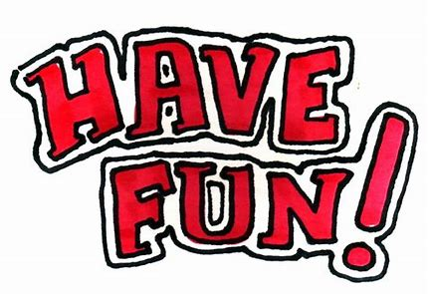
Numeracy
P3 have been learning how to write addition calculations in their squared paper jotters. They must remember to keep the units under the units, tens under the tens and the hundreds under the hundreds.
https://youtu.be/S6S6fmu1eAA for 2 digit number
https://youtu.be/HkNuGnE8SIo for 3 digit numbers

Slide 7
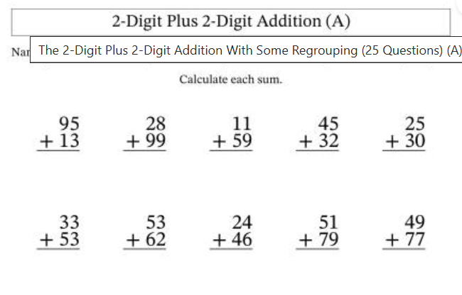
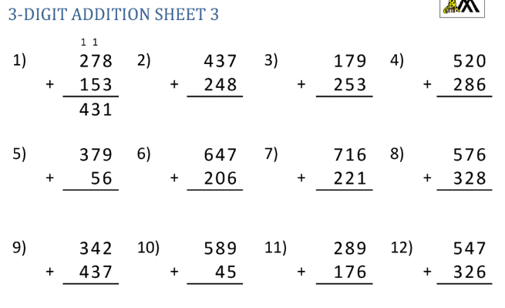
Choose your chilli challenge!

