Slide 1
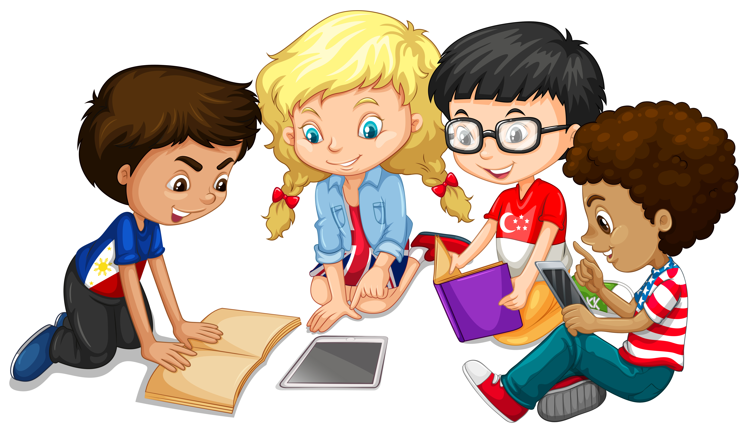
Primary 3 Weekly Learning
Monday 18th November, 2024

Slide 2
Consolidation Week
This week is a consolidation week of the last 3 phonemes and tricky words taught.
ie sound – pie, tie etc
u – full, push etc.
ea – bread, head etc.
Please practise reading, writing and spelling these words.

Slide 3
Here are some suggested activities to use with P3 Active Litercy Words to help you learn to read, spell and write them. Use the activity/activities you think will help you and complete in your Home Learning jotter.

Slide 4
Reading & Writing
Log on to MyOn and choose a book to read for pleasure.
You can read the book to yourself (or your dog, cat or wee brother or sister) or have it read to you...you choose!
Perhaps you would like to read a book to find out more about a hobby you do or would like to do. Whatever you choose, enjoy!
Use the link below to access Star Reader and MYON…
https://login.renaissance.com/12d2c8a8-2823-404d-a533-8a77e03336fc?state=135b3c41-0dc9-4719-ac4b-f36ccfa69aea
If there is a quiz linked to the book you
have picked, please complete it.

Slide 5
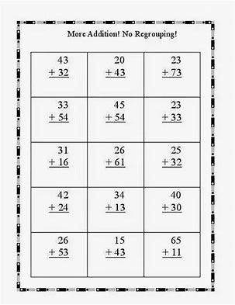
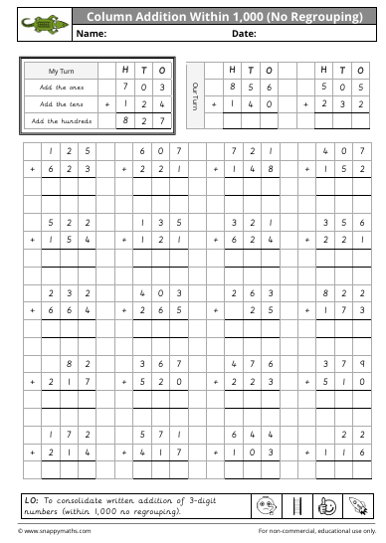
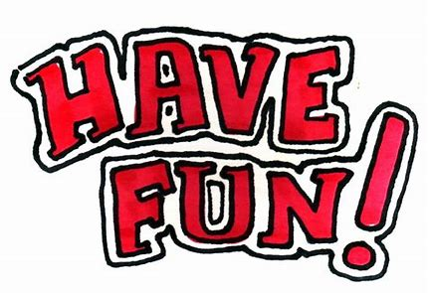
Numeracy
P3 will be learning about addition this week. We will be focussing on writing addition sums in our squared jotter, remembering to keep units with units, tens with tens and hundreds with hundreds.

