Slide 1
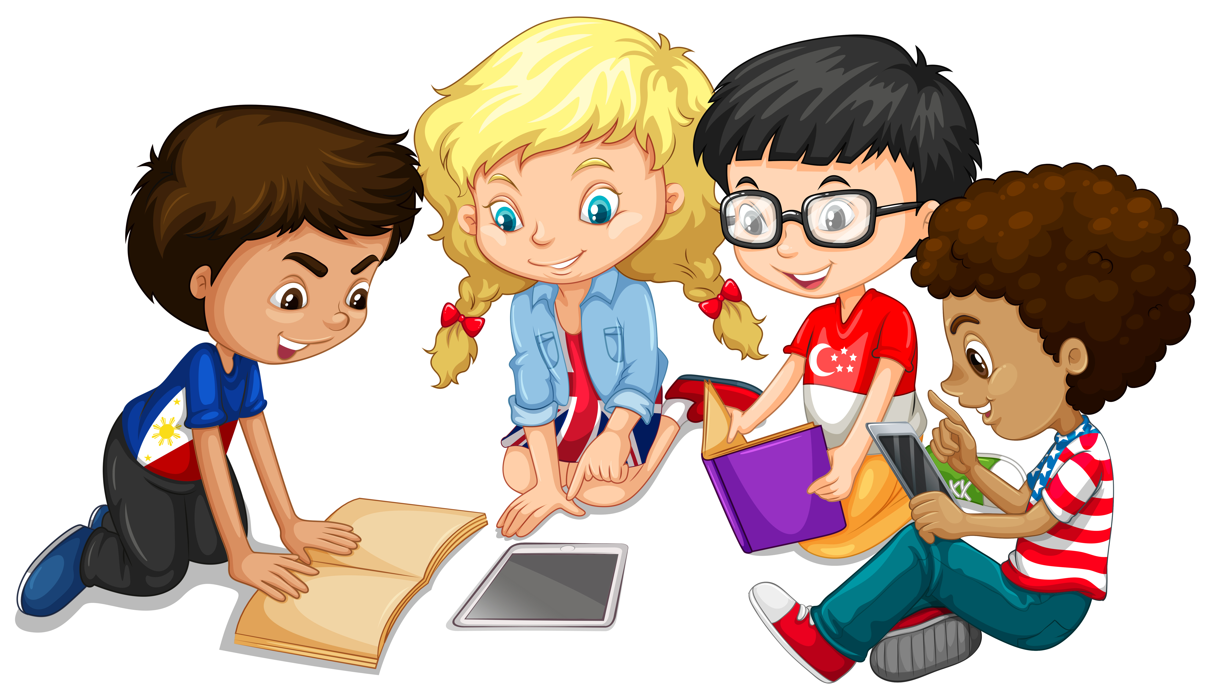
Primary 3 Weekly Learning
Monday 4th November, 2024

Slide 2
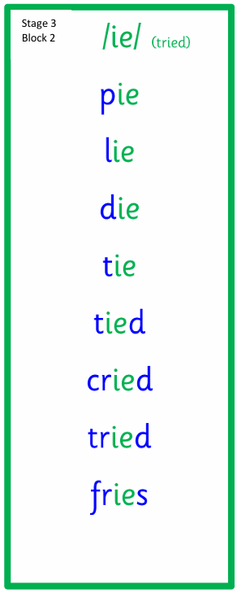
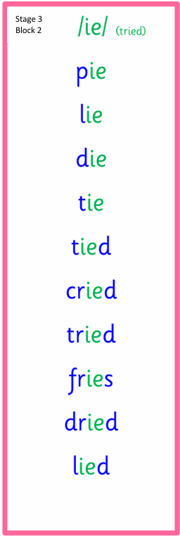
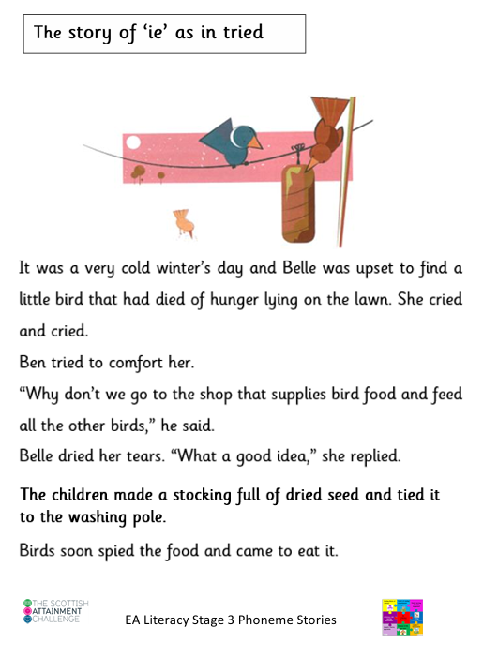
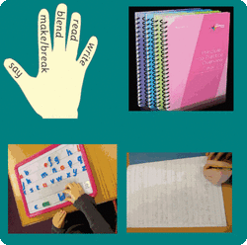
Active Literacy This week P3 are learning to read, spell and write words with the ”ie” sound as in tied. Can you add any more “ie” words to our list?

Slide 3
This week, P3 are learning to read, write and spell these tricky words:
Mr Thorne
Copy the link into your browser to listen to Mr Thorne:
Videos of Mr Thorne ie Tied
together
buy
eye

Slide 4
Here are some suggested activities to use with P3 Active Litercy Words to help you learn to read, spell and write them. Use the activity/activities you think will help you and complete in your Home Learning jotter.

Slide 5
Reading & Writing
Log on to MyOn and choose a book to read for pleasure.
You can read the book to yourself (or your dog, cat or wee brother or sister) or have it read to you...you choose!
Perhaps you would like to read a book to find out more about a hobby you do or would like to do. Whatever you choose, enjoy!
https://www.myon.co.uk/login/index.html
If there is a quiz linked to the book you
have picked, please complete it.

Slide 6
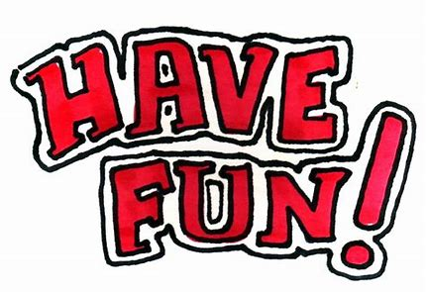
Numeracy
P3 have been learning more about place value and what each digit means in a number. Here is a game to consolidate learning in class. Choose your level of difficulty.
Place Value Charts – Topmarks
Please continue to challenge your child to add and subtract 1, 10, 100 and 1000 from a given number,
Choose your number:
45
+1
-1
+10
-10
145
+1
-1
+10
-10
+100
-100
1145
+1
-1
+10
-10
+100
-100
+1000
-1000

