Slide 1
Primary 3 Weekly Learning
Monday 28th October, 2024

Slide 2
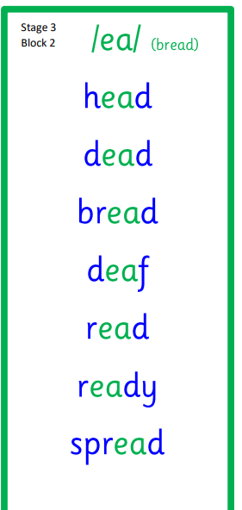
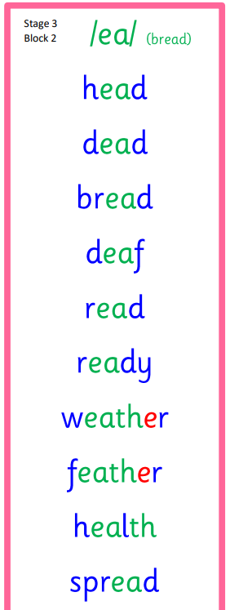
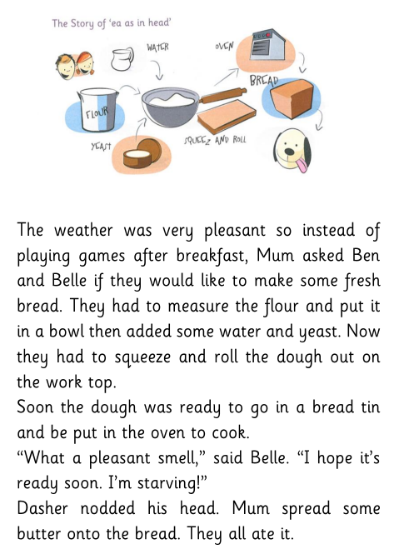
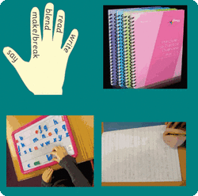
Active Literacy This week P3 are learning to read, spell and write words with the ”ea” sound as in head. Can you add any more “ea” words to our list?

Slide 3
This week, P3 are learning to read, write and spell these tricky words:
Mr Thorne
Copy the link into your browser to listen to Mr Thorne:
https://youtu.be/kdswe0jQo6I
head
pretty
another

Slide 4
Here are some suggested activities to use with P3 Active Litercy Words to help you learn to read, spell and write them. Use the activity/activities you think will help you and complete in your Home Learning jotter.

Slide 5
Reading & Writing
Log on to MyOn and choose a book to read for pleasure.
You can read the book to yourself (or your dog, cat or wee brother or sister) or have it read to you...you choose!
Perhaps you would like to read a book to find out more about the weather. Whatever you choose, enjoy!
https://www.myon.co.uk/login/index.html
If there is a quiz linked to the book you
have picked, please complete it.

Slide 6
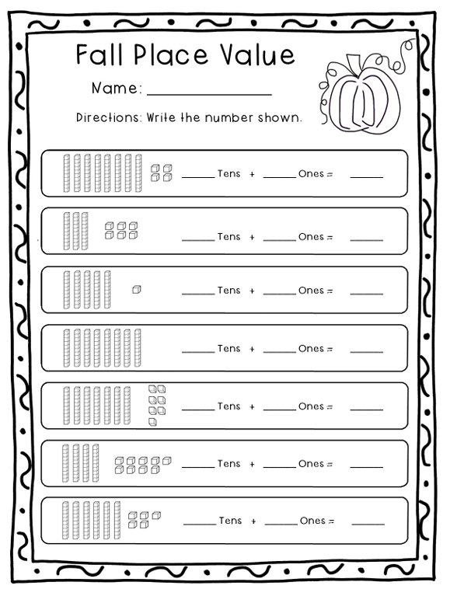
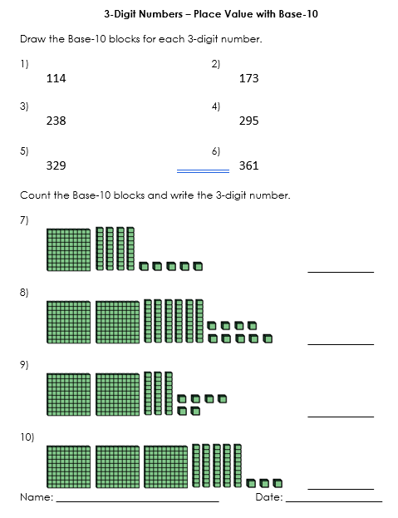
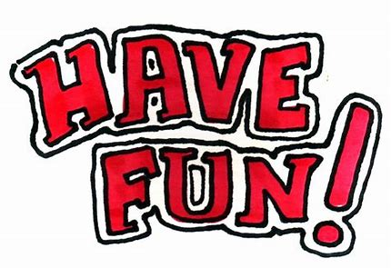
Numeracy
P3 will be learning about place value and how to write numbers in different ways.

Slide 7
Numeracy
Find out how to represent the numbers 1-10 in different ways by clicking on the link:
Place value - KS1 Maths - BBC Bitesize
Log on to Top Marks to test your knowledge:
Place Value, Maths Games for 7-11 Years - Topmarks

