Slide 1

Primary 3
Weekly
Learning
Monday 7th October, 2024

Slide 2
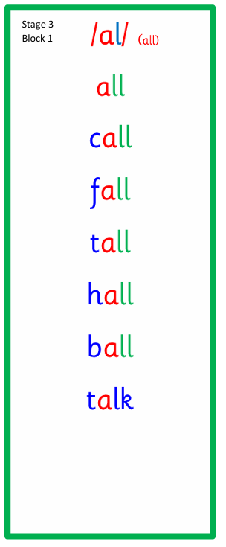
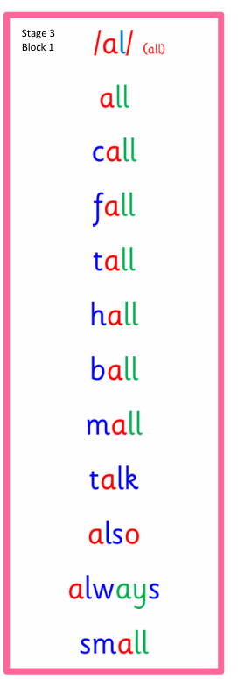
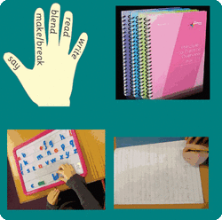
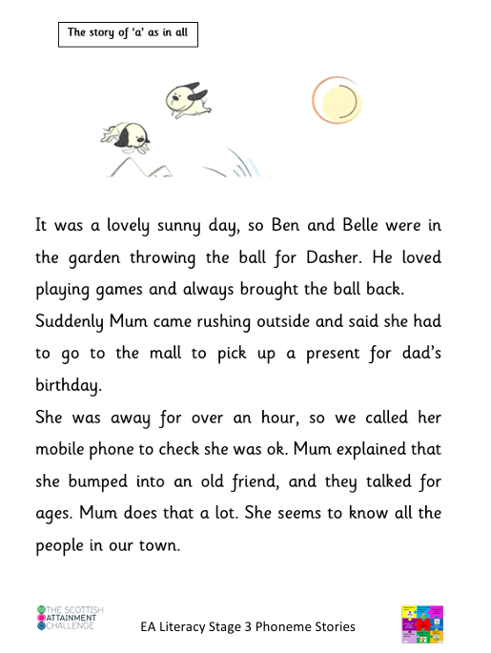
Active Literacy
This week P3 are learning to read, spell and write words with the ”al” sound as in all. Can you add any more “al” words to our list?

Slide 3
Please try to use your very best handwriting (remembering to join the “a” to the “al when writing “al” words.

Slide 4
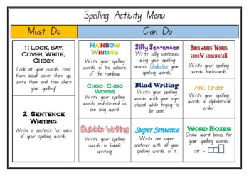
Some activity suggestions to help learn your words.

Slide 5
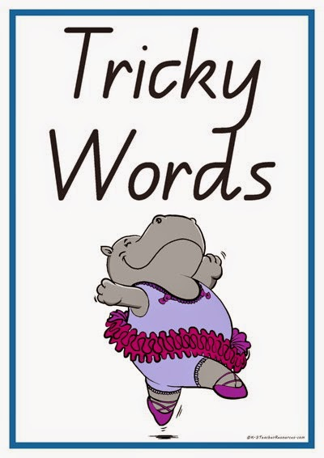
This week, P3 are learning to read, write and spell these tricky words:
Challenge
Try this quick game:
Word list activities: wa words (spellzone.com)
call
fall
talk
also

Slide 6
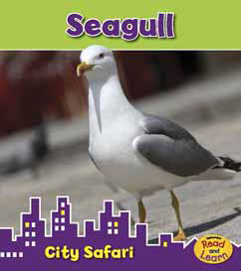

Reading & Writing
Log on to MyOn and choose a book to read for pleasure.
You can read the book to yourself or have it read to you...you choose!
Perhaps you would like to read a book to help you learn about a rescue at sea or maybe read about seagulls.
Whatever you choose, enjoy!
https://www.myon.co.uk/login/index.html
If there is a quiz linked to the book you
have picked, please complete it.

Slide 7
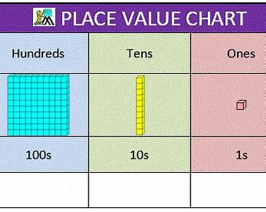
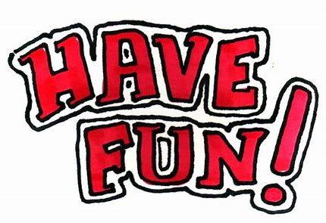
Numeracy
P3 will be learning how to partition numbers (to break down numbers and identify how many units, tens and hundreds are in each one).
Here is a useful website to help.
How to partition a number - BBC Bitesize

Slide 8
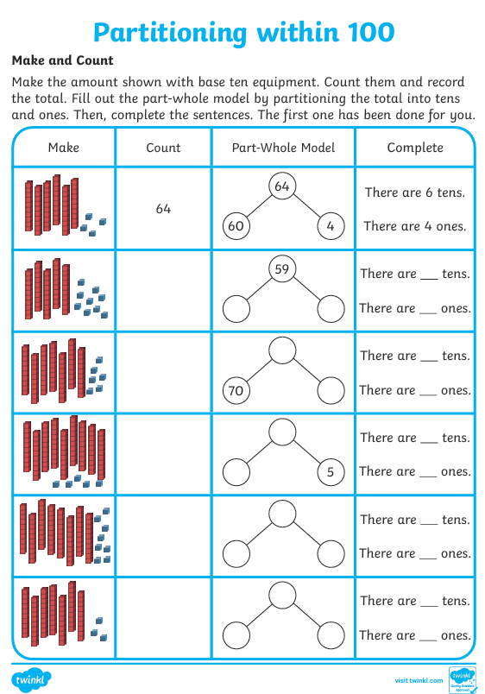
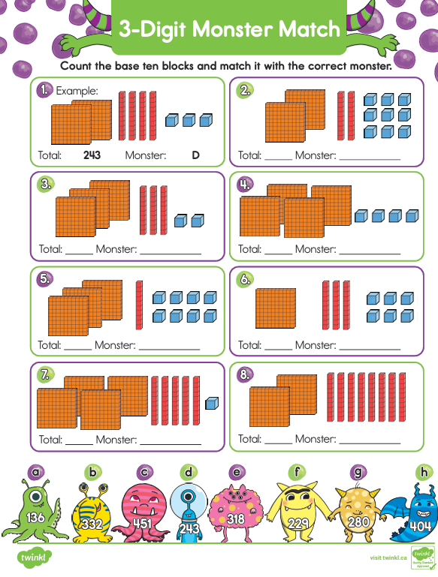
Here are some worksheets to try.

