Slide 1
Primary 3 Weekly Learning
Monday 23rd September, 2024

Slide 2
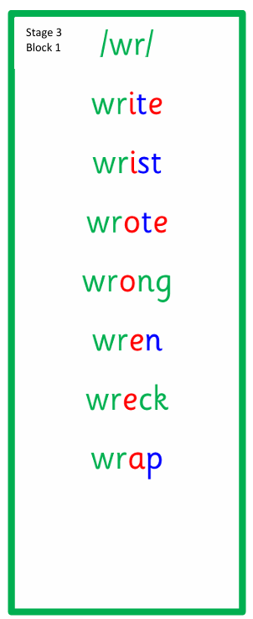
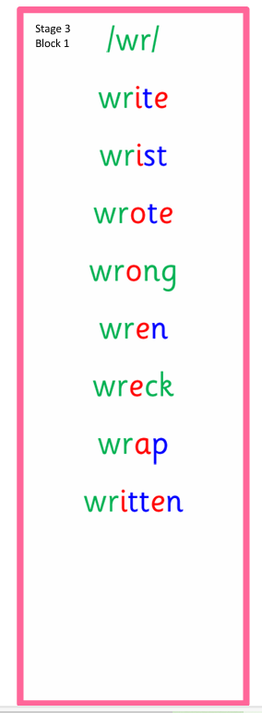
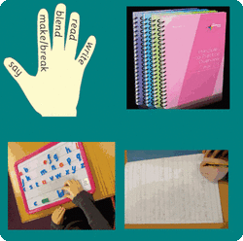
Active Literacy This week P3 are learning to read, spell and write words with the ”wr” sound as in write. Can you add any more “wr” words to our list?

Slide 3
Please try to use your very best handwriting (remembering to join the “w” to the “r”) when writing “wr” words.

Slide 4
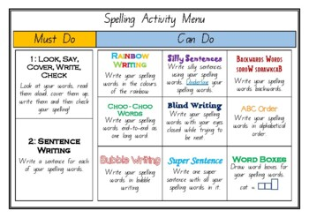
Some activity suggestions to help learn your words.

Slide 5
This week, P3 are learning to read, write and spell these tricky words:
Challenge
Try this quick game:
KS1 Spelling | The Sound WR Quiz for Children in Year 2 (educationquizzes.com)
write
kept
those

Slide 6
Reading & Writing
Log on to MyOn and choose a book to read for pleasure.
You can read the book to yourself or have it read to you...you choose!
Perhaps you would like to read a book to help you learn about a rescue at sea or maybe read about seagulls.
Whatever you choose, enjoy!
https://www.myon.co.uk/login/index.html
If there is a quiz linked to the book you
have picked, please complete it.

Slide 7
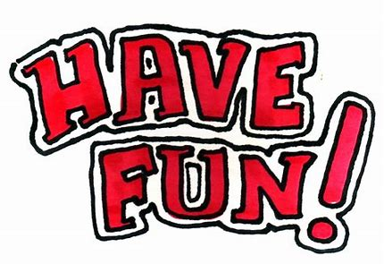
Numeracy
P3 have been learning to round numbers to the nearest 10. If a number is in the middle (ends in a 5) then the number is rounded up to the next 10, so 45 would round up to 50.
Here is a game to practice rounding. You can vary the challenge to make the game more difficult.
Rocket Rounding (topmarks.co.uk)

