Slide 1
Primary 3 Weekly Learning
Monday 26th February, 2024

Slide 2
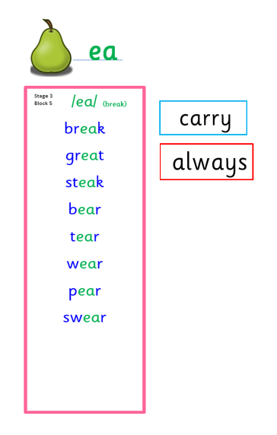
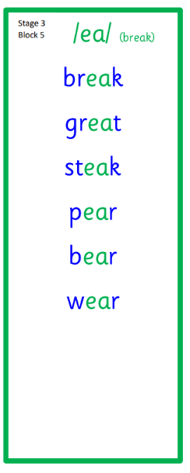
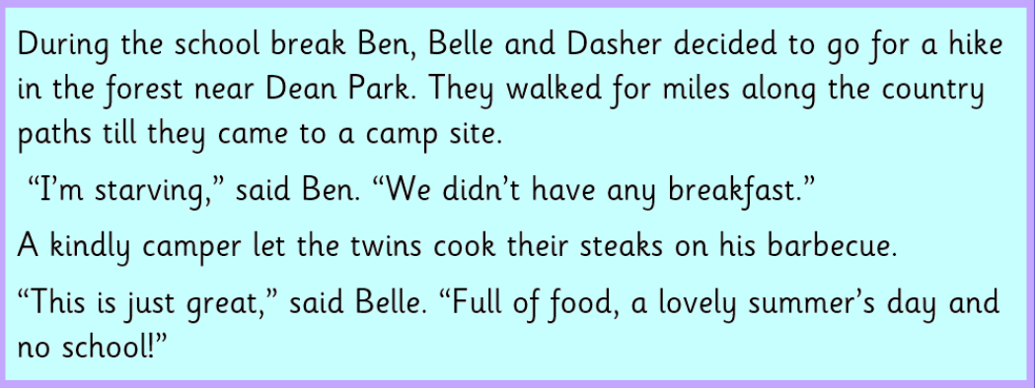
Primary 3 Active Literacy
Consolidation week for spelling words.
We have covered these words in class but do you know them all!!??
This week P3 will be learning to read, write and spell words with ea as in break.

Slide 3
This week, P3 will be practising to read, write and spell these 2 tricky words. Remember to keep practising the ones you have been taught so far and turn those “enemies” into “friends”.
always
carry

Slide 4
Here are some suggested activities to use with P3 Active Literacy Words to help you learn to read, spell and write them.
Use the activity/activities you think will help you and complete in your Home Learning jotter.

Slide 5
Reading & Writing
Log on to MyOn and choose a book to read for pleasure.
You can read the book to yourself or have it read to you...you choose!
Perhaps you would like to read a book to help you learn about a rescue at sea or learn about seagulls?
Whatever you choose, enjoy!
https://www.myon.co.uk/login/index.html
If there is a quiz linked to the book you
have picked, please complete it.

Slide 6
School Library and Class Library
Your child has the opportunity to bring home a book from the class or school library. They can check it out, then back in whenever they have finished reading it.
The book they choose may be one suited to their level or they may choose a book to share with you at home. These sharing books will require your help. Hope you enjoy reading together.

Slide 7
Numeracy
Here is a bbc link to watch to reinforce learning:
Divide by 2 - Maths - Learning with BBC Bitesize - BBC Bitesize
There is a quiz at the end to try out your new skills.
P3 will be learning how to divide this week. It is really important that your child continues to practice times tables facts taught so far to ensure they are confident with multiplying and dividing.

Slide 8
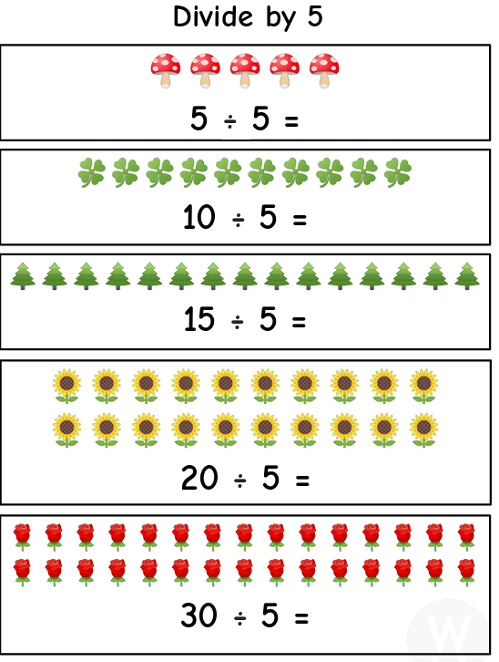
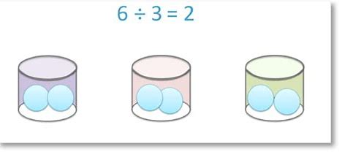
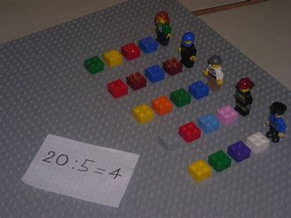
Dividing by 2 and 5
We introduce division as sharing into equal groups. Using counters, Lego bricks etc to share out the problem really helps understanding.

