Slide 1
Primary 3 Weekly Learning
Monday 29th January, 2024

Slide 2
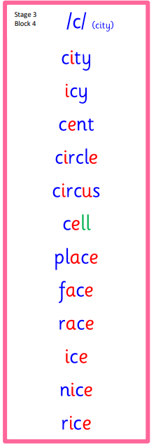
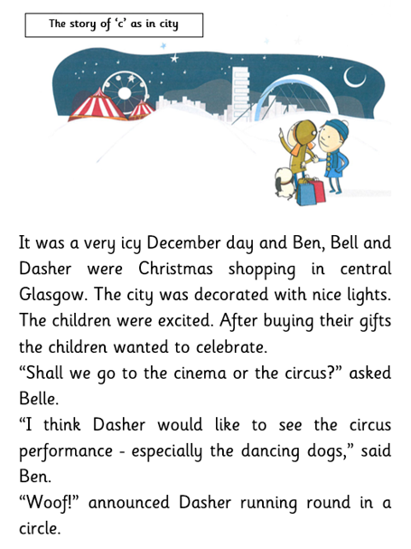
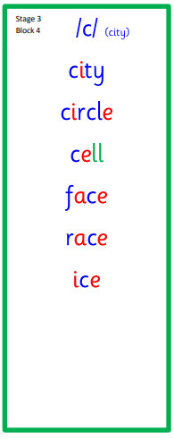
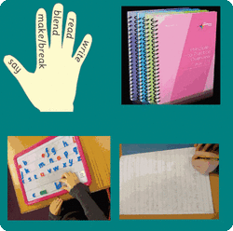
Active Literacy This week P3 are learning to read, write and spell soft “c” words.

Slide 3
This week, P3 are learning to read, write and spell these tricky words:
place
upon
once
Please continue to practice A Dug, A Dug.

Slide 4
Here are some suggested activities to use with P3 Active Litercy Words to help you learn to read, spell and write them. Use the activity/activities you think will help you and complete in your Home Learning jotter.

Slide 5
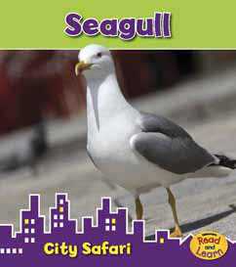
Reading & Writing
Log on to MyOn and choose a book to read for pleasure.
You can read the book to yourself or have it read to you...you choose!
Perhaps you would like to read a book to help you learn about a rescue at sea or learn about seagulls.
Whatever you choose, enjoy!
https://www.myon.co.uk/login/index.html
If there is a quiz linked to the book you
have picked, please complete it.

Slide 6
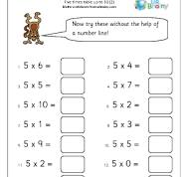
Numeracy
P3 are learning the 5 times table.
Please practice at home.

Slide 7
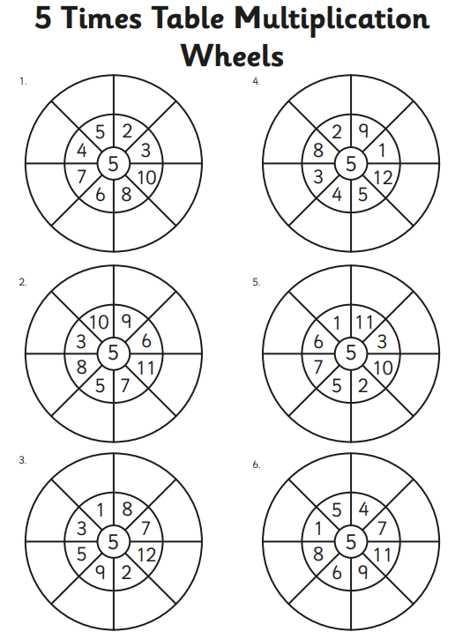
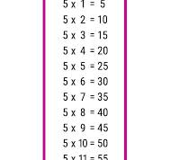
Can you copy and complete the worksheet?
Click on the link for a 5 times table song and dance:
Super Movers: Scottish Times Tables

