Slide 1
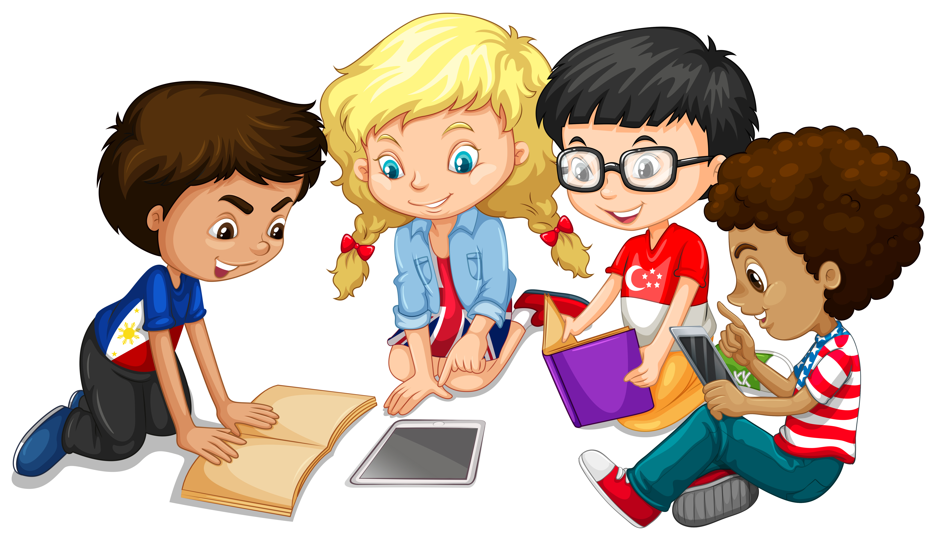
Primary 3 Weekly Learning
Monday 22nd January, 2024

Slide 2
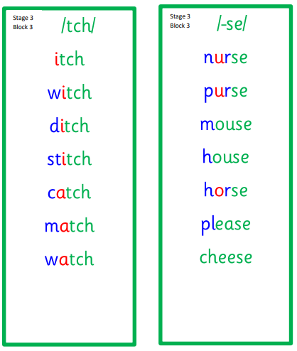
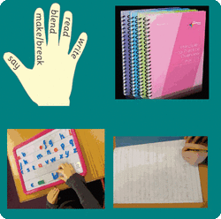
Active Literacy This is a consolidation week for P3 this week, so revise se, tch and ve words please.

Slide 3
This week, P3 are learning to read, write and spell these tricky words:
give live have love
watch
please first girl bird

Slide 4
Here are some suggested activities to use with P3 Active Litercy Words to help you learn to read, spell and write them. Use the activity/activities you think will help you and complete in your Home Learning jotter.

Slide 5
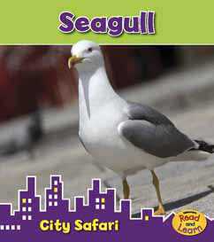
Reading & Writing
Log on to MyOn and choose a book to read for pleasure.
You can read the book to yourself or have it read to you...you choose!
Perhaps you would like to read a book to help you learn about a rescue at sea or learn about seagulls.
Whatever you choose, enjoy!
https://www.myon.co.uk/login/index.html
If there is a quiz linked to the book you
have picked, please complete it.

Slide 6
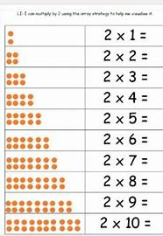
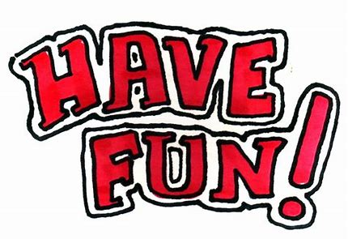
Numeracy
P3 have been learning the 2 times table this week.
Please practice at home.

Slide 7
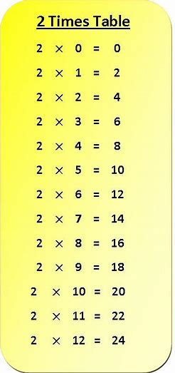
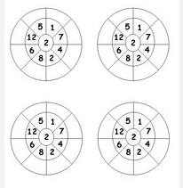
Can you copy and complete the worksheet?
Click on the link for a 2 times table song and dance:
Early: 2 Times Table - BBC Teach

