Slide 1
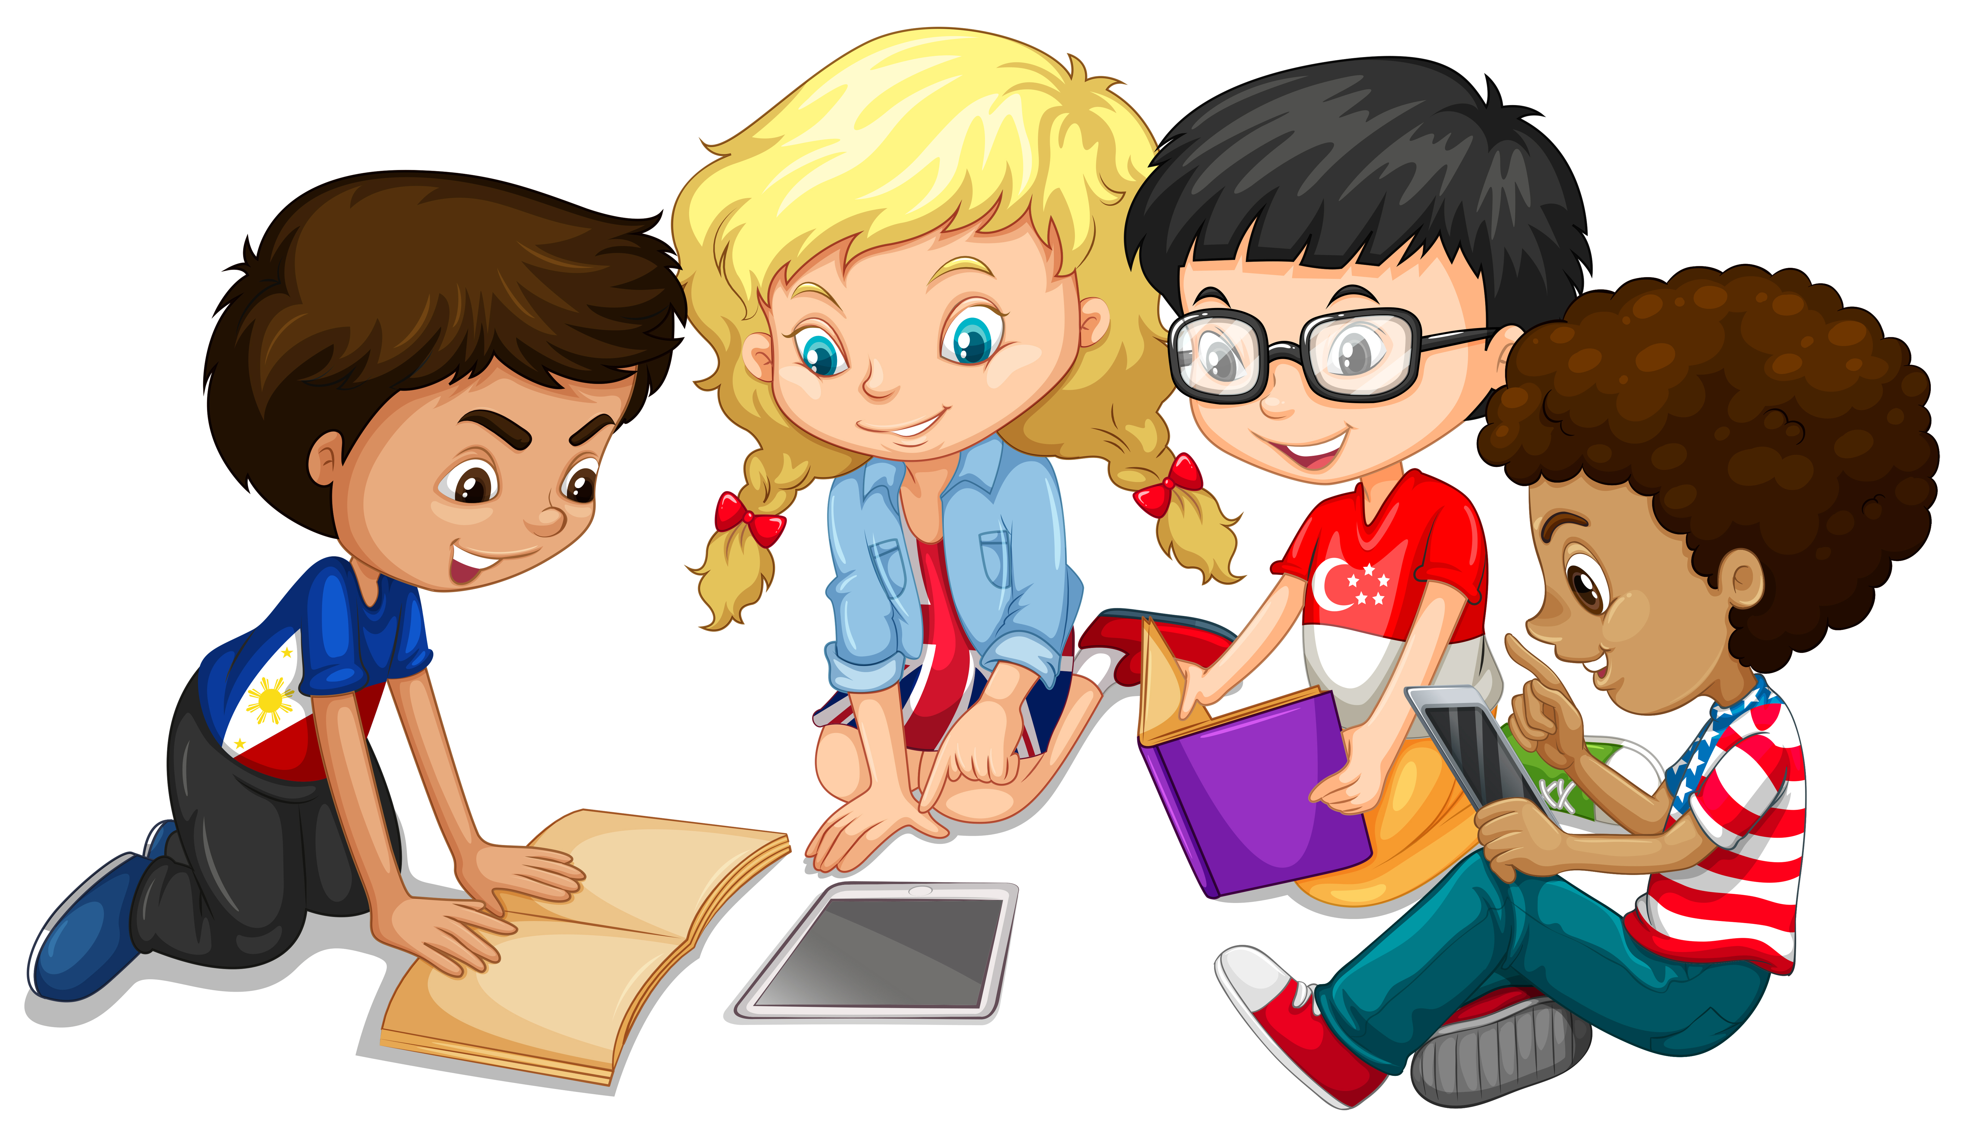
Primary 3 Weekly Learning
Monday 19th January, 2024

Slide 2
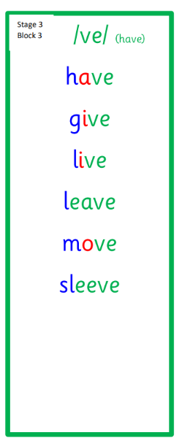
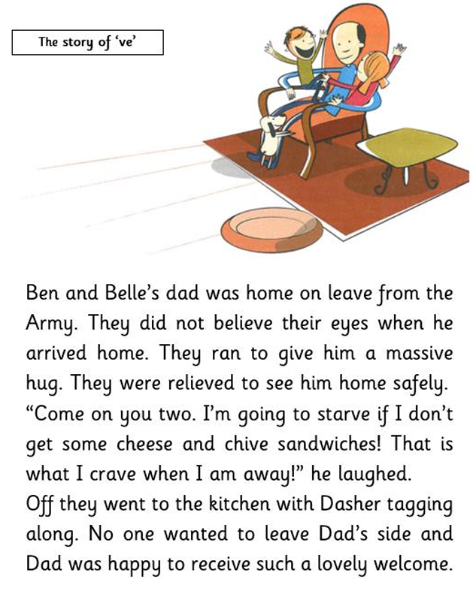
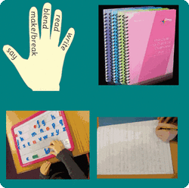
Active Literacy This week P3 are learning to read, spell and write words with the ”ve” sound as in call. Can you add any more “ve” words to our list?

Slide 3
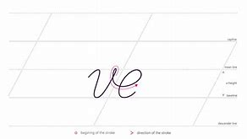
Please try to use your very best handwriting (remembering to join the “v” to the “e”) when writing “ve” words.

Slide 4
This week, P3 are learning to read, write and spell these tricky words:
give
live
have
love

Slide 5
Here are some suggested activities to use with P3 Active Litercy Words to help you learn to read, spell and write them. Use the activity/activities you think will help you and complete in your Home Learning jotter.

Slide 6
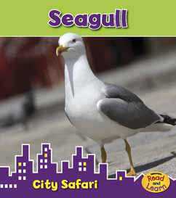
Reading & Writing
Log on to MyOn and choose a book to read for pleasure.
You can read the book to yourself or have it read to you...you choose!
Perhaps you would like to read a book to help you learn about a rescue at sea or learn about seagulls.
Whatever you choose, enjoy!
https://www.myon.co.uk/login/index.html
If there is a quiz linked to the book you
have picked, please complete it.

Slide 7
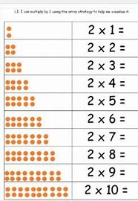
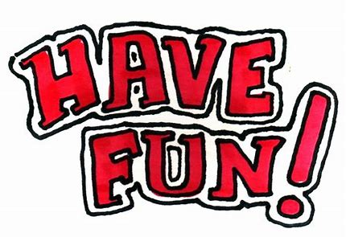
Numeracy
P3 have been learning the 2 times table this week.
Please practice at home.

Slide 8
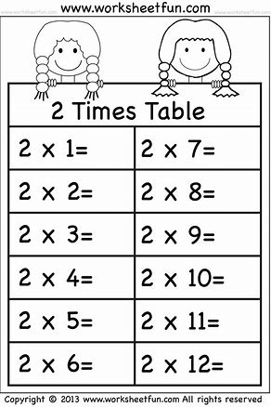
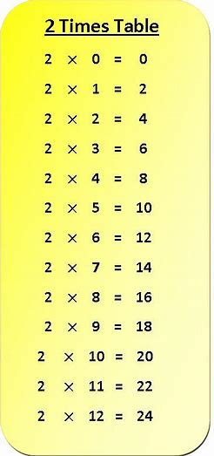
Can you copy and complete the worksheet?
Click on the link for a 2 times table song and dance:
Early: 2 Times Table - BBC Teach

