Slide 1
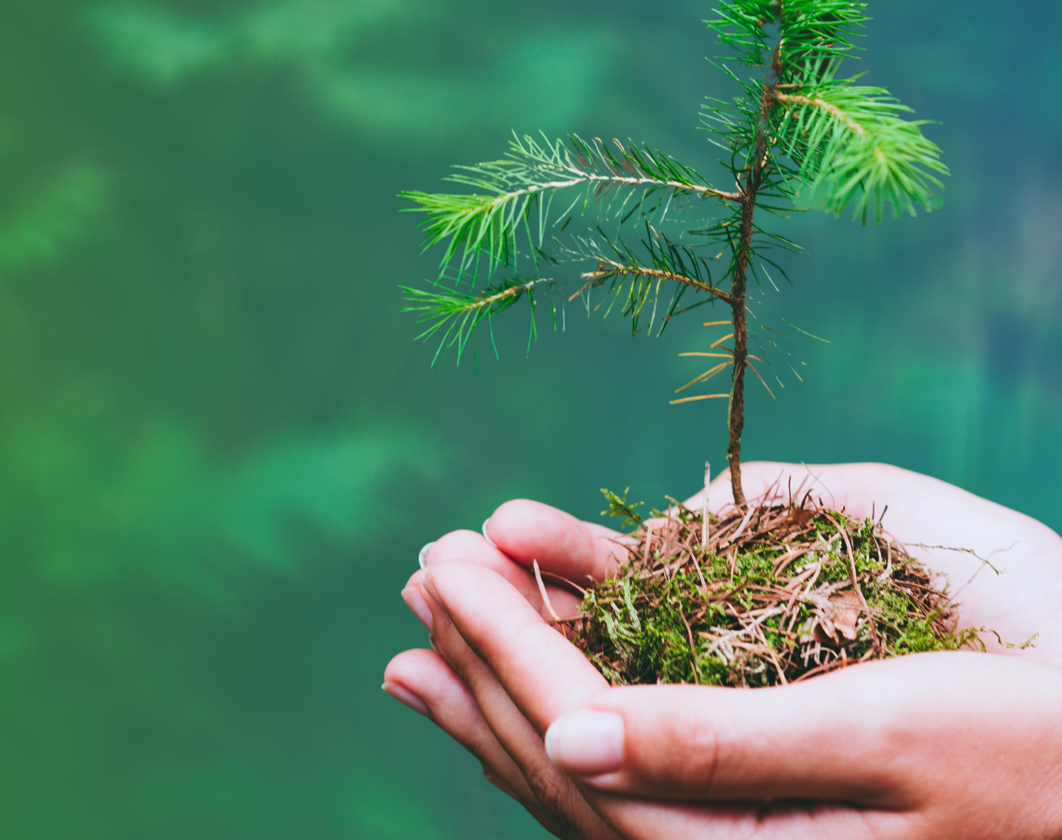
Primary 2/3
Weekly Learning Update
5/5/26
Environmental Week of Action

Slide 2
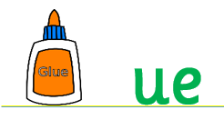
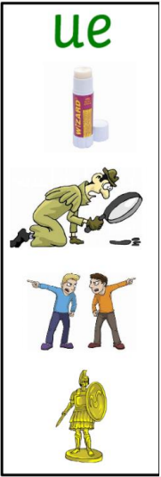
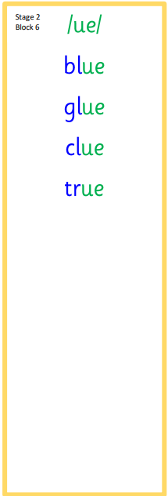



Group 1
Active Literacy
https://youtu.be/DXvp4Ybx0W4
This week group 1 have been working on ue phoneme.
I can read and spell my tricky words.

Slide 3

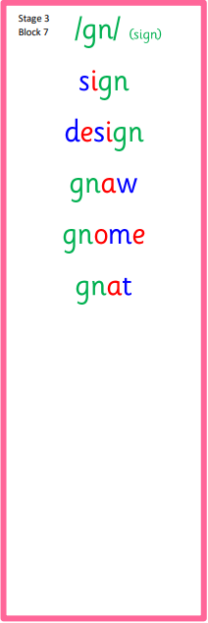

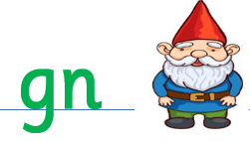

Group 2
Active Literacy
Consolidation week for spelling words.
We have covered these words in class but do you know them all!!??
I can read and spell my phoneme and tricky words. This week we have a new phoneme, gn as in gnome.

Slide 4

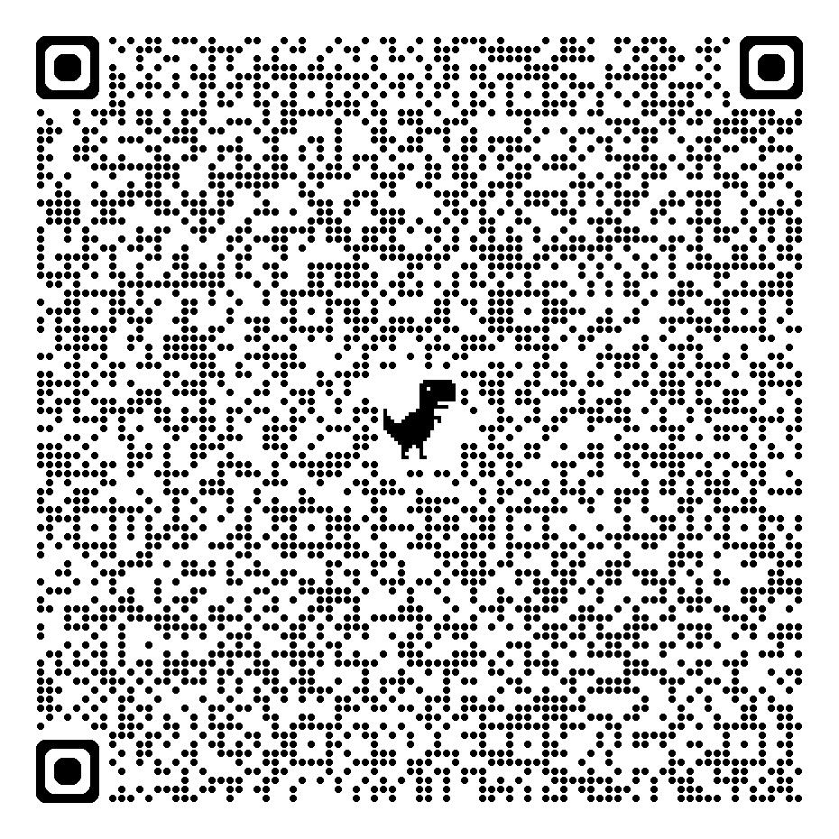
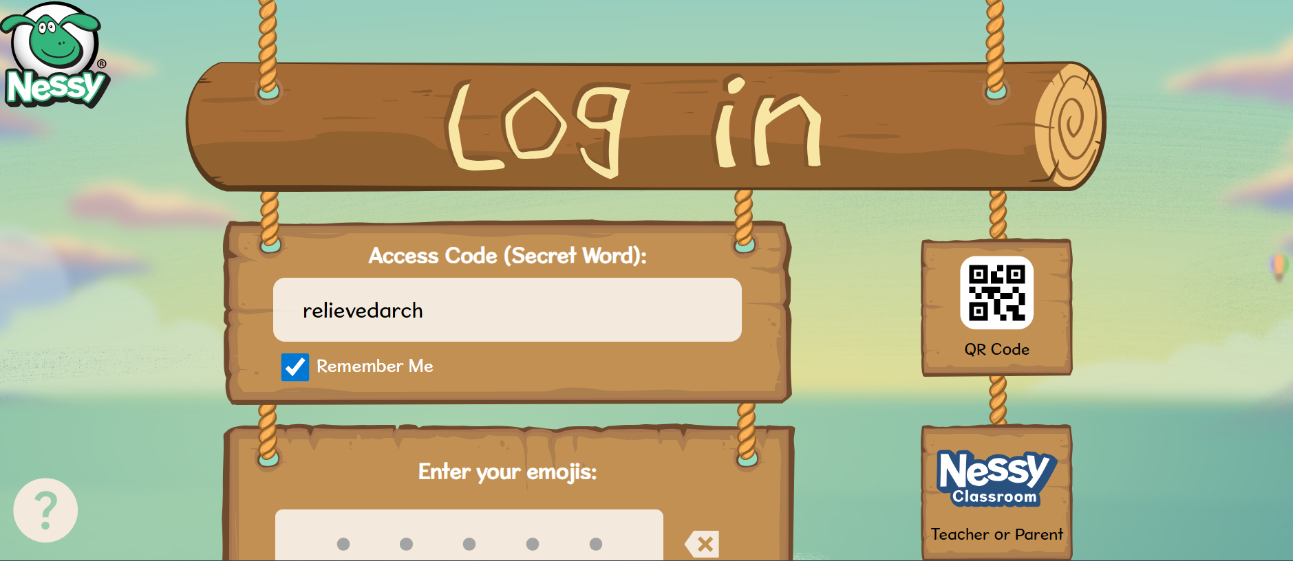
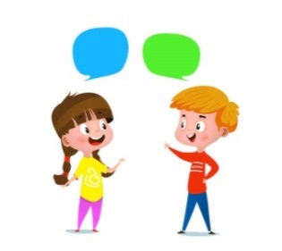


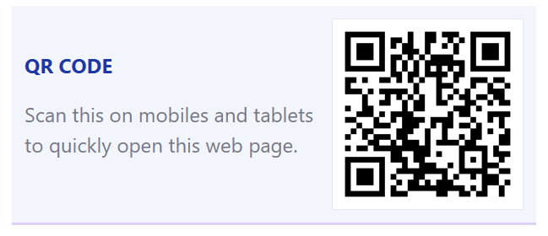
Home Learning
Active Literacy Spelling and Phoneme of the week.
Please practise your spelling/new phoneme words at home using the spelling activity cards or think of your own fun ways to practise your words. We will have a quick check up of the spelling words towards the end of the week!
Get on to Nessy! Give it your best shot!
GIGLETS!!! Get on and explore! I might
have even left you a task!
Numeracy and Mathematics
Let’s learn the facts for the 2x table!
Got it?
Try the 5x or even the 10x….

Slide 5
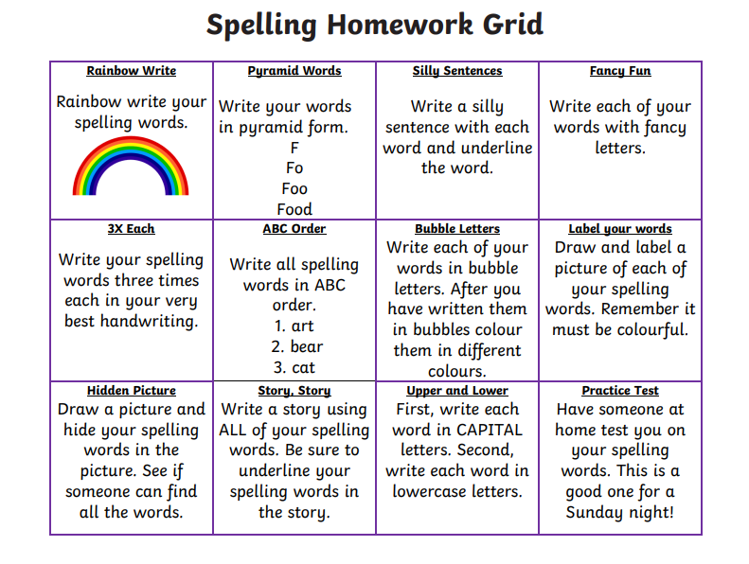

Some ideas for you to try with the new phoneme or your spelling words.
Record them in your Home Learning jotter.

Slide 6
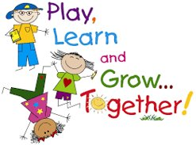
P2/3 Learning Update
Please visit the blog for photos and information about activities taking place in class.

