Slide 1

Primary 2/3 Weekly Learning Update 23/2/26

Slide 2
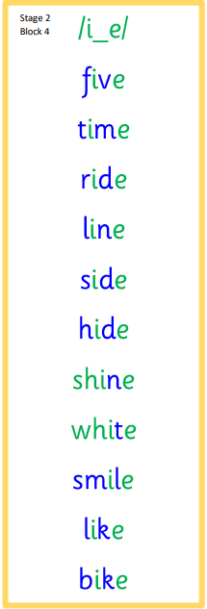


Group 1 Active Literacy
https://youtu.be/DXvp4Ybx0W4
This week group 1 has a new sound, i-e as in five
I can read and spell my tricky word.

Slide 3
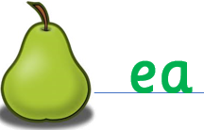


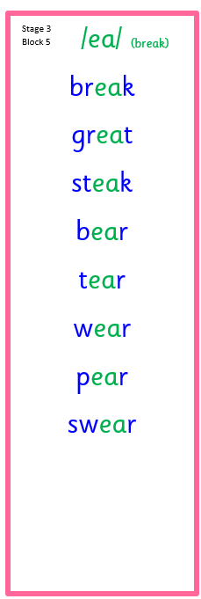
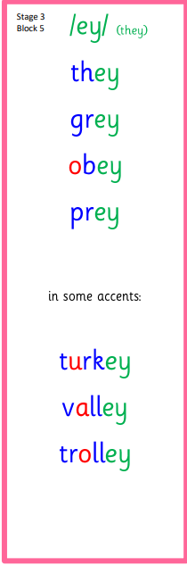


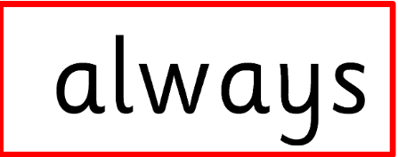


Group 2 Active Literacy
Consolidation week for spelling words.
We have covered these words in class but do you know them all!!??
I can read and spell my phoneme and tricky words. This is a consolidation week.

Slide 4

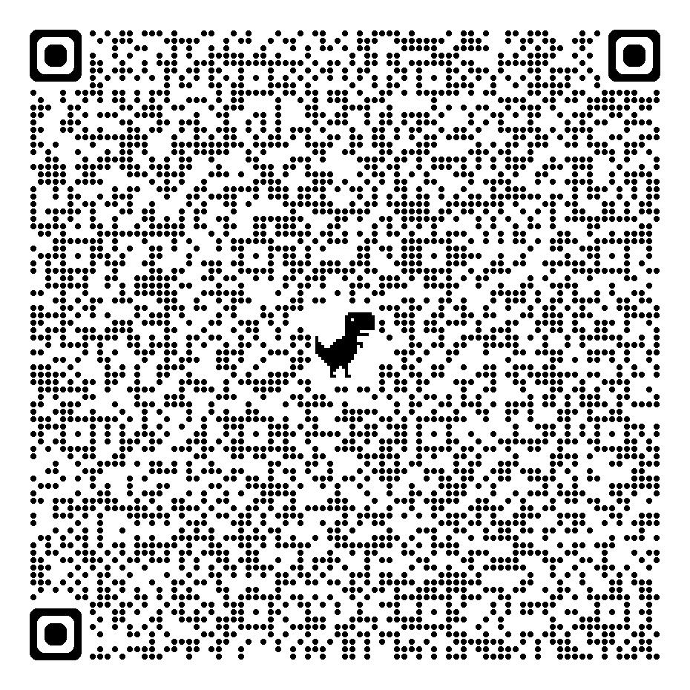
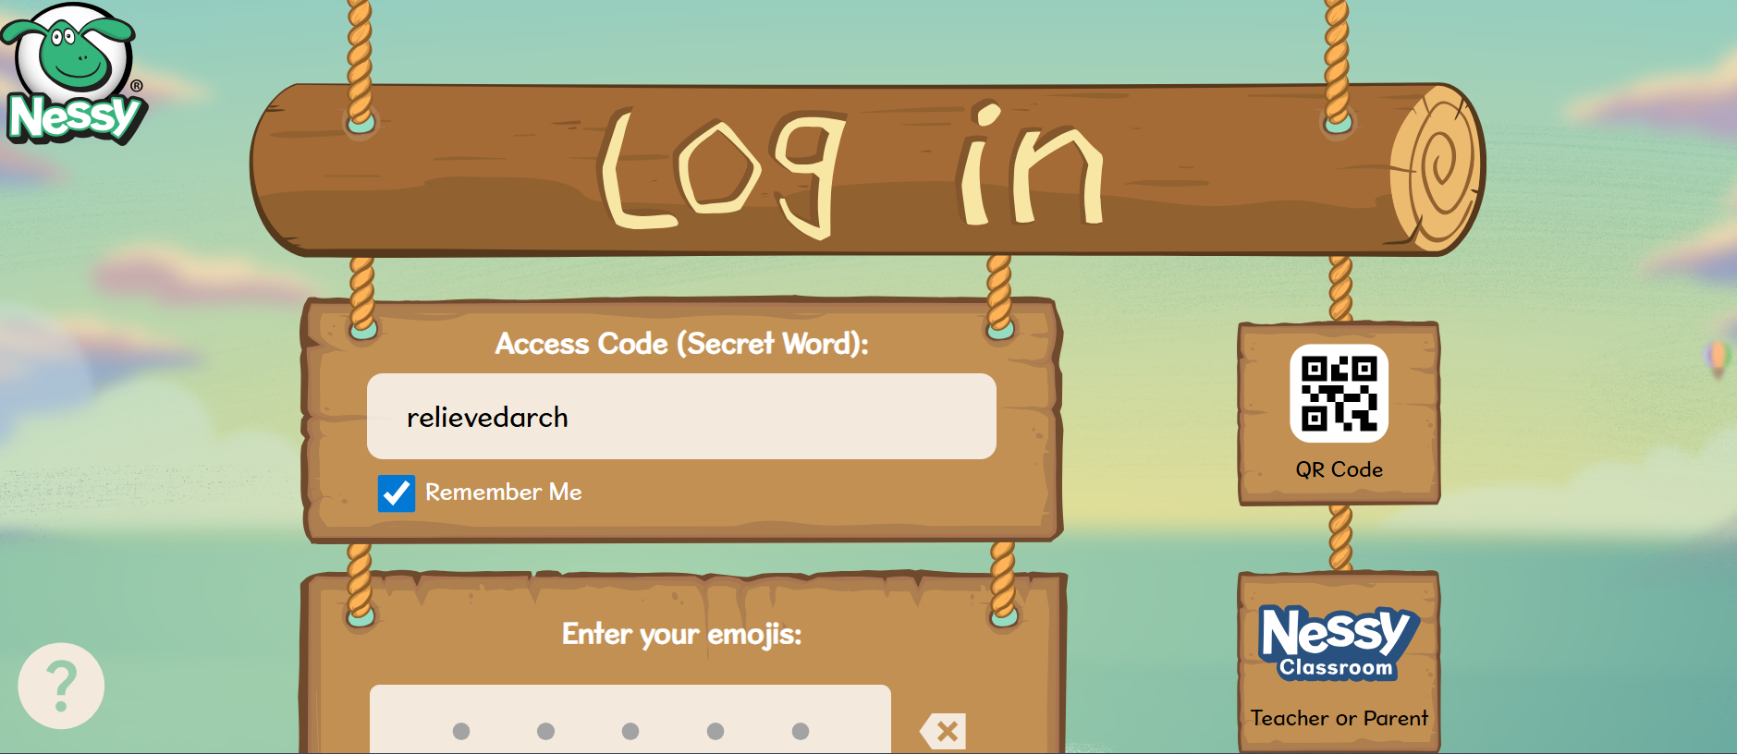
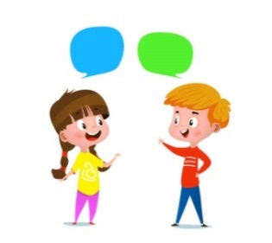


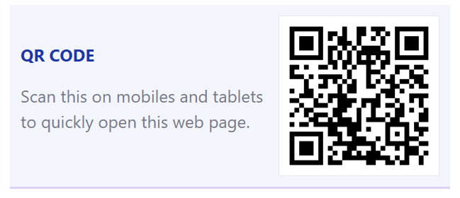
Home Learning
Active Literacy Spelling and Phoneme of the week.
Please practise your spelling/new phoneme words at home using the spelling activity cards or think of your own fun ways to practise your words. We will have a quick check up of the spelling words towards the end of the week!
Get on to Nessy! Give it your best shot!
Numeracy and Mathematics
Let’s learn the facts for the 2x table!
Got it?
Try the 5x or even the 10x….

Slide 5
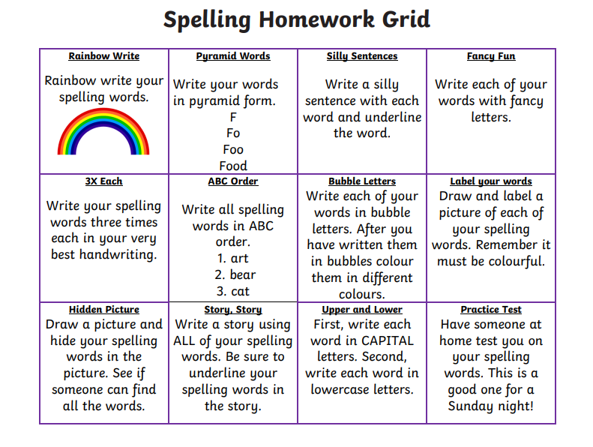

Some ideas for you to try with the new phoneme or your spelling words.
Record them in your Home Learning jotter.

Slide 6

P2/3 Learning Update
Please visit the blog for photos and information about activities taking place in class.

