Slide 1
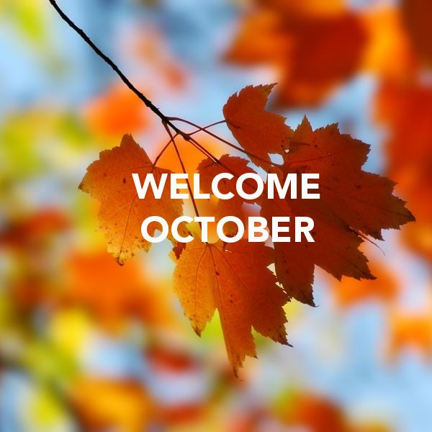
Primary 2/3
Weekly Learning Update
6/10/2025

Slide 2


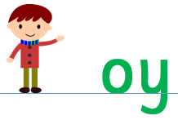
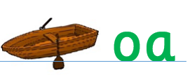
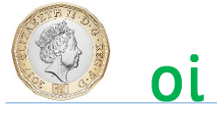

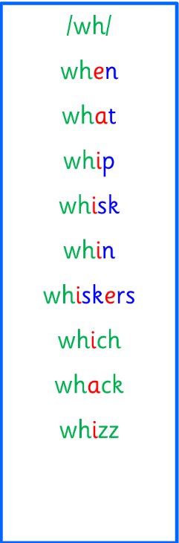

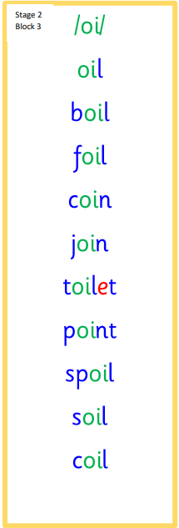
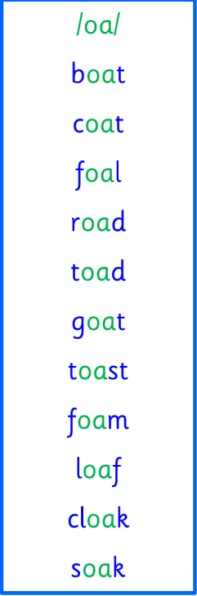
Group 1
Active Literacy
https://youtu.be/DXvp4Ybx0W4
This week group 1 are revising ph, wh, oi,oy and oa sounds.
I can read and spell my words.

Slide 3


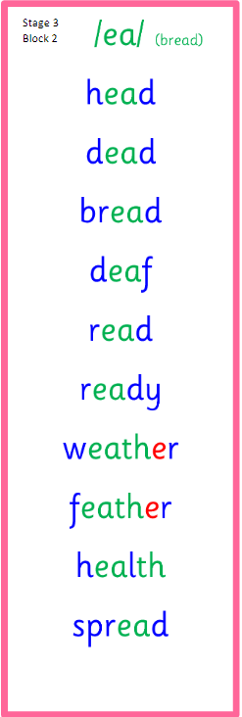


Group 2
Active Literacy
Consolidation week for spelling words.
We have covered these words in class but do you know them all!!??
I can read and spell my my phoneme and tricky words.
Blue border words are easy to sound out.
Red border words are tricky words.

Slide 4




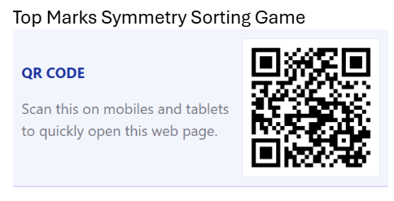
Home Learning
Active Literacy Spelling and Phoneme of the week.
Please practise your spelling/new phoneme words at home using the spelling activity cards or think of your own fun ways to practise your words. We will have a quick check up of the spelling words towards the end of the week!
Talk to me about… what are good table manners.
We will be making a poster about table manners
as part of a health and wellbeing lesson soon.
Numeracy and Mathematics
Complete the Sumdog tasks
That have been set for you! I’ve sent home
Your login, please stick it in your homework jotter.

Slide 5
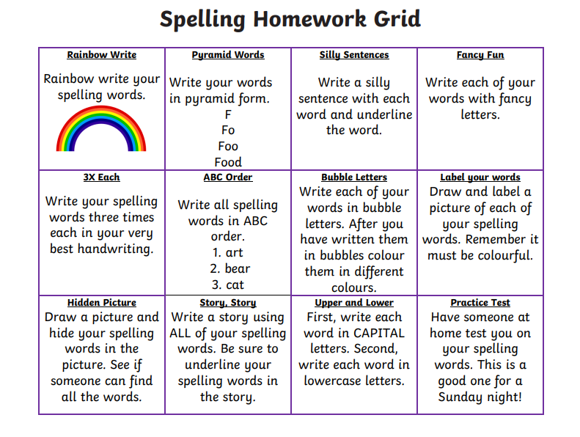

Some ideas for you to try with the new phoneme or your spelling words.
Record them in your Home Learning jotter.

Slide 6

P2/3 Learning Update
Please visit the blog for photos and information about activities taking place in class.

