Slide 1
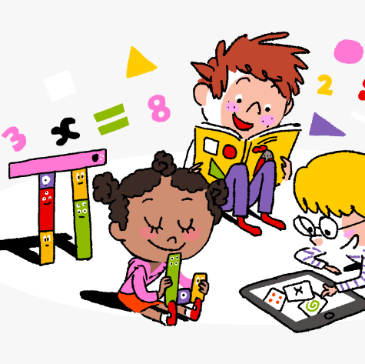
Primary 2/3
Weekly Learning Update
29/9/2025

Slide 2
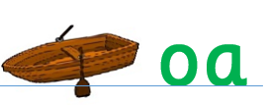
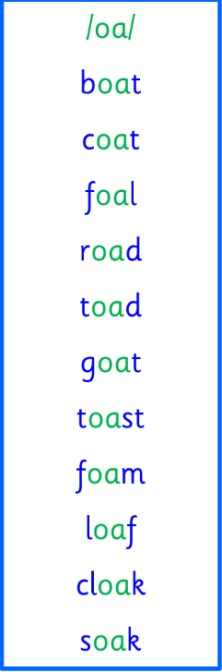
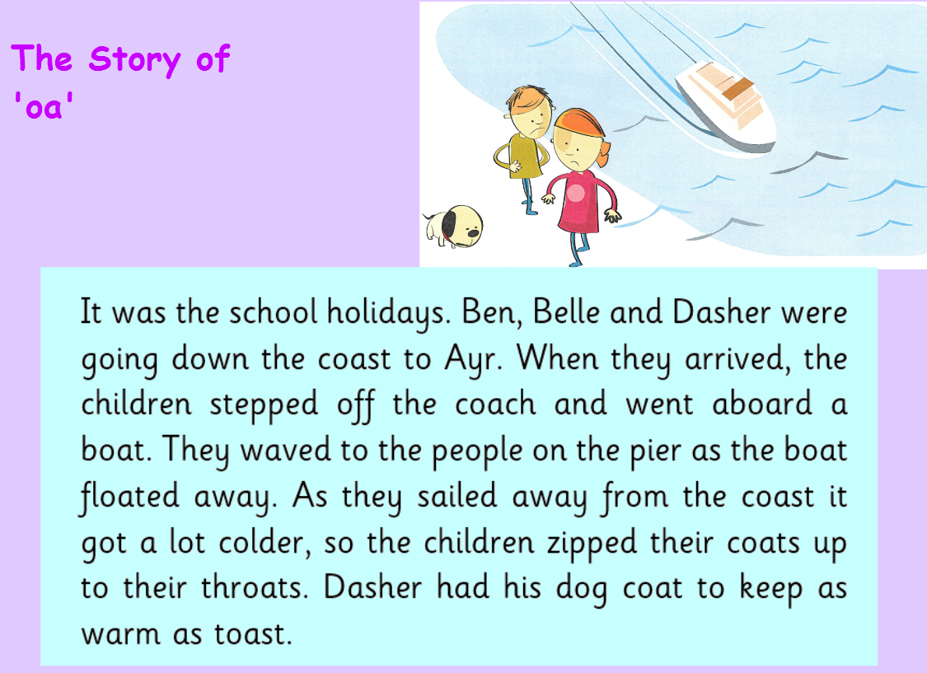
Group 1
Active Literacy
https://youtu.be/DXvp4Ybx0W4
I can read and spell my oa words and tricky words.
This week group 1 are learning to recognise and use the phoneme oa to read and spell.
Tricky Words
come
some
if
came

Slide 3




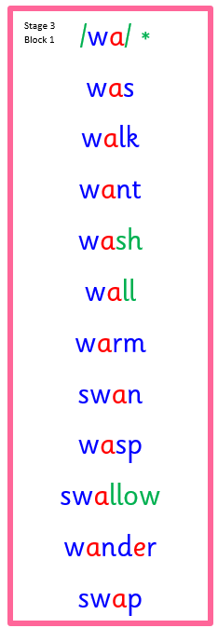
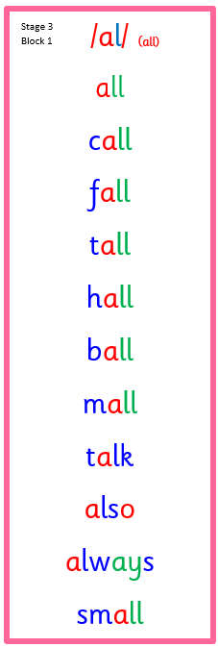
Group 2
Active Literacy
Consolidation week for spelling words.
We have covered these words in class but do you know them all!!??
Sounds like o
I can read and spell my my phoneme words. This week we are revising wr,wa and o.

Slide 4

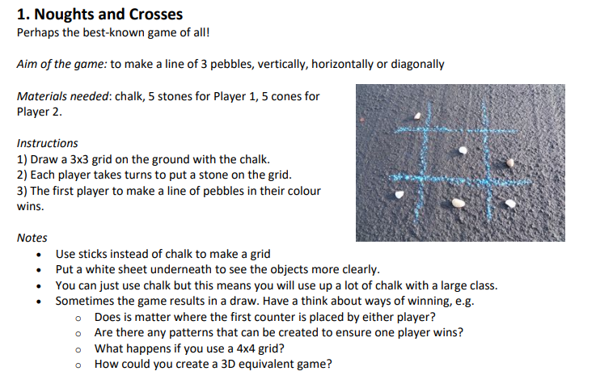


Home Learning
Active Literacy Spelling and Phoneme of the week.
Please practise your spelling/new phoneme words at home using the spelling activity cards or think of your own fun ways to practise your words. We will have a quick check up of the spelling words towards the end of the week!
Talk to me about… Harvest
Numeracy and Mathematics
Take it outdoors!
Complete the Sumdog tasks
That have been set for you! I’ve sent home
Your login, please stick it in your homework jotter.

Slide 5
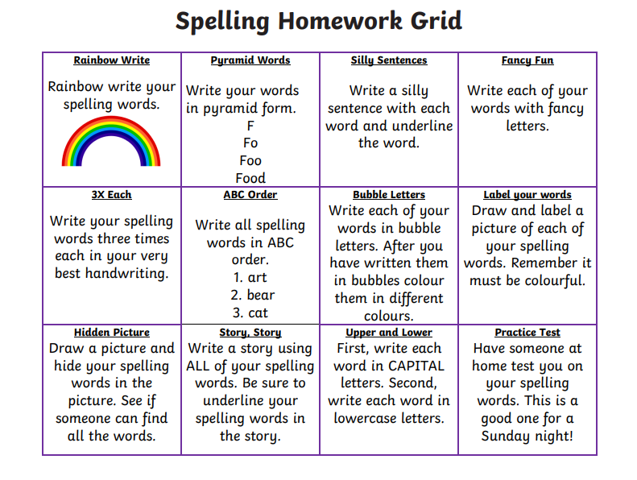

Some ideas for you to try with the new phoneme or your spelling words.
Record them in your Home Learning jotter.

Slide 6

P2/3 Learning Update
Please visit the blog for photos and information about activities taking place in class.

