Slide 1

Primary 2/3
Weekly Learning Update
2/12/2024

Slide 2
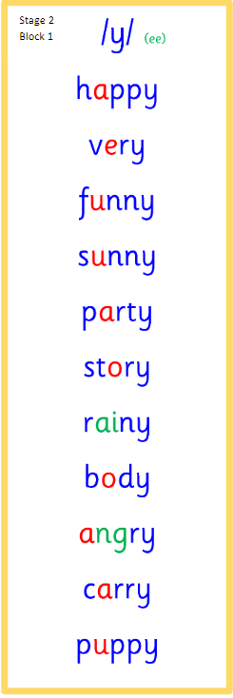
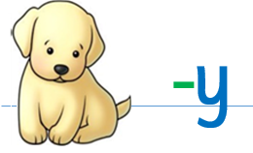
Group 1
Active Literacy
https://youtu.be/DXvp4Ybx0W4
Tricky words I can read… on word wall
This week group 1 are learning to recognise and use the y phoneme to read and spell.

Slide 3
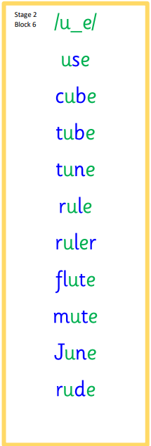
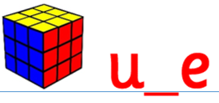
Group 2
Active Literacy
Consolidation week for spelling words.
We have covered these words in class but do you know them all!!??
This week group 2 are revising this phoneme.
I can read and spell them!
Tricky words are on the word wall in the homework bags.
If you can read them try spelling them!

Slide 4
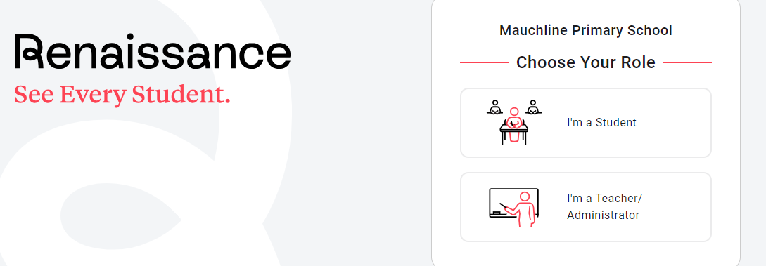

P3 can now log on to MyOn and access a huge online library for them to read for enjoyment. Please make the most of this and enjoy the books with your child.
https://login.renaissance.com/12d 2c8a8-2823-404d-a533-8a77e03336fc?state=135fa224-c108-4b9d-a279-022b015990ed
As well as this they are using the school library to bring home a book linked to their reading assessments. After they have enjoyed this book at home they can come to school and take a small quiz on the book and then swap for anther one.
We are also sending home reading books that we have completed in their reading groups in class.
Plenty of reading opportunities for you to enjoy at home!

Slide 5
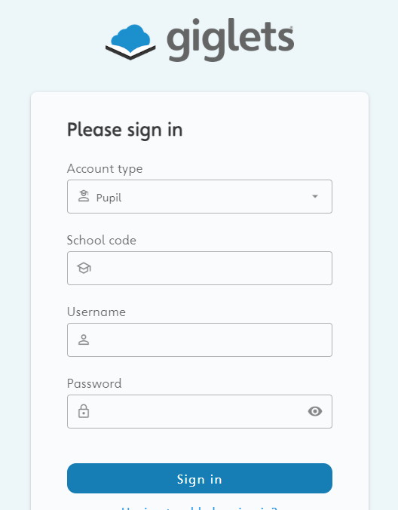
P2 can now log onto Giglets and read and answer question on books that I have selected for them. I have selected a variety of six book so far.
https://pupil.gigletsedu.com/landing/
Please try and complete one book per week.
The school code is Mauchline.
As well as this they are also borrowing books of their choice from the class library to read for enjoyment.
We are also sending home reading books they have completed in their reading groups in class.

Slide 6

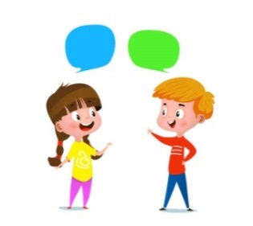
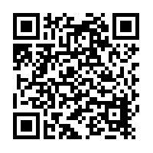
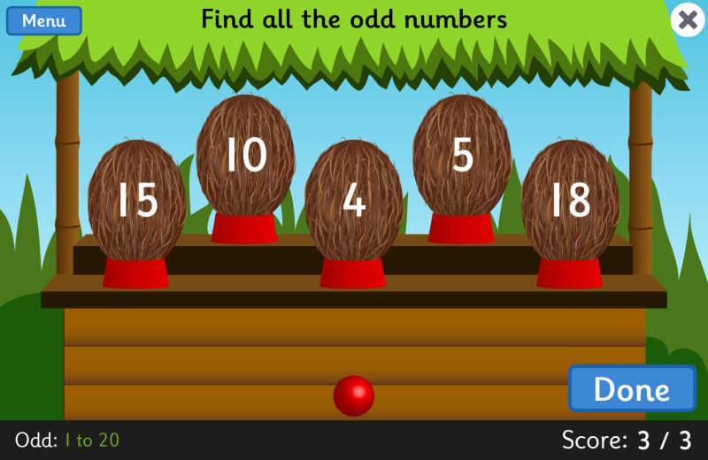
Home Learning
Active Literacy Spelling and Phoneme of the week.
Please practise your spelling/new phoneme words at home using the spelling activity cards or think of your own fun ways to practise your words. We will have a quick check up of the spelling words towards the end of the week! Remember to log on and read!
Talk to me about…Article of the month 30. Children have the right to use their own language, culture and religion - even if these are not shared by most people in the country where they live.
Numeracy and Mathematics
https://www.topmarks.co.uk/learning-to-count/coconut-odd-or-even

Slide 7
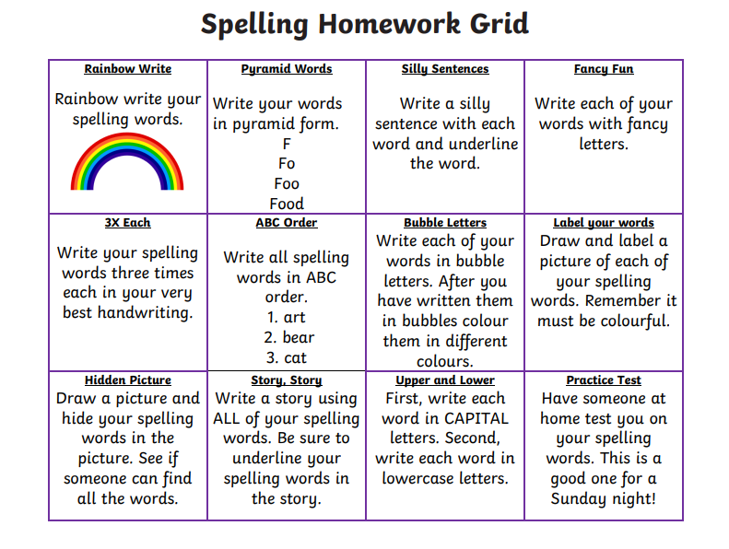

Some ideas for you to try with the new phoneme or your spelling words.
Record them in your Home Learning jotter.

Slide 8
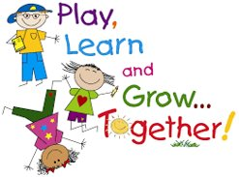
P2/3 Learning Update
Please visit the blog for photos and information about activities taking place in class.
If you have any questions, please do not hesitate to contact me, jacqueline.bryson@glow.sch.uk

