Slide 1
Primary 2/3 Weekly Learning Update 25/11/2024

Slide 2
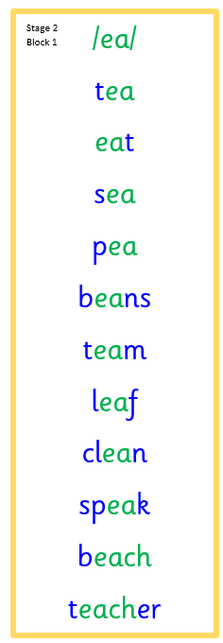
Group 1 Active Literacy
https://youtu.be/DXvp4Ybx0W4
Tricky words I can read… on word wall
This week group 1 are learning to recognise and use the ea phoneme to read and spell.

Slide 3
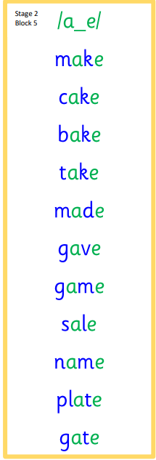
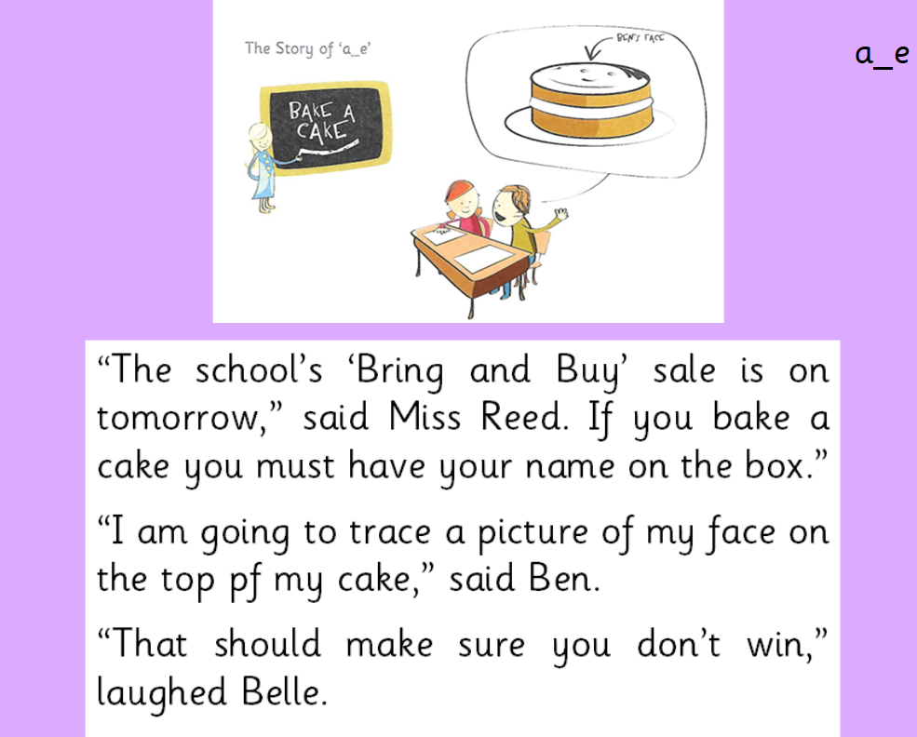
Group 2 Active Literacy
Consolidation week for spelling words.
We have covered these words in class but do you know them all!!??
This week group 2 are revising this phoneme.
I can read and spell them!
Tricky words are on the word wall in the homework bags.
If you can read them try spelling them!

Slide 4
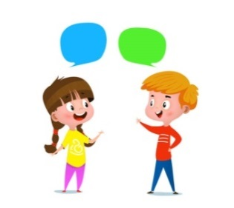
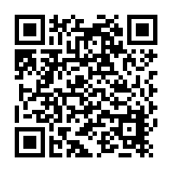
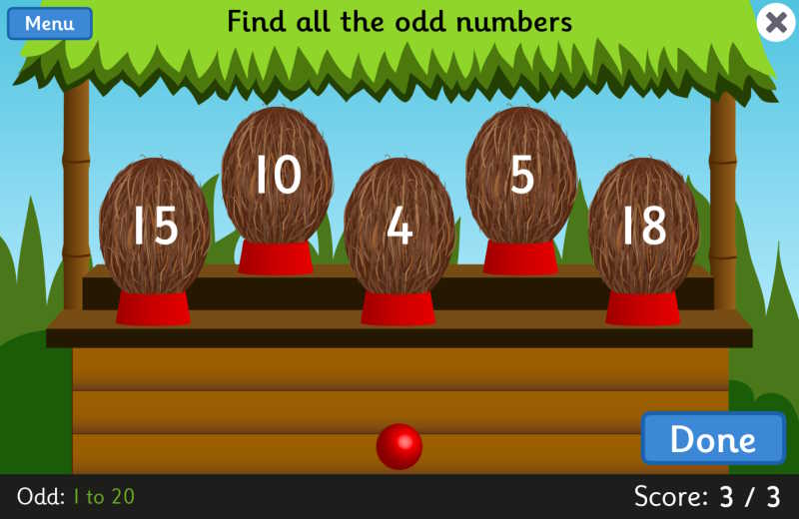
Home Learning
Active Literacy Spelling and Phoneme of the week.
Please practise your spelling/new phoneme words at home using the spelling activity cards or think of your own fun ways to practise your words. We will have a quick check up of the spelling words towards the end of the week!
Talk to me about…Article of the month 27. “Food, clothing and a safe home.” Can you talk about these in terms of the differences between wants and needs.
Numeracy and Mathematics
https://www.topmarks.co.uk/learning-to-count/coconut-odd-or-even

Slide 5
Some ideas for you to try with the new phoneme or your spelling words.
Record them in your Home Learning jotter.

Slide 6
P2/3 Learning Update
Please visit the blog for photos and information about activities taking place in class.
If you have any questions, please do not hesitate to contact me, jacqueline.bryson@glow.sch.uk

