Slide 1
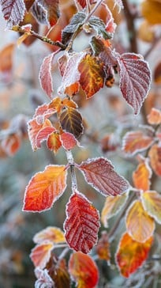
Primary 2/3 Weekly Learning Update 18/11/2024

Slide 2
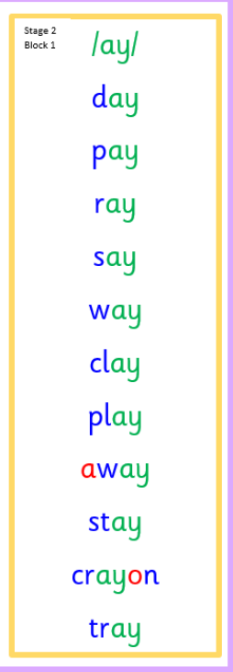
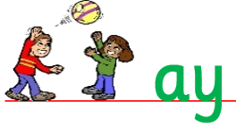
Group 1 Active Literacy
https://youtu.be/DXvp4Ybx0W4
Tricky words I can read… on word wall
This week group 1 are learning to recognise and use the ay phoneme to read and spell.

Slide 3
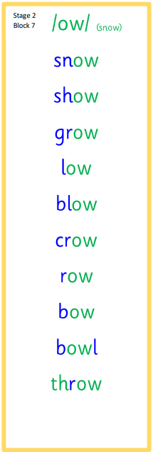
Group 2 Active Literacy
Consolidation week for spelling words.
We have covered these words in class but do you know them all!!??
This week group 2 are revising this phoneme.
I can read and spell them!
Tricky words are on the word wall in the homework bags.
If you can read them try spelling them!

Slide 4
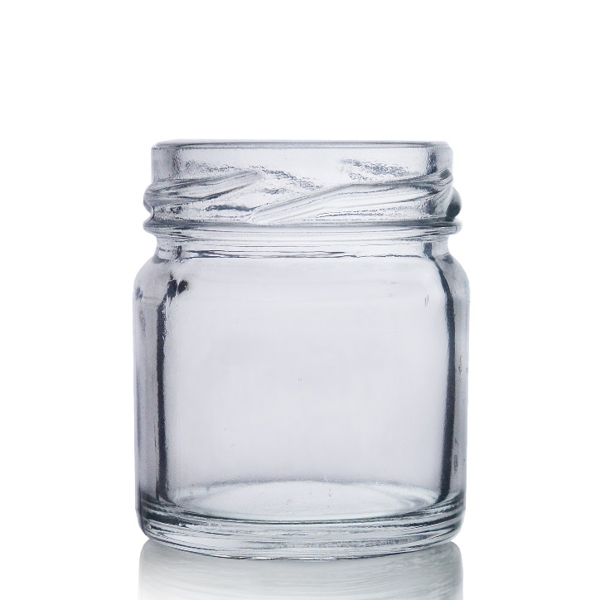
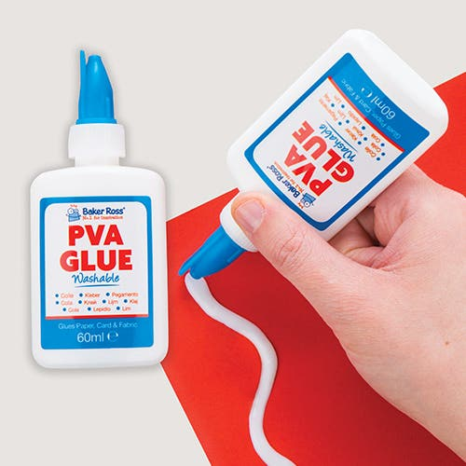
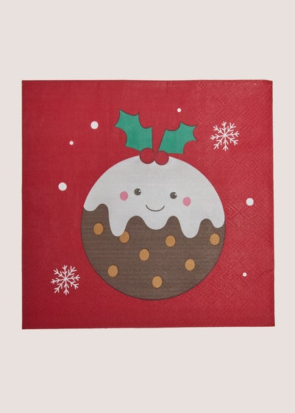
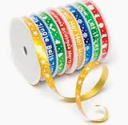
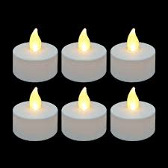
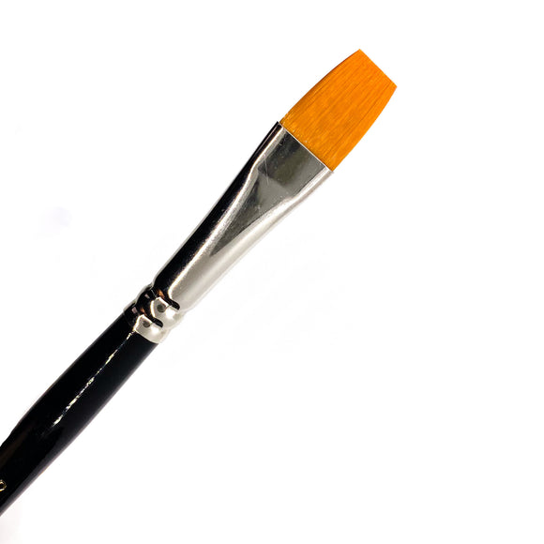
This week for writing we will be writing intructions…
How to make a Christmas lantern
Ask me how I made mine!

Slide 5
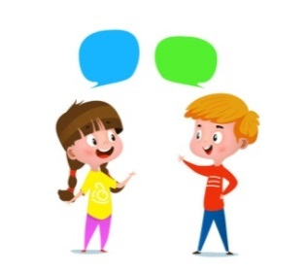
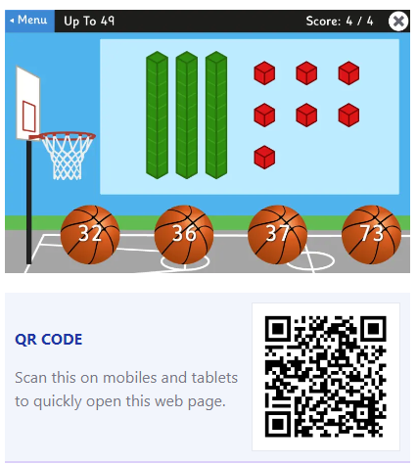
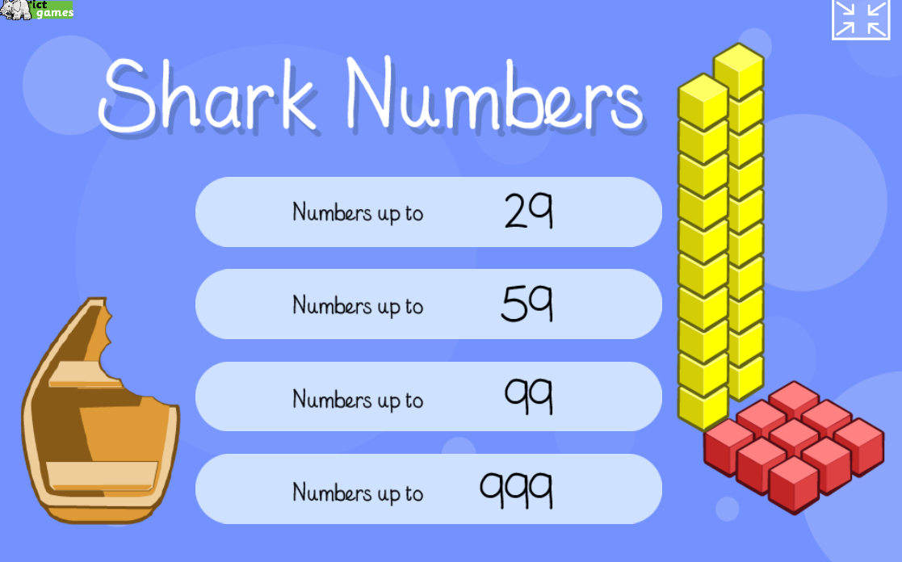
Home Learning
Active Literacy Spelling and Phoneme of the week.
Please practise your spelling/new phoneme words at home using the spelling activity cards or think of your own fun ways to practise your words. We will have a quick check up of the spelling words towards the end of the week!
Talk to me about…How to make a Christmas lantern
Numeracy and Mathematics
https://ictgames.com/sharkNumbers/mobile/index.html
Google Topmarks and play basketball to help with place value.

Slide 6
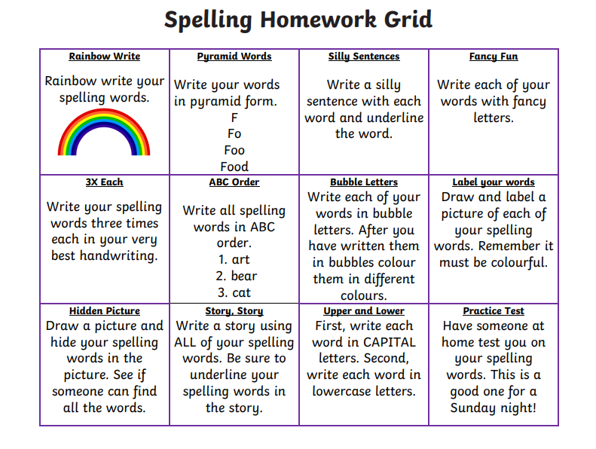
Some ideas for you to try with the new phoneme or your spelling words.
Record them in your Home Learning jotter.

Slide 7
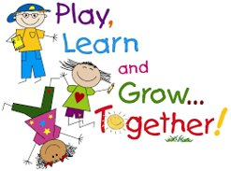
P2/3 Learning Update
Please visit the blog for photos and information about activities taking place in class.
If you have any questions, please do not hesitate to contact me, jacqueline.bryson@glow.sch.uk

