Slide 1
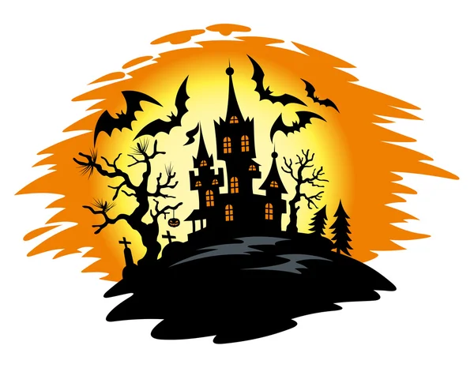
Primary 2/3
Weekly Learning Update
28/10/2024

Slide 2
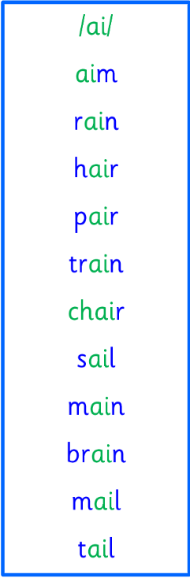
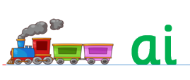
Group 1
Active Literacy
https://youtu.be/DXvp4Ybx0W4
Tricky words I can read… on word wall
This week group 1 are learning to recognise and use the phoneme ai to read and spell.

Slide 3

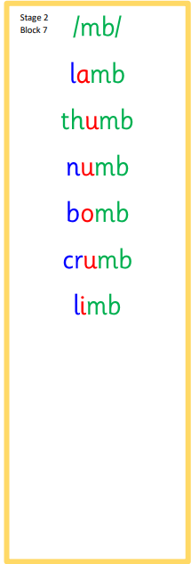
Group 2
Active Literacy
Consolidation week for spelling words.
We have covered these words in class but do you know them all!!??
This week group 2 are revising this phoneme.
I can read and spell them!
Tricky words are on the word wall in the homework bags.
If you can read them try spelling them!

Slide 4
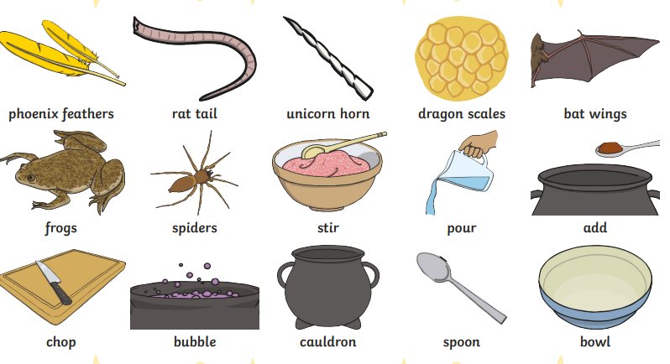
This week for writing we will be writing instructions to make a potion for…
How to make a Teacher disappear!
Can you talk about ingredients you might need.
Equipment you might need and the instruction how to do it!

Slide 5

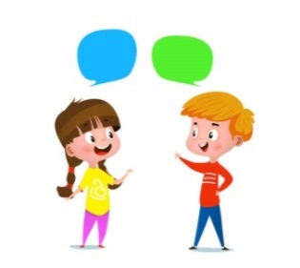
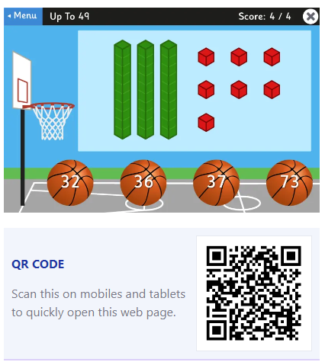
Home Learning
Active Literacy Spelling and Phoneme of the week.
Please practise your spelling/new phoneme words at home using the spelling activity cards or think of your own fun ways to practise your words. We will have a quick check up of the spelling words towards the end of the week!
Talk to me about… How to make a Teacher disappear!
Numeracy and Mathematics
Google Topmarks and play basketball to help with place value.

Slide 6
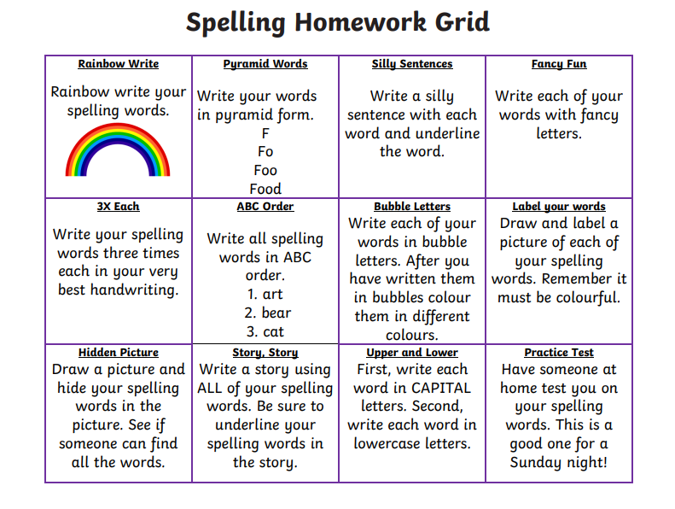

Some ideas for you to try with the new phoneme or your spelling words.
Record them in your Home Learning jotter.

Slide 7

P2/3 Learning Update
Please visit the blog for photos and information about activities taking place in class.
If you have any questions, please do not hesitate to contact me, jacqueline.bryson@glow.sch.uk

