Slide 1
Primary 2/3 Weekly Learning Update 7/10/2024

Slide 2
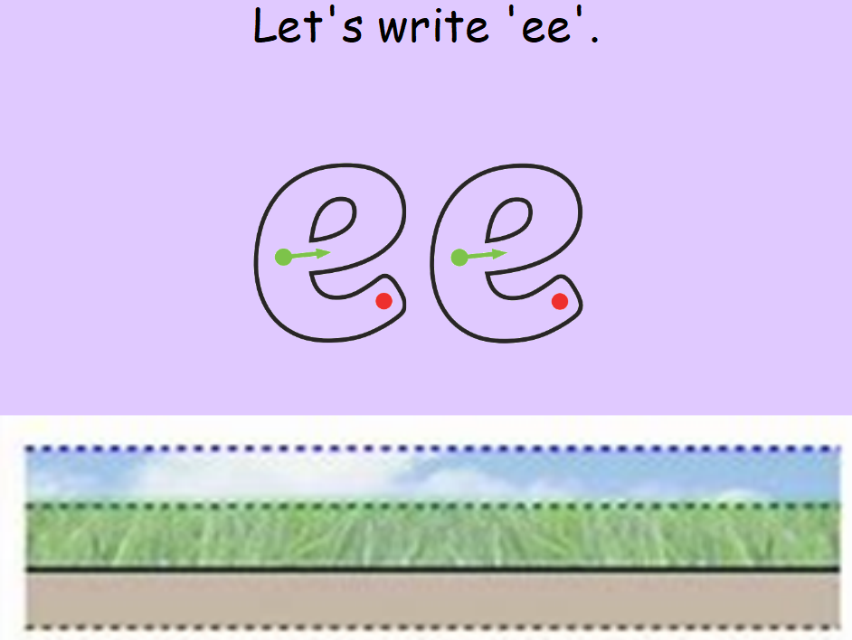
Group 1 Active Literacy
https://youtu.be/DXvp4Ybx0W4
Tricky words I can read… in home/school link jotter.
This week group 1 are learning to recognise and use the phoneme ee to read and spell.

Slide 3
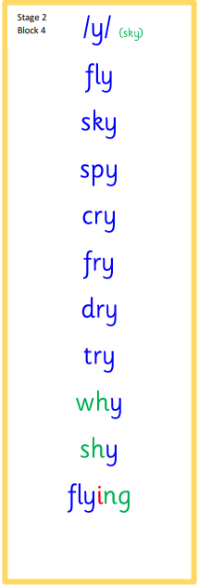
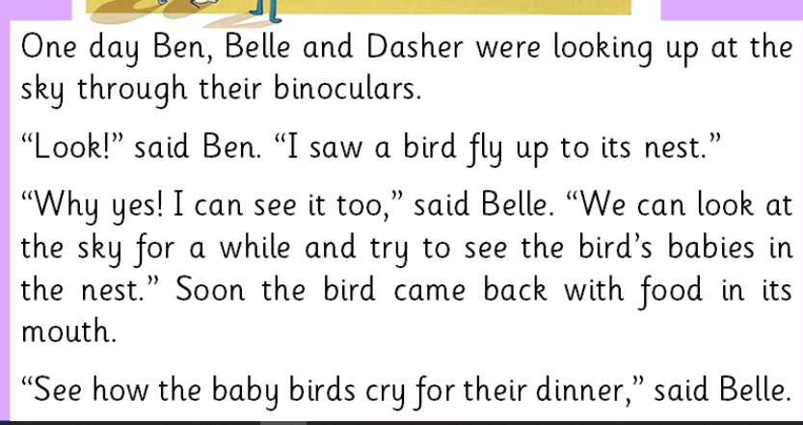
Group 2 Active Literacy
Consolidation week for spelling words.
We have covered these words in class but do you know them all!!??
This week group 2 are revising this phoneme.
I can read and spell them!
Tricky words are in the home /school link jotter.
If you can read them try spelling them!

Slide 4
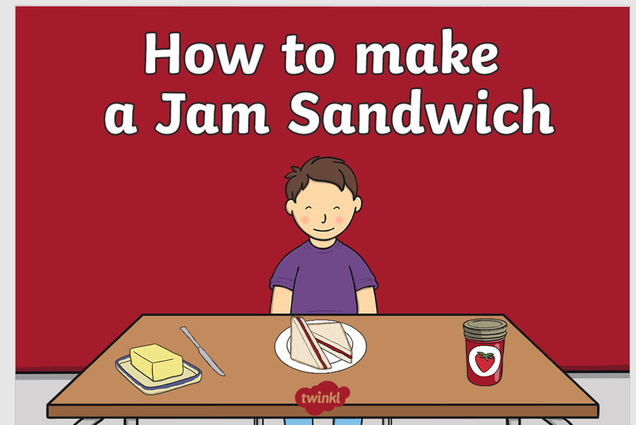
Can you talk about the instruction on how to make it with your child?
Please let your child make a sandwich and take some pictures for us to look at in class. You can email them to me or print them out and send them in.

Slide 5
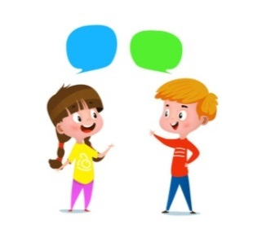
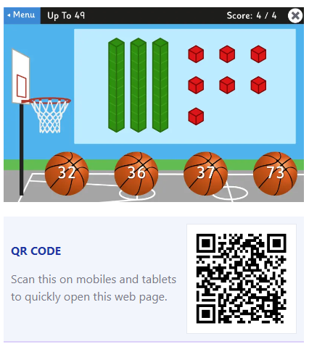
Home Learning
Active Literacy Spelling and Phoneme of the week.
Please practise your spelling/new phoneme words at home using the spelling activity cards or think of your own fun ways to practise your words. We will have a quick check up of the spelling words towards the end of the week!
Talk to me about… How to make a sandwich
Numeracy and Mathematics
Google Topmarks and play basketball to help with place value.

Slide 6
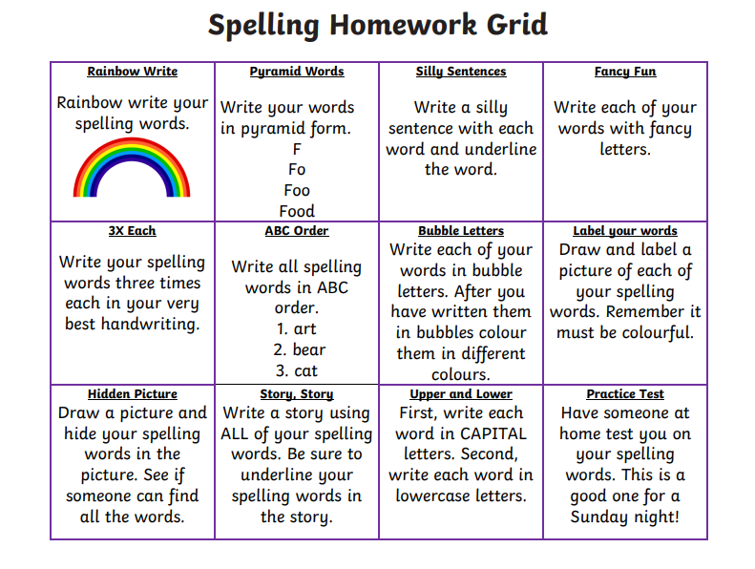
Some ideas for you to try with the new phoneme or your spelling words.
Record them in your Home Learning jotter.

Slide 7
P2/3 Learning Update
Please visit the blog for photos and information about activities taking place in class.
If you have any questions, please do not hesitate to contact me, jacqueline.bryson@glow.sch.uk

