Slide 1
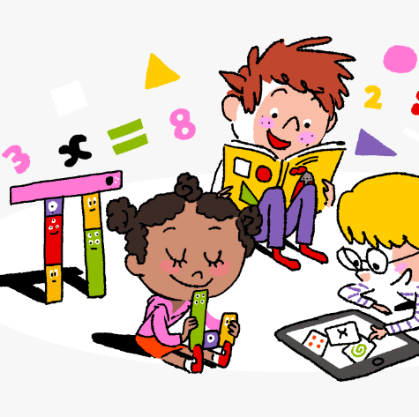
Primary 2/3 Weekly Learning Update 24/9/2024

Slide 2
Group 1 Active Literacy
https://youtu.be/DXvp4Ybx0W4
Tricky words I can read… in home/school link jotter.
This week group 1 are learning to recognise and use the phoneme wh to read and spell.

Slide 3
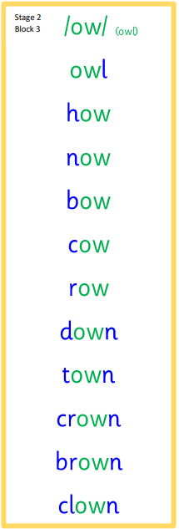
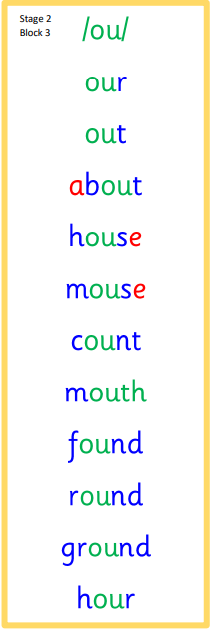
Group 2 Active Literacy
Consolidation week for spelling words.
We have covered these words in class but do you know them all!!??
This week group 2 are revising these phonemes.
I can read and spell them!
Tricky words are in the home /school link jotter.
If you can read them try spelling them!

Slide 4
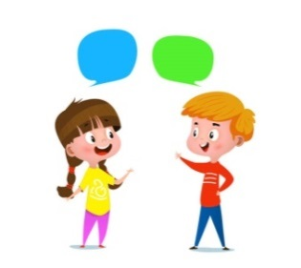
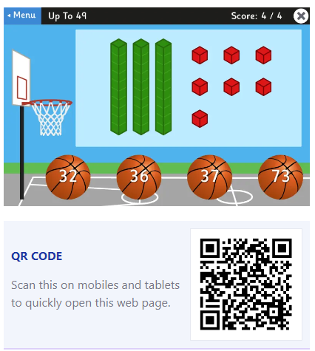
Home Learning
Active Literacy Spelling and Phoneme of the week.
Please practise your spelling/new phoneme words at home using the spelling activity cards or think of your own fun ways to practise your words. We will have a quick check up of the spelling words towards the end of the week!
Talk to me about… Autumn
Numeracy and Mathematics
Take it outdoors!
Google Topmarks and play basketball to help with place value.

Slide 5
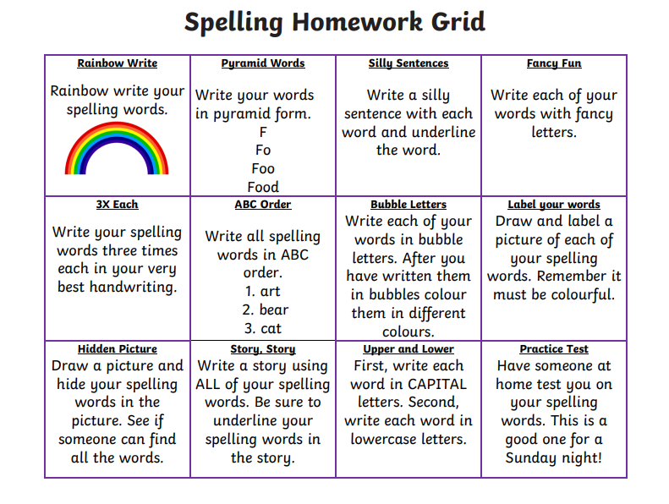
Some ideas for you to try with the new phoneme or your spelling words.
Record them in your Home Learning jotter.

Slide 6
P2/3 Learning Update
Please visit the blog for photos and information about activities taking place in class.
If you have any questions, please do not hesitate to contact me, jacqueline.bryson@glow.sch.uk

