Slide 1
Primary 2/3 Weekly Learning Update 7/5/2024

Slide 2
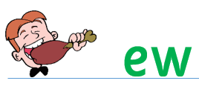
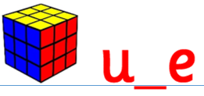
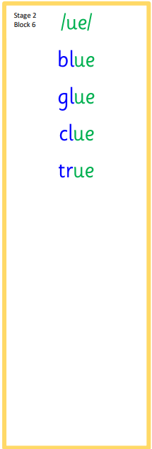
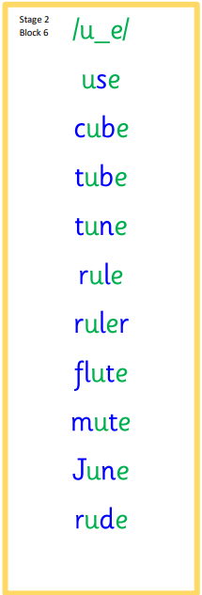
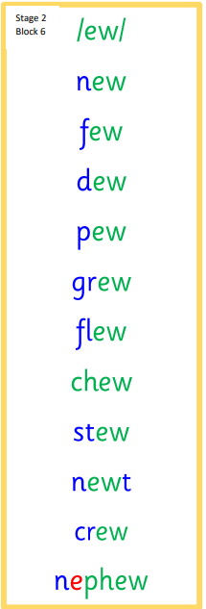
Primary 2 Active Literacy
https://youtu.be/DXvp4Ybx0W4
This week P2 have a consolidation week!
We will have a check up on Friday to see that we know all our spelling words.

Slide 3
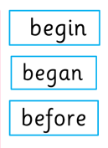
Primary 3 Active Literacy
Consolidation week for spelling words.
We have covered these words in class but do you know them all!!??
This week our focus is on gn as in gnome.
I can read these words!

Slide 4
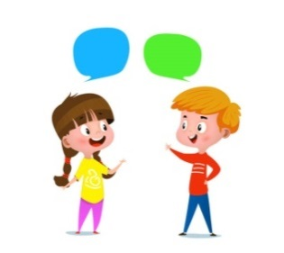
Home Learning
Active Literacy Spelling and Phoneme of the week.
Please practise your spelling/new phoneme words at home using the spelling activity cards or think of your own fun ways to practise your words. We will have a quick check up of the spelling words towards the end of the week!
Reading
Log into MyON and pick a book to read for pleasure. You can read the story yourself or have it read to you. Reading books are also in some bags too this week. P3 pupils are now visiting the school library every week and bringing books home. P2 can borrow from the class library if they want to bring a book home.
Talk to me about… the job you do. Ask me about the job I would like to do when I grow up.
Numeracy and Mathematics Log onto Sumdog and get started! In Sumdog you will find a Amazing April Fun 1 challenge to practise number and number process skills.
https://www.sumdog.com/user/sign_in

Slide 5
Some ideas for you to try with the new phoneme or your spelling words.
Record them in your Home Learning jotter.

Slide 6
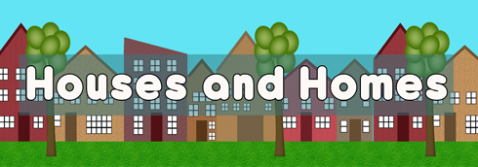
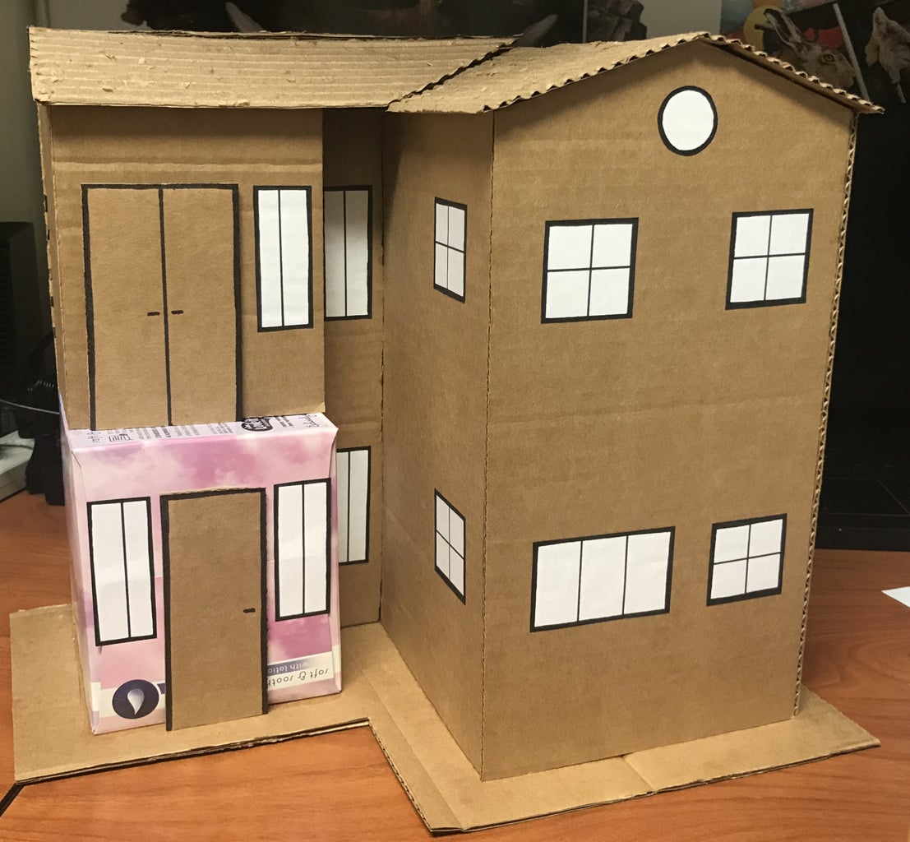
Challenge time!
This term P2/3 will be looking at Houses and Homes through a number of areas in the curriculum.
Can you construct a 3D model of your house using recycled materials?
Due the week of 13th May

Slide 7
P2/3 Learning Update
Please visit the blog for photos and information about activities taking place in class.
If you have any questions, please do not hesitate to contact me, jacqueline.bryson@glow.sch.uk

