Slide 1
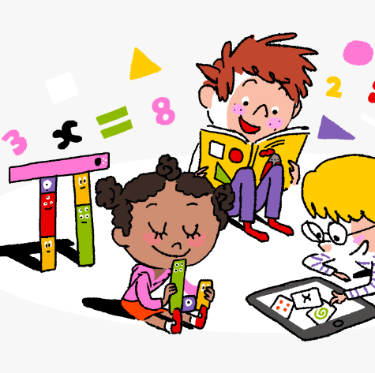
Primary 2/3 Weekly Learning Update 13/11/2023

Slide 2
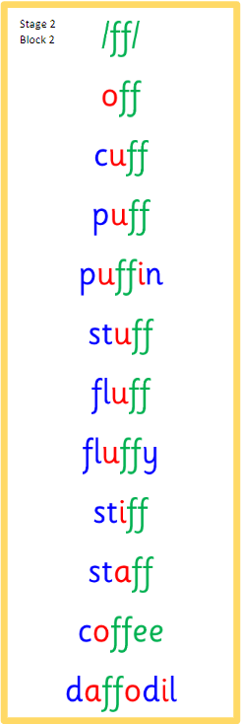
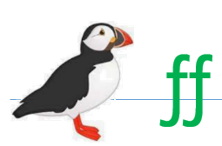
Primary 2 Active Literacy
https://youtu.be/DXvp4Ybx0W4
This week P2 are learning the phoneme “ff”
We should be able to read and write all these words.
These are words my spelling word this week

Slide 3
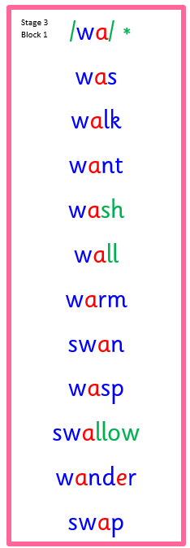
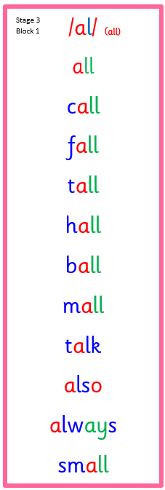
Primary 3 Active Literacy
Consolidation week for spelling words.
We have covered these words in class but do you know them all!!??
This week P3 are revising this week and we need to know
Our spelling words for the week are below.
Blue: we can use our phonemes.
Red: are tricky words

Slide 4
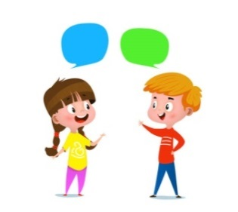
Home Learning
Active Literacy Spelling and Phoneme of the week.
Please practise your spelling/new phoneme words at home using the spelling activity cards or think of your own fun ways to practise your words. We will have a quick check up of the spelling words towards the end of the week!
Reading
Log into MyON and pick a book to read for pleasure. You can read the story yourself or have it read to you. Reading books are also in some bags too this week. P3 pupils are now visiting the school library every week and bringing books home. P2 will start to borrow from the class library if they want to bring a book home.
Talk to me about…How to play my favourite board game.
Numeracy and Mathematics Log onto Splashlearn and get started!
https://uk.splashlearn.com/

Slide 5
Some ideas for you to try with the new phoneme or your spelling words.
Record them in your Home Learning jotter.

Slide 6
P2/3 Learning Update
Please visit the blog for photos and information about activities taking place in class.
If you have any questions, please do not hesitate to contact me, jacqueline.bryson@glow.sch.uk

