Slide 1
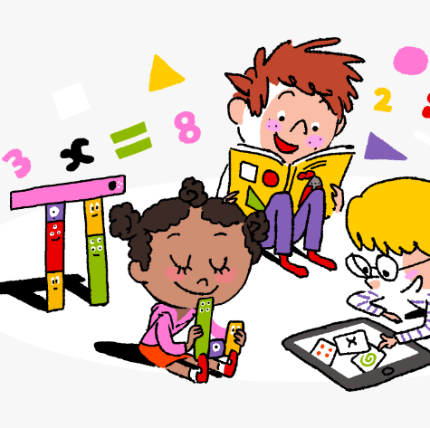
Primary 2/3 Weekly Learning Update 24/10/2023

Slide 2
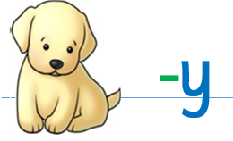
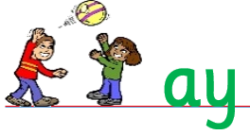
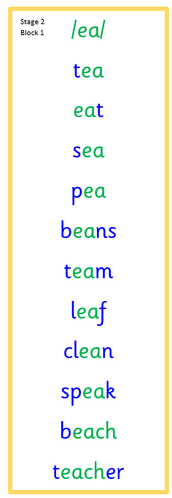
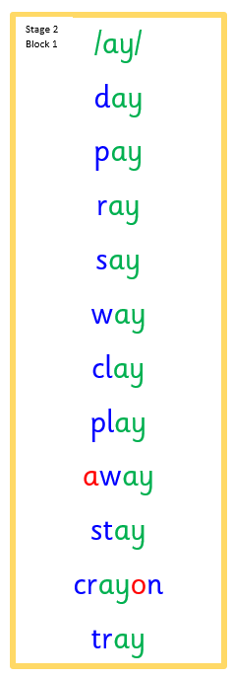
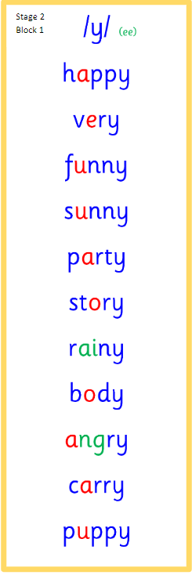
Primary 2 Active Literacy
https://youtu.be/DXvp4Ybx0W4
This week P2 are revising!
We should be able to read and write all these words.
Check my spelling!!!
These are words I should be able to spell.
play away put eat as has
funny very any only

Slide 3
Primary 3 Active Literacy
Consolidation week for spelling words.
We have covered these words in class but do you know them all!!??
This week P3 are learning wr
Our spelling words for the week are below.
Blue: we can use our Phonemes.
Red: are tricky words

Slide 4
Home Learning
Active Literacy Spelling and Phoneme of the week.
Please practise your spelling/new phoneme words at home using the spelling activity cards or think of your own fun ways to practise your words. We will have a quick check up of the spelling words towards the end of the week!
Reading
Log into MyON and pick a book to read for pleasure. You can read the story yourself or have it read to you.
Talk to me about…How I made a Witch Mobile.
Numeracy and Mathematics Log onto Splashlearn and get started!
https://uk.splashlearn.com/

Slide 5
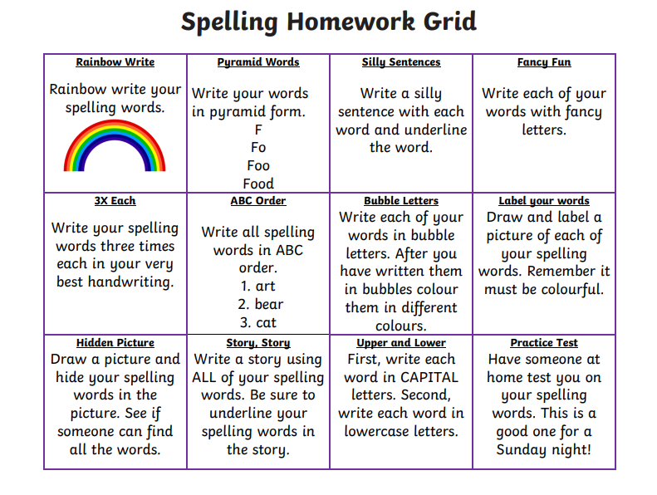
Some ideas for you to try with the new phoneme or your spelling words.
Record them in your Home Learning jotter.

Slide 6
P2/3 Learning Update
Please visit the blog for photos and information about activities taking place in class.
If you have any questions, please do not hesitate to contact me, jacqueline.bryson@glow.sch.uk

