Slide 1
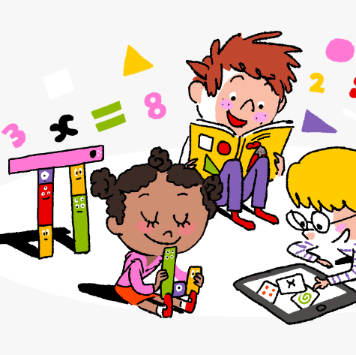
Primary 2/3 Weekly Learning Update 2/10/2023

Slide 2
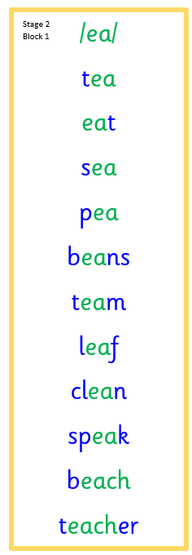
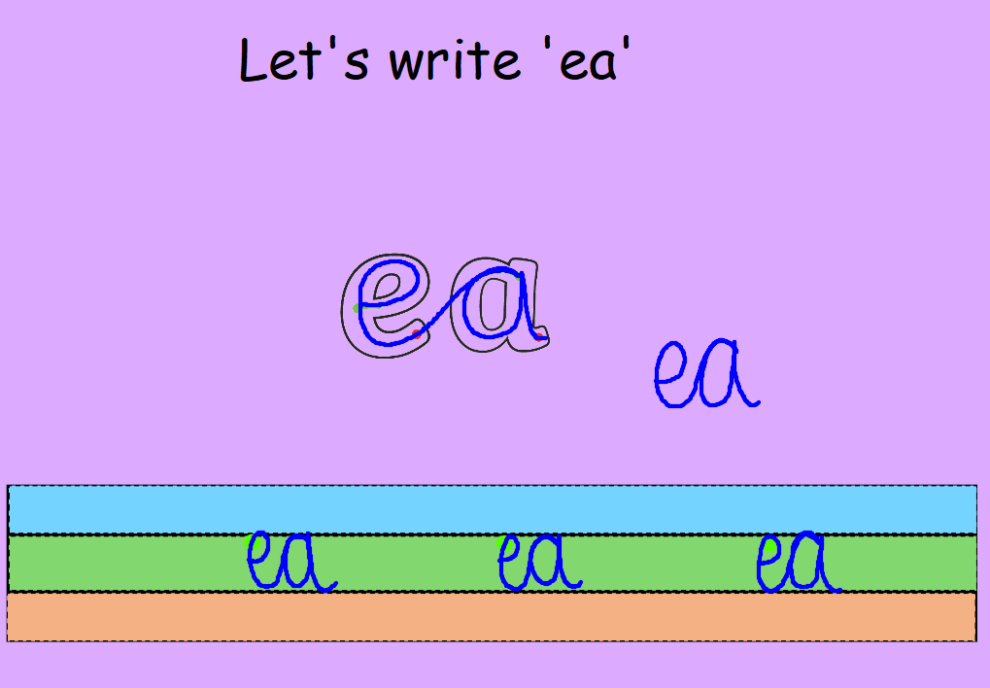
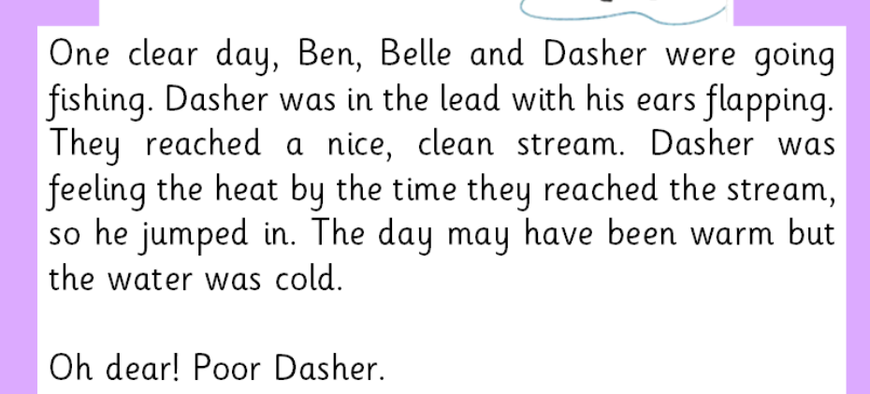
Primary 2 Active Literacy
https://youtu.be/DXvp4Ybx0W4
This week we are trying to
read and spell:
play
away
put
This week P2 are learning to recognise and use the phoneme ea to read and spell.

Slide 3
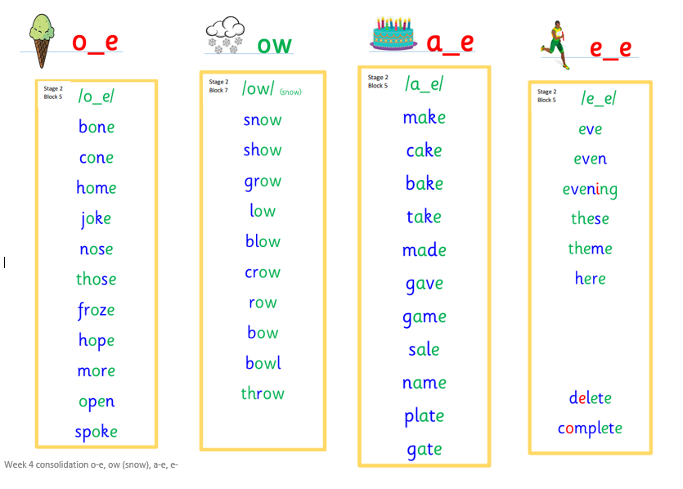
Primary 3 Active Literacy
Consolidation week for spelling words.
We have covered these words in class but do you know them all!!??
This week P3 are revising these phonemes.

Slide 4
Home Learning
Active Literacy Spelling and Phoneme of the week.
Please practise your spelling/new phoneme words at home using the spelling activity cards or think of your own fun ways to practise your words. We will have a quick check up of the spelling words towards the end of the week!
Reading
Log into MyON and pick a book to read for pleasure. You can read the story yourself or have it read to you.
Talk to me about… Living and Non living.
Numeracy and Mathematics
Take it outdoors!

Slide 5
Some ideas for you to try with the new phoneme or your spelling words.
Record them in your Home Learning jotter.

Slide 6
P2/3 Learning Update
Please visit the blog for photos and information about activities taking place in class.
If you have any questions, please do not hesitate to contact me, jacqueline.bryson@glow.sch.uk

