Slide 1
Teaching Children To Listen
(Based on the book by Liz Spooner and Jacqui Woodcock)
Information for both teachers and parents
Scottish Attainment Team
Speech & Language Therapy
If you see a star on any of the slides, there should be some extra information through an audio clip next to it (if you would like to find out a little bit more ☺). Come out of the slide show and you will see a loudspeaker icon – double click to listen!

Slide 2
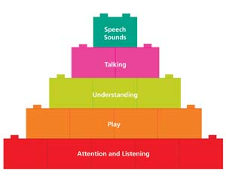
Building Blocks for Language
Listening underpins all of language development
It is what needs to be developed before any of these other skills
Listening skills are one of the foundational blocks which need to be in place when children are starting school. This then helps them to develop their literacy skills

Slide 3
Listening Comes First!
WRITING
Children learn to speak by listening to those around them
They need to learn new words and listen to the sounds of words to help them later on with their reading and writing
READING
SPEAKING
LISTENING

Slide 4
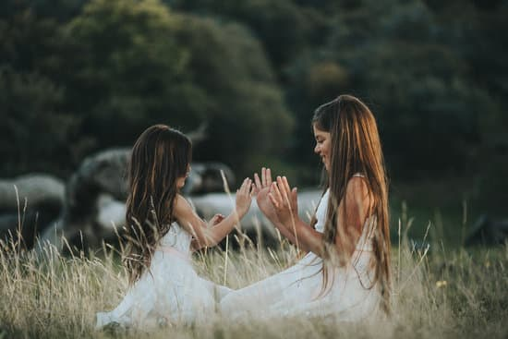
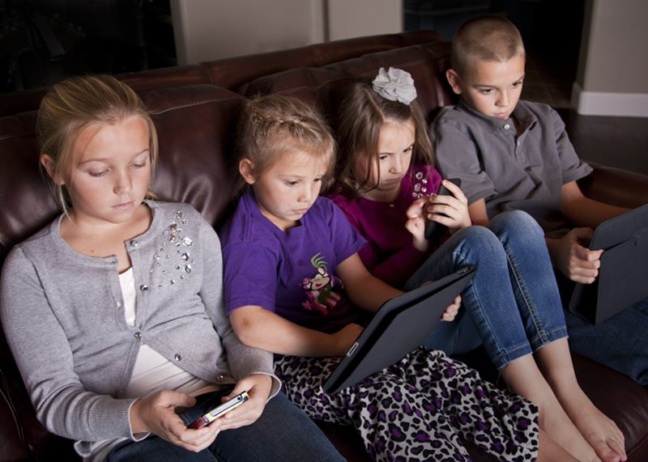
Why is listening hard for so many children?
Time for one to one interaction and opportunities to develop children’s language are impacted by the following:
They are distracted by lots of screen based entertainment
They are sometimes choosing to watch a DVD or play computer games rather than playing interactively with one another
Families are spending less time talking and listening to each other due to busy, working lives
There are increased noise levels in the home during the crucial time when children are learning to interact

Slide 5
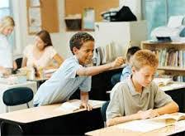
Why is working on so listening important?
Poor listening skills can impact children’s ability to:
Focus well in the classroom. They may then also distract others from listening
Follow instructions given to them in the classroom/home
Learn in all curriculum areas
Complete age appropriate tasks (due to poor listening rather than academic ability)
Socially engage well with others, as they have not learned the need to stay quiet and wait their turn when communicating. This can then impact their ability to make friends
1
2
3
4
5

Slide 6
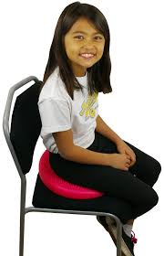
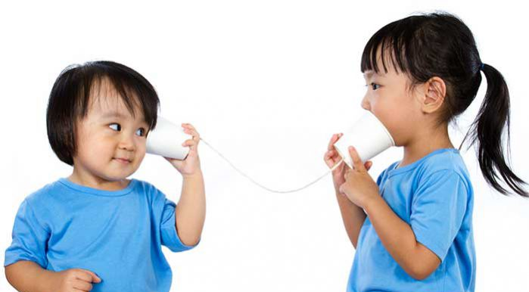
What is good listening?
To be a good listener children need to:
Look at the person who is talking
Sit still
Stay quiet so that everyone can listen
Listen to ALL of the words
1
2
3
4

Slide 7
1. Look at the person talking
This skill is important as:
It shows an interest in what someone is saying (an important social skill for children to know)
It helps to initiate turn taking in conversations
Many learning situations require children to work in groups where they need to listen and respond to other children. Looking helps them to gain more information
1
2
3
Extra information for children on the autistic spectrum

Slide 8
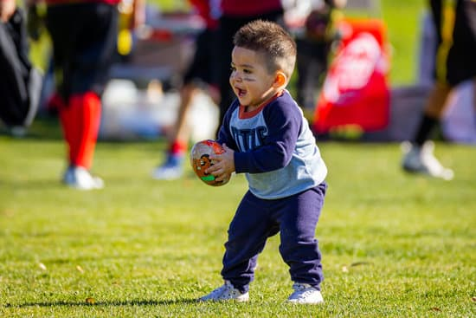
Looking activities to try
Pass The Turn- Choose an activity your child loves (it could be completing a puzzle or taking turns in their favourite game) You can only take your turn by looking at the other person first/or by giving them a nod. If you’re doing this altogether as a family, you can put your child in charge of looking at whoever’s turn it is next and then that person can have their turn.
Catch - You can play catching or kicking a football in the garden
and before you pass the ball to your child they need to
look at you first.
Emotions Picture Game- Have your child close their eyes, while you choose an emotions picture card to do for them. When they open their eyes, see if they can match your face to one of the cards. You can swap round (*see extra information sheet for cards)

Slide 9
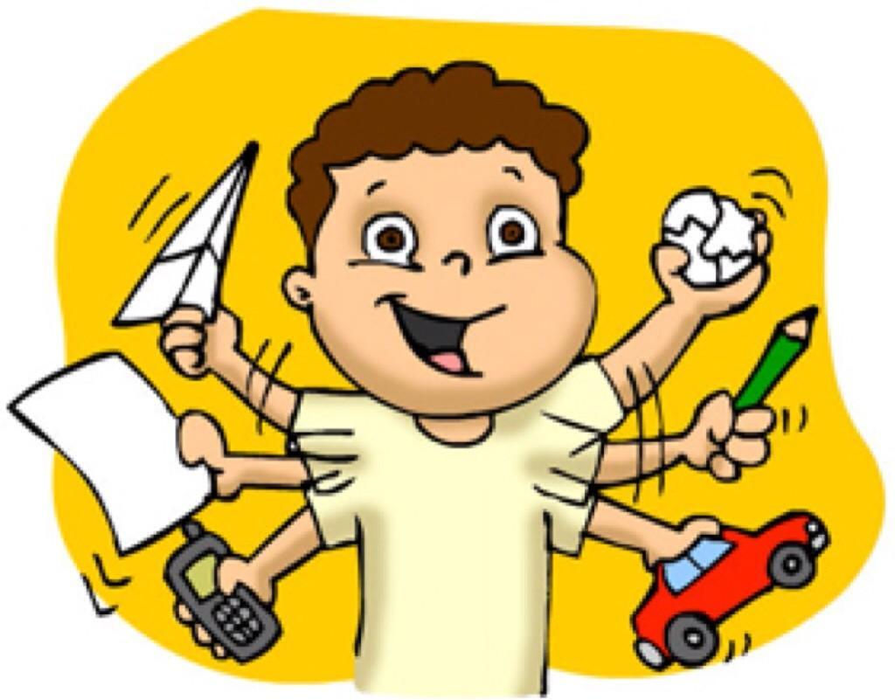
2. Sitting Still
This skill is important as:
When children are sitting appropriately this reduces distractions for them and enables them to focus more easily on what the speaker is saying
It stops children from distracting others when they fidget
When they learn this skill it will also then help to improve the listening of the whole class
1
2
3
Extra information for children on the autistic spectrum and the best way for children to sit

Slide 10
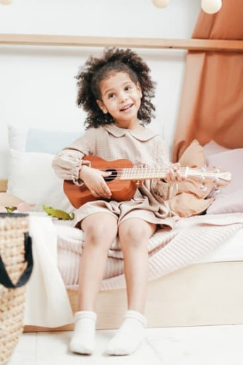
Sitting Still Activities To Try
Sitting Still With Instruments- Give your child/children different musical instruments. They need to stay still with the instruments for about 15 seconds (if they start fidgeting you’ll be able to hear the instrument make a noise!) Once the time is up they can play their instruments (then you can swap the instruments around and do the task again)
What Am I Doing Wrong? - Sit on a chair in front of your child and tell them you are going to do some things which are NOT good sitting. Model different types of fidgeting behaviour (rocking on your chair, taking shoes off, playing with your hair, rolling down your socks, sucking on your thumb..) Ask your child to put their hand up (teaching them not to shout out) when they see a behaviour which is not good and tell you what it is. This will hopefully raise their awareness to what good sitting is and copy it themselves.
Sitting Still With Distractions- Ask your child to sit still on a chair. You will try and distract them by blowing bubbles or blowing a fan at them. They need to stay completely still and see how long they can do this for (have a timer on which they can see) They can see if they can beat their times for staying still (they are likely to be distracted by others in class so encourage them to try and stay as still as possible, so that they’re able to listen better to their teacher)

Slide 11
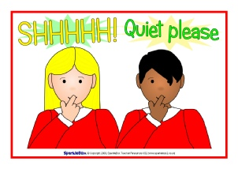
3. Staying Quiet
This skill is important as:
If children can learn to stay quiet, it will have a huge impact on the listening environment for everyone – children who shout out always disrupt other people’s listening as well as their own
They need to learn to wait their turn before speaking. This is a social skill children need both for formal learning situations and conversations
1
2

Slide 12
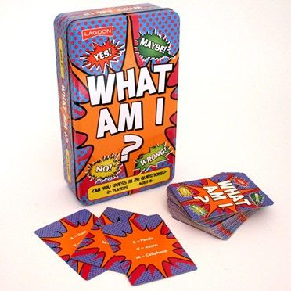
Staying Quiet Activities To Try
Sound Location Game- Ask your child to go out the room and then hide a radio/musical toy/phone with music on it. When they come back in everyone has to be really quiet and the child then needs to try and follow where the sound is coming from and find the toy. Emphasise how being quiet helps them to do this (you can make it harder by making the noise of the toy/phone quieter so they have to listen really carefully)
Giant’s Keys- Have your child sit on a chair with a blindfold on. Behind them is a box with some keys in it. You can be the thief and have to try and get the keys. If your child hears you however, they need to point to where they think you might be and if they point to where you are they win the game!
What Am I? - *Use the What Am I? cards in the extra information sheet. Give your child the clues, but they only get to guess what they think it is if they have their hand up. If they shout out they lose a life (and they get three lives). See how many cards they can collect.

Slide 13
4. Listen to ALL of the words
This is an important skill to have as:
Some children may only listen if their own name is called
Other children may listen to the first part of an instruction, think they know what is coming next, and then stop listening
Some children may switch off once they have had a turn as they know they won’t get chosen again
1
2
3
Extra information for children with language difficulties

Slide 14
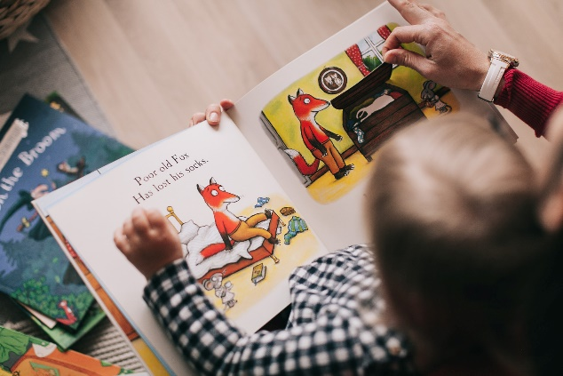
Listening To ALL The Words
Activities To Try
Interactive Stories - Give your child some matching pictures of different characters in a story book they have. Tell them you’re going to read the story and when they hear one of their characters mentioned they need to stand up.
The Silly Shaker- Tell your child you’re going to read a story (*see the extra information sheet) and that there are going to be lots of silly words in it. When they hear a silly word they need to put up their hand or shake a toy shaker. Explain to them what a silly word is first, for example, stiggleflump! Remind them it’s ok if they don’t know what all the words mean!
Do As I Say Not As I Do- A variation on Simon Says! Tell your child that you’re going to give them an instruction, but you then do an opposite action to the instruction you’ve given. They need to listen to your instructions, carry them out and not copy your actions. See how many they can do!

Slide 15
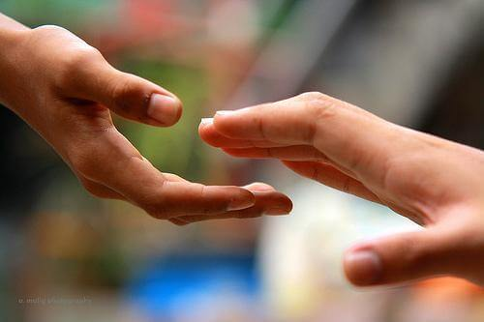
How to talk so children will listen? The kind of language adults use when talking to children makes a real difference to how well they listen
1
Say your child’s name before speaking to them
Keep your language simple and at their level
Avoid ambiguous language which can confuse the message you’re trying to convey (“Your behaviour is driving me up the wall!”)
Remind them of the rule before you need them to listen (“I’ve got a surprise for you. If you’re quiet I’ll tell you what it is”)
Praise them when you see them using these skills and do this each day in your daily activities
Be specific about what they’re doing wrong when they’re not listening (“You’re talking at the same time as me which makes it hard for you to do good listening.”)
2
3
4
5
6

Slide 16
Speech & Language Therapy Helpline

Slide 17
Social Media

