Slide 2
Activities to be completed throughout the week Week beginning 6.9.21 Chapter 1

Slide 3
Understanding
LI: To identify true & false statements about a text.
SC: I can listen/read for information.
Task:
Read, or listen to the recording of, chapter 1.
Read statements 1-5.
Re-read or listen to chapter 1 and decide if the statements are true or false.
If there is little or no evidence, answer can’t tell.
 |  | T, F or CT | Page Number
1 | Joey was separated from his mum at a horse sale.
2 | Albert’s dad was unsympathetic toward his horses.
3 | Albert’s mother likes to obey his father.
4 | Joey felt comforted by Albert.
5 | Albert’s mother doesn’t like the horses.

Slide 4
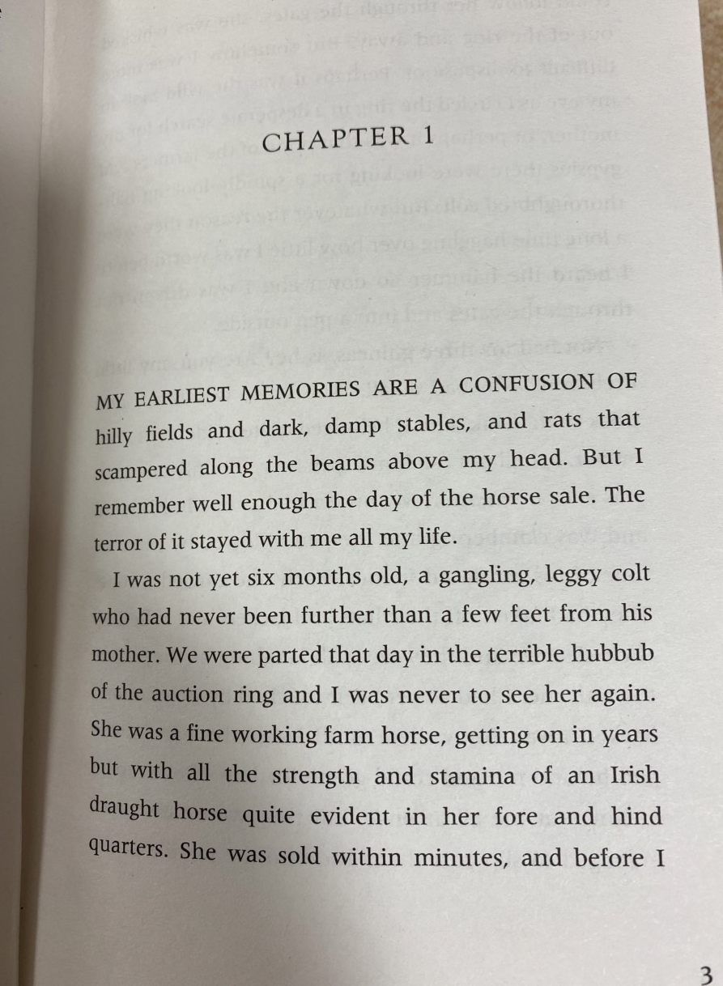

Slide 5
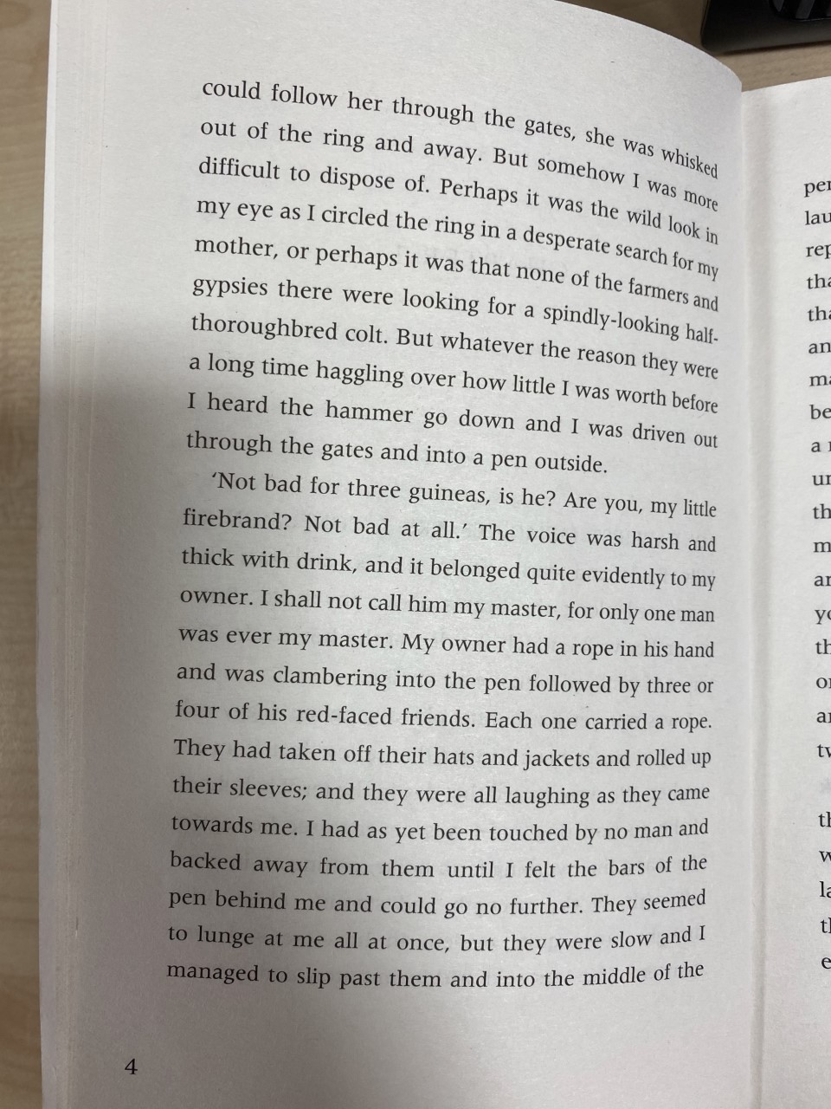
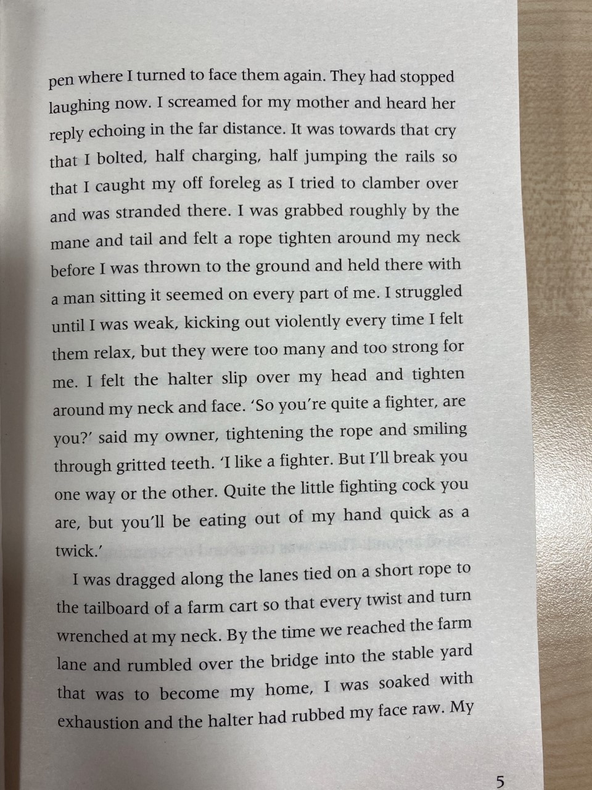

Slide 6
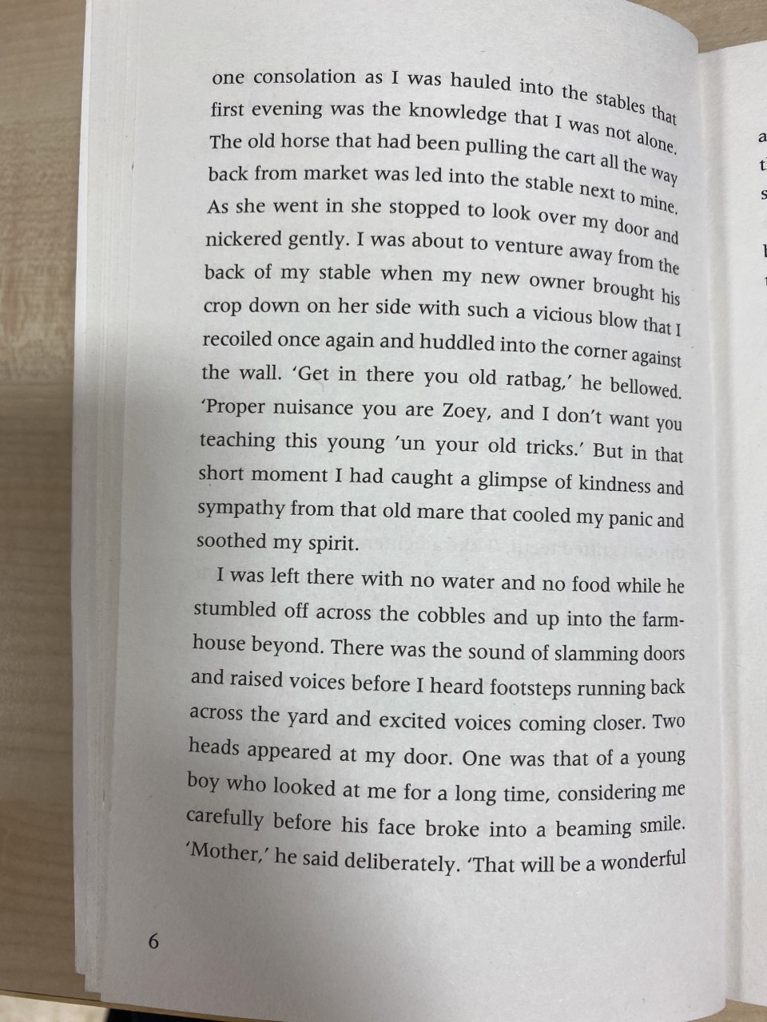
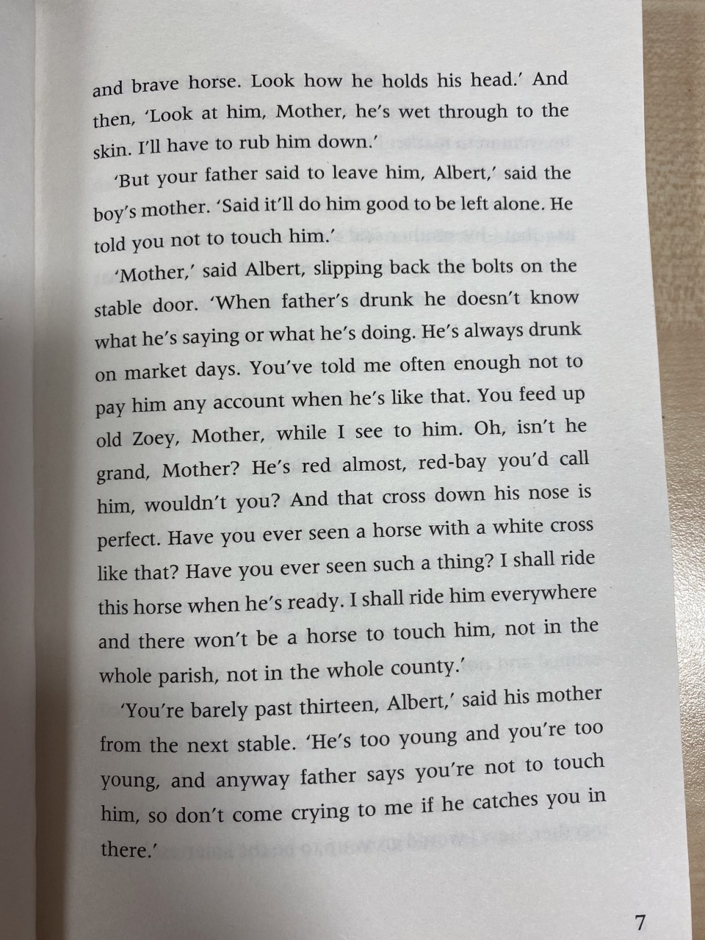

Slide 7
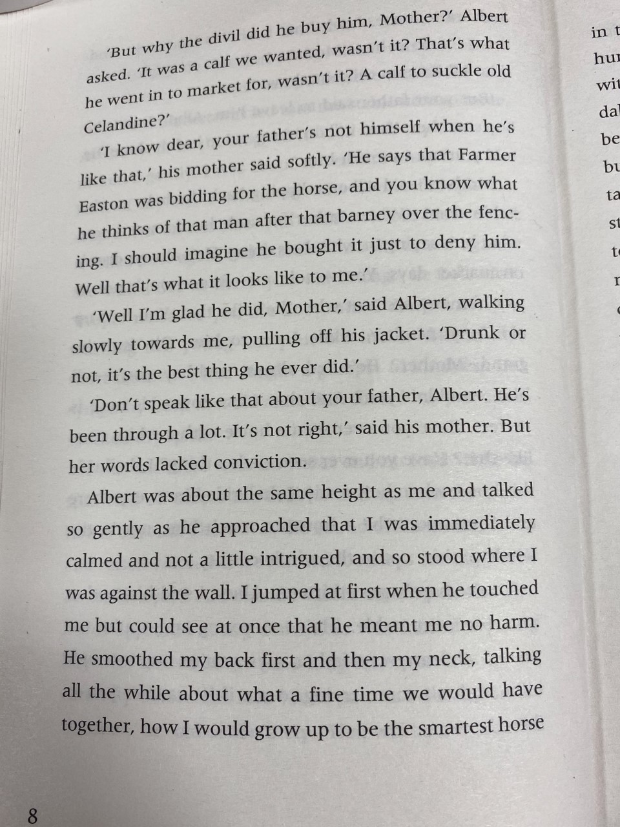
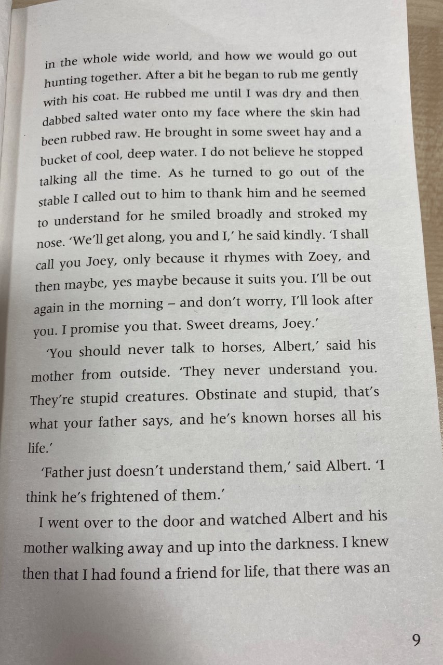

Slide 8
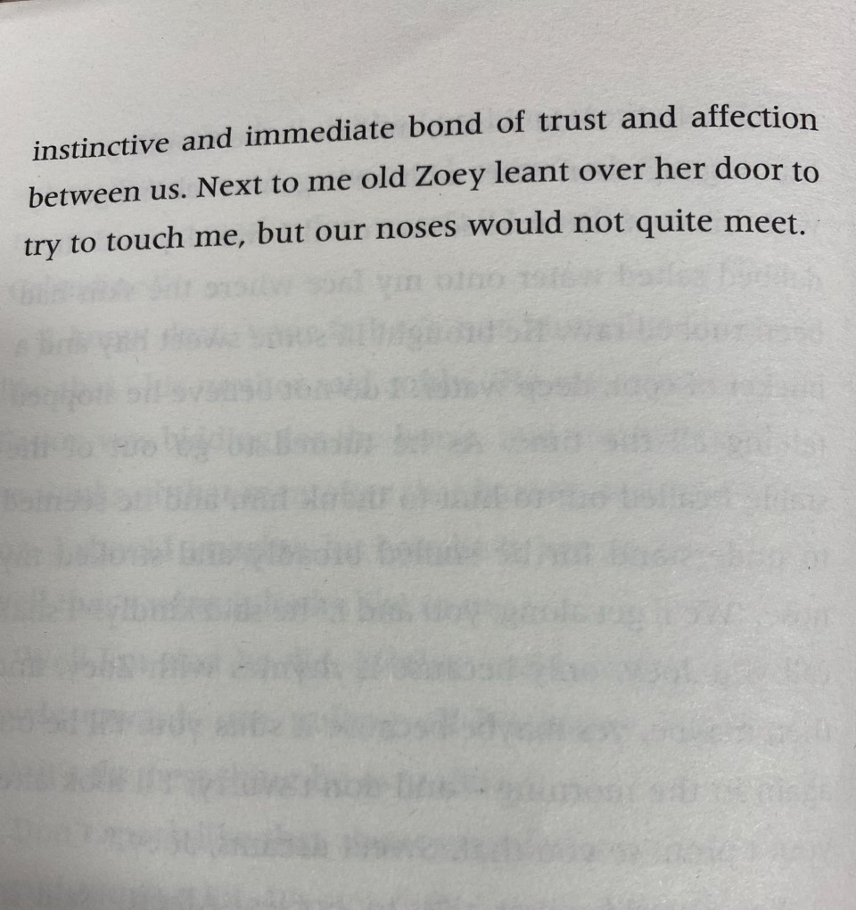

Slide 9
Metalinguistics
LI: To work out the meaning of new and unknown words.
SC:
I can use reading strategies to help understand new words.
I can check the meaning of new words using a dictionary or the internet.
I can provide a synonym (words which mean the same or very similar to a word) for each new word.
I can use new words in a sentence.
Reading Strategies
Read on & Read back- Look for clues mentioned elsewhere in the text.
Familiar words- Look for any words you may already know inside the word.
Replace the word- Use a different word in its place. Does the sentence still make sense?
What type of word is it? A noun, adjective, verb, adverb etc.

Slide 10
Metalinguistics
Choose words from this slide or the next slide, or a combination of both.
New Word | Page | What you think it means | What the dictionary/ internet says | Synonym
parted
dispose
halter
hauled
bellowed

Slide 11
Metalinguistics
New Word | Page | What I think it means | What the dictionary/internet says | Synonym
scampered
clambering
consolation
intrigued

Slide 12
Summarising
LI: To give a brief summary (statement) of the key points.
SC:
I can identify the main points of the story so far.
I can write the main points in my own words.
Task:
Write or record a short summary of the main events from chapter 1 in only 3 sentences.
Try not to include unnecessary information.

