Slide 1
Dyslexia
By Enzo Gibb

Slide 2
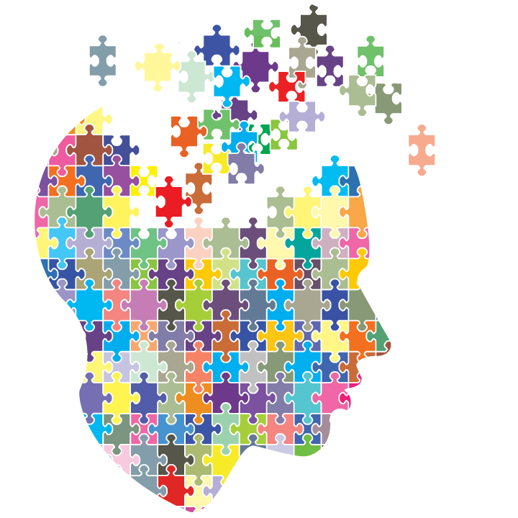
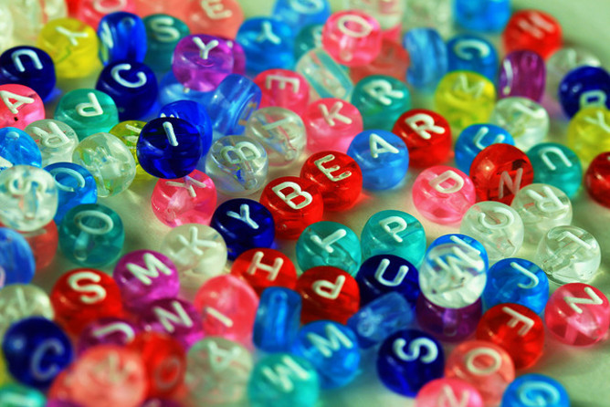
Dyslexia is a condition that makes it difficult to learn, read and spell words
This Photo by Unknown Author is licensed under CC BY-NC

Slide 3
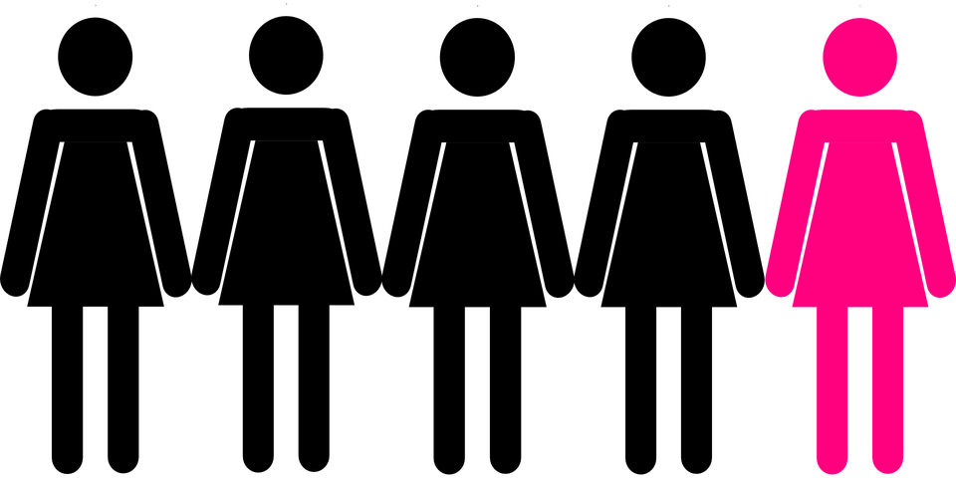
It is the most common learning disability
One in five people is dyslexic

Slide 4
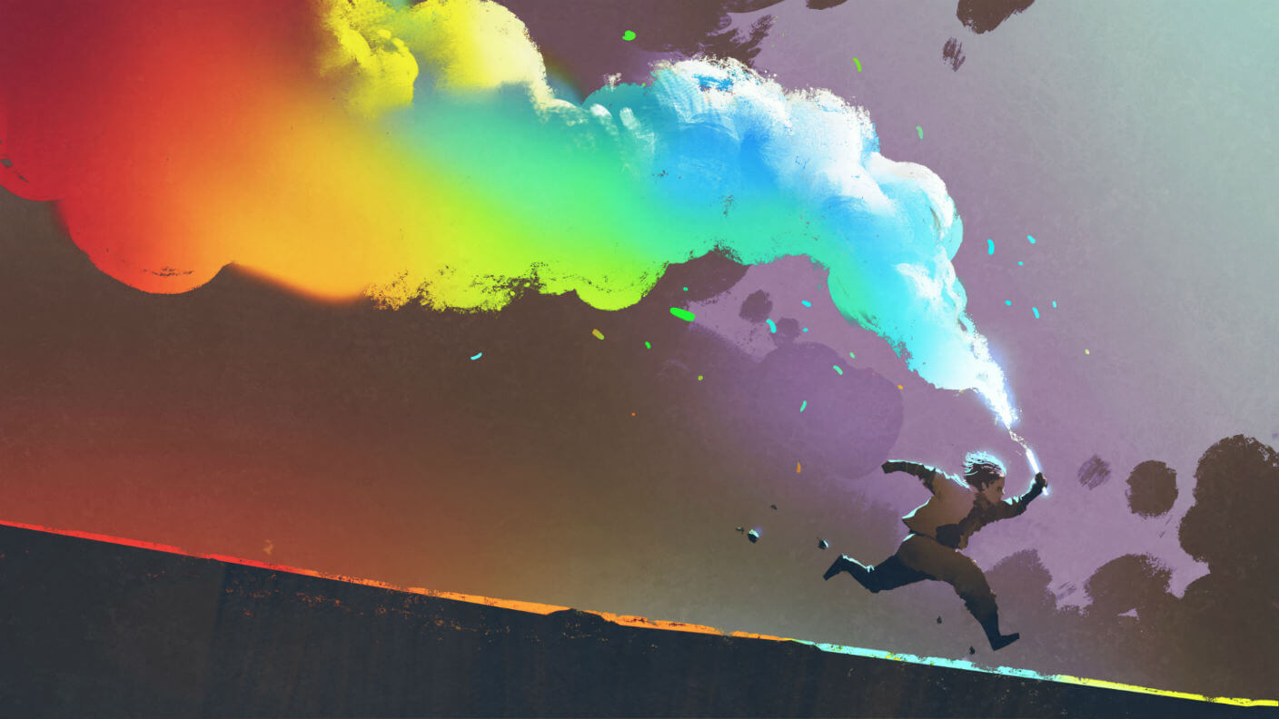
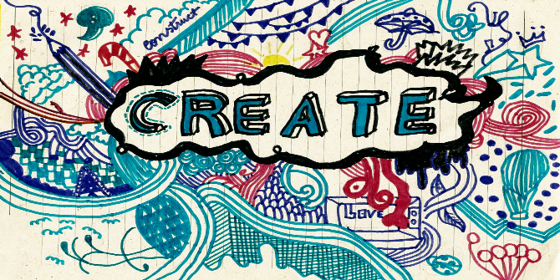
Dyslexic people are usually more creative

Slide 5
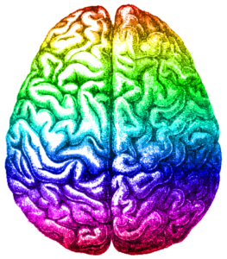
Dyslexic people use only the right side of their brain for language, instead of 3 areas of the left side

Slide 6
They use five time more energy to complete mental tasks, so they might be more tired.

Slide 7
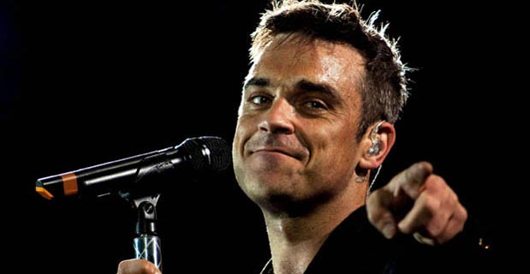
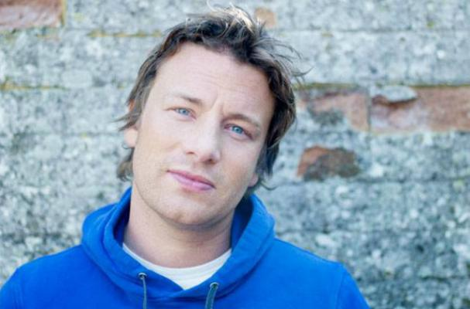
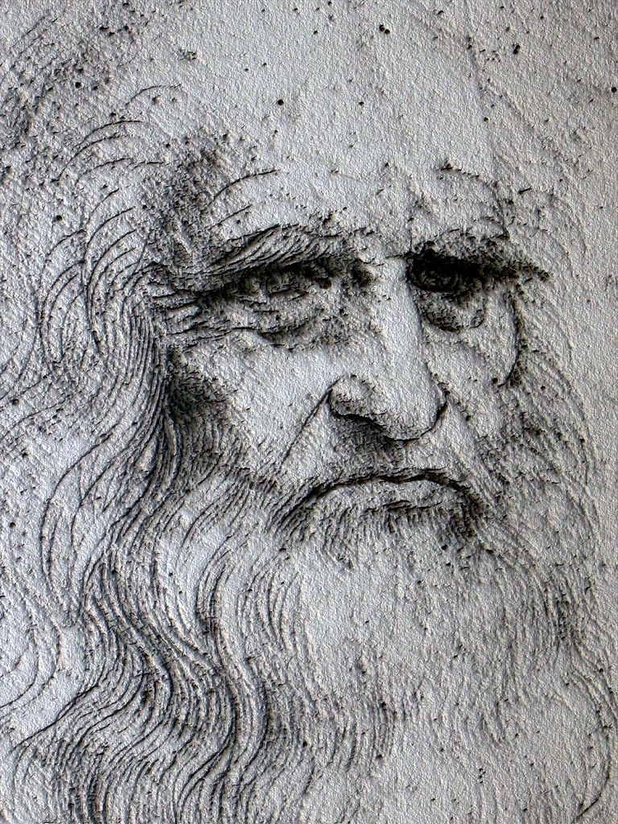
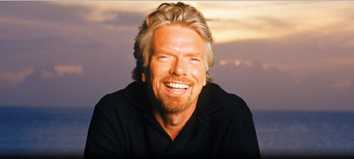
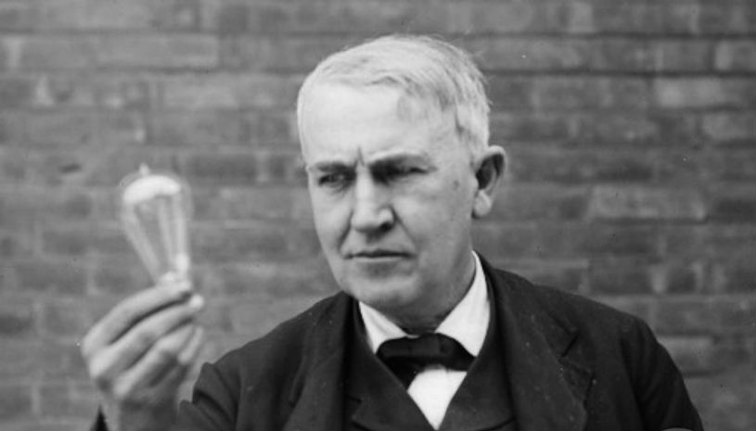
If you have dyslexia, you are not stupid, your brain just works differently.
Look at those famous dyslexic people!
This Photo by Unknown Author is licensed under CC BY

