Slide 1
Scotland - Fact File

Slide 2
Did you spot the false facts? Here they are below.
There are 4 cities in Scotland. There are in fact 7 cities in Scotland.
Scottish drivers use the right-hand side of the road. No, they use the left-hand side.
It is always sunny in Scotland. Unfortunately it isn’t always sunny – but fingers crossed for some lovely weather soon!

Slide 3
Now we have got a great bank of facts let’s look at them in a bit more detail.

Slide 4
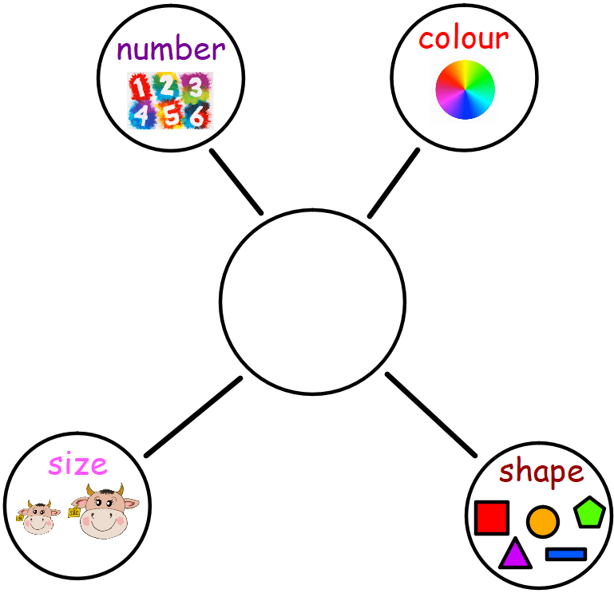
Description Bubble
We have used this in class before.
We use this to up level our writing and make it more interesting for our readers.
Writing 1 interesting sentence for each bubble.
4 sentences in total.

Slide 5
Here is a fact…
Scotland’s flag is called the Saltire.
It is a fact – but it’s not the most interesting fact. Let’s use our bubble to make it more interesting.

Slide 6
Can you think of 4 things about this flag? One from each part of the bubble?
Number -The Saltire has one cross and four triangles.
Colour - It is blue and white.
Size – It can be very large when put up on a pole.
Shape – The Saltire flag is a rectangle.

Slide 7
Noun Pronoun Pronoun Noun
When we write these four sentences we begin the first one with a noun, second with a pronoun, third with a pronoun then the fourth with a noun.
Check back on the slide before to see how I did it. I’ve changed the font to green.
It just varies your sentences so they don’t all sound the same.

Slide 8
Connectives
Another way to up level our sentences is to add in a connective.
Scotland’s flag is called the Saltire.
We could add in a simple ‘and’ creating a longer, more interesting sentence with more detail.
Scotland’s flag is called the Saltire and it is blue and white.
and | but | because | so | also
however | therefore | although | then | as well as

Slide 9
Task
I would like you to pick 3 Scotland facts – more if you wish and up level each of them to make them much more interesting.
Use the description bubble for at least one of them.
Tomorrow we will use these interesting facts to create a fact file.

