Slide 1
Fractions
Triangles - Halves and Quarters

Slide 2
Halves and Quarters
We have been looking at halves and quarters.
Halves and quarters of quantities
Halves and quarters of shapes.
From seeing your super work I can see that you all understand it really well.

Slide 3
Task 1
Your first task today is to go around your house and look for anything that you can split into halves or quarters.
I had a pancake yesterday and cut it down the middle into 2 equal parts. Sometimes your windows are split into 2 or 4 equal parts.
Let me know what you can find. I have put some examples in the next two slides. You can write a list in your jotter.

Slide 4
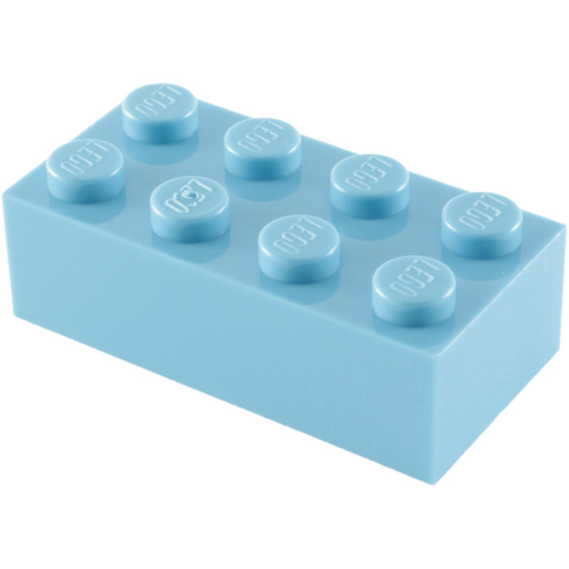
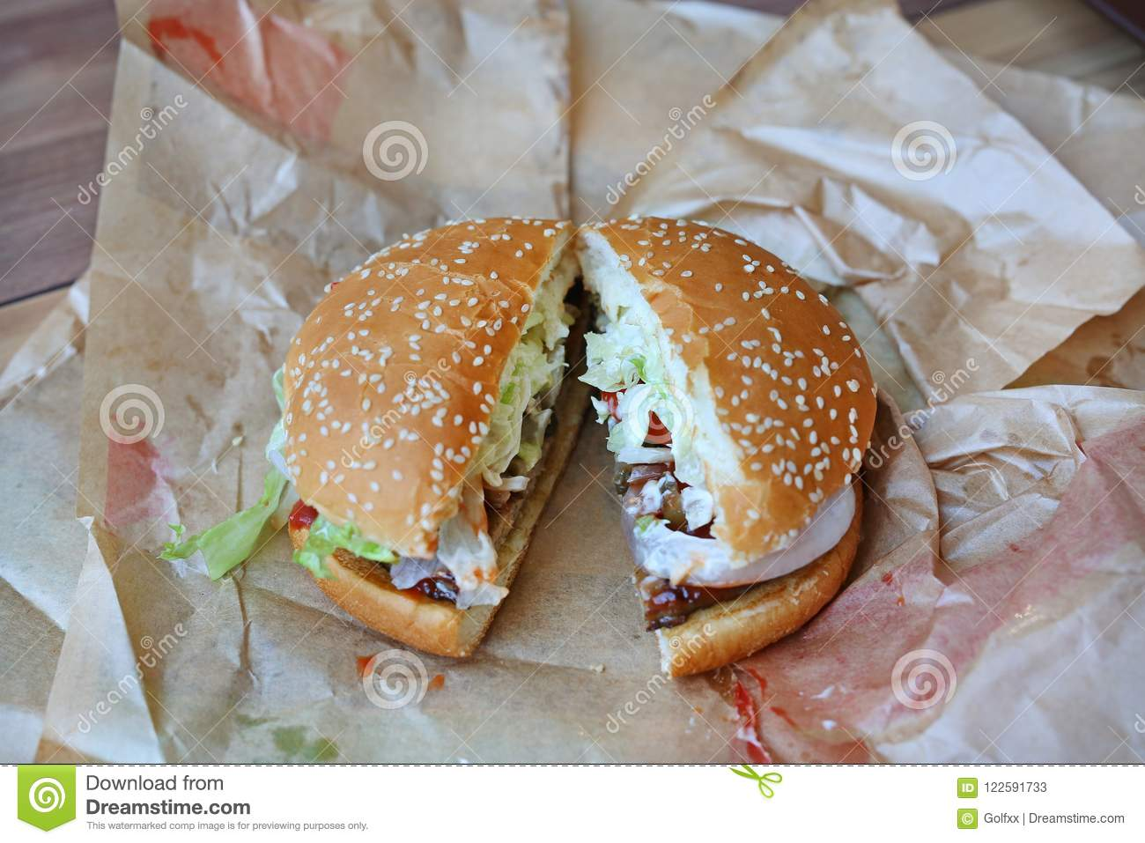
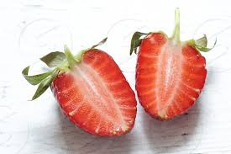
Halves

Slide 5
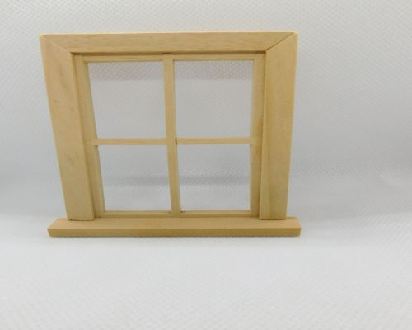
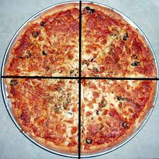
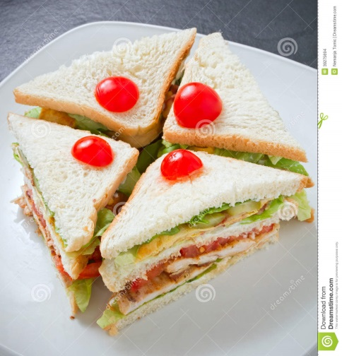
Quarters

Slide 6
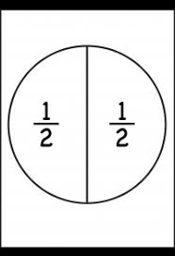
How to write a fraction
Instead of saying one half there is a way we write it with digits.

Slide 7
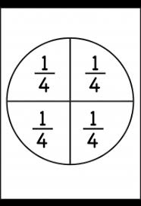
How to write a fraction
Instead of saying one quarter there is a way we write it with digits.

Slide 8
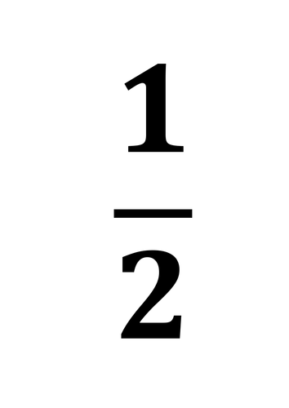
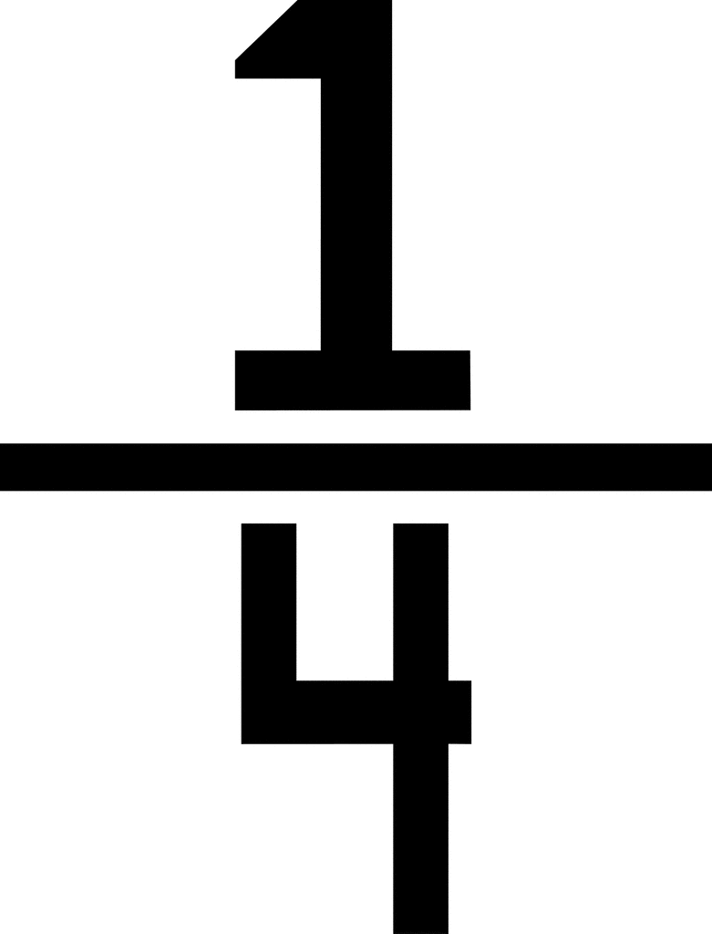
Task 2
Use your jotter to practise writing these fractions. Remember to write the digit in one square of your jotter underline the bottom of that square and then the digit directly underneath that square.

Slide 9
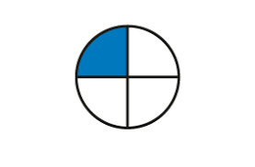
Numerator and Denominator
1
4
Numerator – number on the top
Shows the number of equal parts of the whole you have.
Denominator – number on the bottom
How many equal parts the whole is divided into.

Slide 10
Task 3 – What is the fraction of the coloured shapes
We have 1 equal part coloured in.
There are 4 equal parts of this shape altogether.
So what is the fraction? You can write these in your jotter and draw the shape – using a ruler and the squares to keep it neat.

Slide 11
Yes it is…
1
4

Slide 12
Task 3 – What is the fraction of the coloured shapes
We have 3 equal parts coloured in.
There are 4 equal parts of this shape altogether
So what is the fraction? You can write these in your jotter and draw the shape – using a ruler and the squares to keep it neat.

Slide 13
Yes it is…
3
4

Slide 14
Task 4
If you go back to the main blog and click the link you will find task 4.

