Slide 2
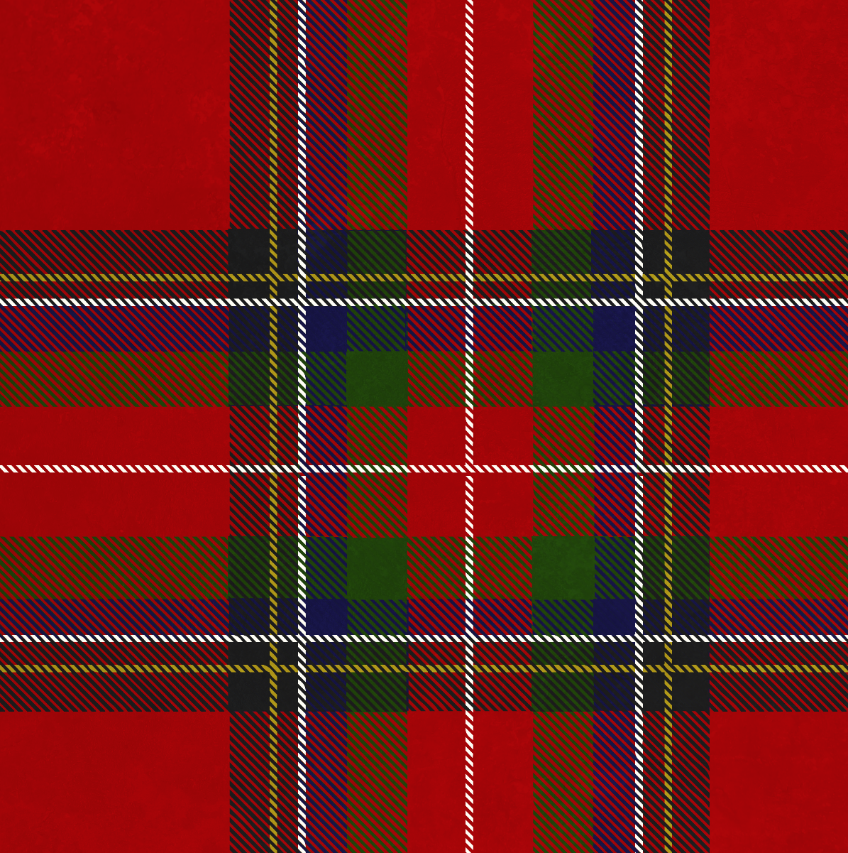
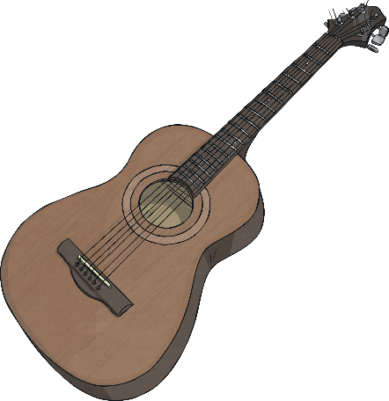
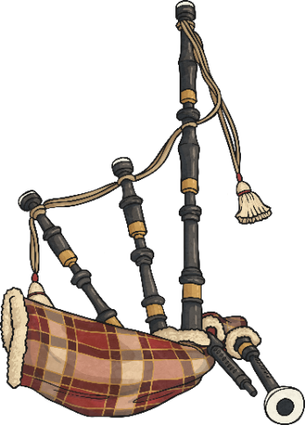
What do all of these musicians have in common?
They are all from Scotland!
Biffy Clyro
Amy MacDonald
Runrig
Calvin Harris
Red Hot Chilli Pipers
The Corries

Slide 3
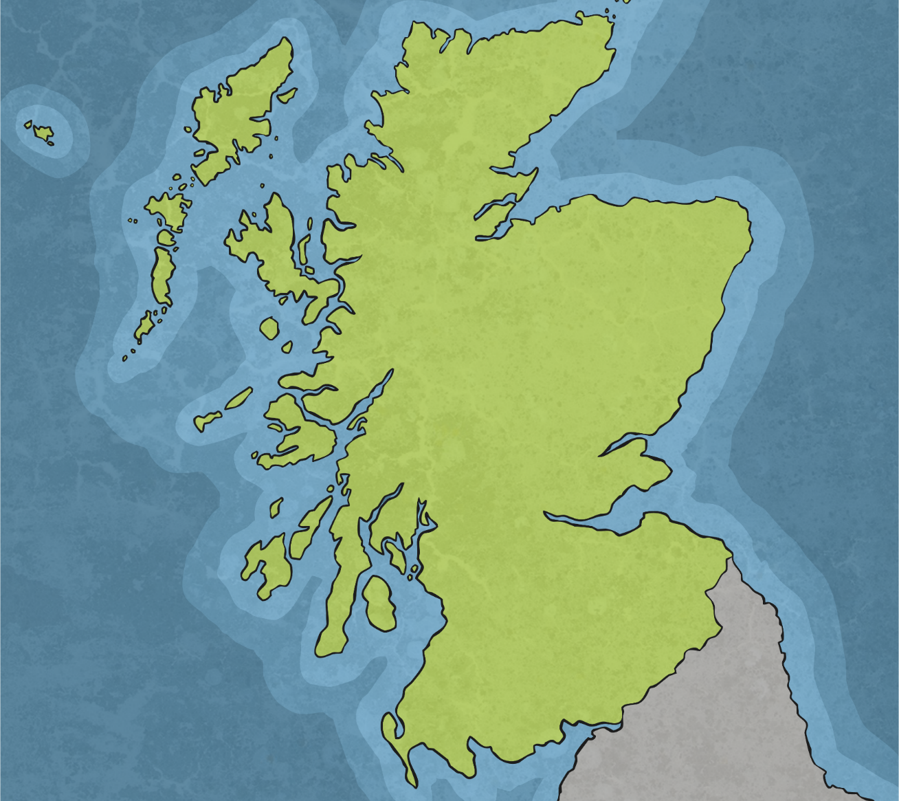
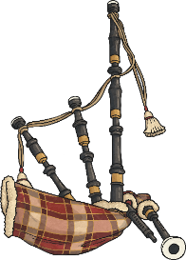
Scottish Musicians
Runrig
Amy MacDonald
Red Hot Chilli Pipers
Biffy
Clyro
Calvin Harris
The
Corries

Slide 4
The Corries
Next page
The Corries were a Scottish folk band that
formed in the 1960s. Folk music is a type of traditional music that was originally passed
down through families and other small
social groups.
Originally a three-piece band, Bill Smith, Roy Williamson and Ronnie Browne met while studying at The Royal College of Art, Edinburgh. They regularly played at the Edinburgh Festival Fringe. Bill Smith left the band in 1965, however, they continued until Williamson’s death in 1990.
Did You Know…?
A corrie is a deep hole in a mountain.

Slide 5
The Corries
Home
One Corries’ song has a special place in Scottish people’s hearts.
Can you guess what it is?
The song refers to the victory of the Scots led by Robert the Bruce at Bannockburn.
It is the unofficial national anthem of Scotland.
O Flower of Scotland
In June 2006, The Royal National Scottish Orchestra conducted a poll to find out which tune Scotland should use as its unofficial national anthem. ‘Flower of Scotland’ came out on top with 41% of the vote.

Slide 6
Biffy Clyro
Next page
Biffy Clyro are a Scottish rock band from Kilmarnock, East Ayrshire.
The band formed in 1995 when the musicians were still at school. They were inspired by metal bands, such as Guns N’ Roses and Metallica, however, they now have their own style of Scottish rock.
The members of the band are Simon Neil (guitar and lead vocals) and twin brothers James (bass guitar and vocals) and Ben Johnson (drums, vocals).

Slide 7
Biffy Clyro
Home
The band have never disclosed the origin of their name. One story is that it originated from another British male singer’s name.
Can you guess who?
Tom Jones
Cliff Richard
Paul McCartney
When the band were 13, they were playing a game to keep them entertained on a wet Scottish day. They were trying to think of merchandise for the singer Cliff Richard. They came up with Cliff biro pens called Cliffy Biros. Somehow this turned into Biffy Clyro!

Slide 8
Red Hot Chilli Pipers
Next page
The Red Hot Chilli Pipers are a Celtic rock band originally founded in Falkirk. They perform a fusion of traditional Scottish music and
rock/pop anthems. Their notable covers include Queen’s ‘We Will Rock You’ and Snow Patrol’s ‘Chasing Cars’.
The band consists of three Highland bagpipers, a traditional marching snare drummer and an electric guitarist.
The Chilli Pipers usually play 200 lives shows a year and have played at several events such as the Commonwealth Games and the Rugby
World Cup.
Did You Know…?
The Red Hot Chilli Pipers refer to their music as ‘bagrock’.

Slide 9
Red Hot Chilli Pipers
Home
In 2019, the Red Hot Chilli Pipers performed with Tom Walker at Glasgow Quay. They added a Scottish twist to his song ‘Leave the Light On’.
The band were asked to perform on the soundtrack of a computer-animated movie. Can you guess the movie?
The movie is based on a series of books.
The author of the books spent her summer holidays on a small, uninhabited island off the west coast of Scotland.
The movie features the characters Hiccup and Toothless.
How to Train Your Dragon 2

Slide 10
Runrig
Next page
Runrig are a Scottish Celtic rock band from
Skye, a small island in the Inner Hebrides
of Scotland.
Their songs are a blend of traditional Scottish folk songs and anthemic rock. The lyrics of their songs often focus on the history, politics and people of Scotland.
Did You Know…?
A runrig was a land-sharing system in Scotland.Tenants were given strips of land (rigs) to tend to each year. It was the basis of Scottish farming in the 18th century.

Slide 11
Runrig
Home
Most of Runrig are fluent Gaelic speakers. A number of their songs are sung in Scottish Gaelic, a Celtic language spoken mainly in the highlands and islands of western Scotland.
Their most iconic song, Loch Lomond, is a remix of a traditional Scottish song. It was recorded for Children in Need in 2007 and it reached number nine in the UK singles chart. The song was also voted the Best Scottish Song of all Time in 2008.
Do you recognise it?
https://www.bbc.co.uk/music/artists/b55a7c9f-5a25-4a70-86ab-9dc07ff8dc10

Slide 12
Calvin Harris
Next page
Adam Richard Wiles was born in 1974, in
Dumfries, Scotland. He is known professionally
as Calvin Harris. Calvin is a DJ, record producer and singer-songwriter. He has collaborated
with artists such as Rita Ora, Katy Perry and Pharrell Williams.
Calvin won two Brit Awards in 2019, for Producer of the Year and Song of the Year. He has also won a Grammy award and a prestigious Ivor Novello award for songwriting.
Did You Know…?
Calvin was discovered on the social media platform ‘Myspace’.

Slide 13
Calvin Harris
Home
Who did Calvin Harris collaborate with on the following tracks:
Promises (2019)
Sam Smith
Pharrell Williams
Justin Bieber
Giant (2019)
John Legend
Dua Lipa
Rag‘n’ Bone Man

Slide 14
Amy MacDonald
Home
Amy MacDonald is a Scottish singer-songwriter and guitarist. She was born in 1987 in Bishopbriggs, East Dunbartonshire.
At the age of 12, after watching the Scottish band Travis play at T in the Park, Amy bought a book and taught herself how to play the guitar. She then began composing her own songs and playing in coffee shops at the young age of fifteen.
How many singles do you think Amy has sold to date (2020)?
Amy’s second single, ‘Mr Rock and Roll’, was a Top 40 hit and her first album reached number one in four European countries.
12 million

Slide 15
Lewis Capaldi
Lewis Capaldi was born 7 October 1996. He is a Scottish singer-songwriter and musician from Glasgow, Scotland.
He was nominated for the Critics' Choice Award at the 2019 Brit Awards.
In March 2019, his single "Someone You Loved" topped the UK Singles Chart for seven weeks.
In November 2019, it reached number 1 on the US Billboard Hot 100. The song was also nominated at the 62nd Grammy Awards for Song of the Year and won the 2020 Brit Award for Song of the Year.
Capaldi also won the 2020 Brit Award for Best New Artist.

