Slide 2
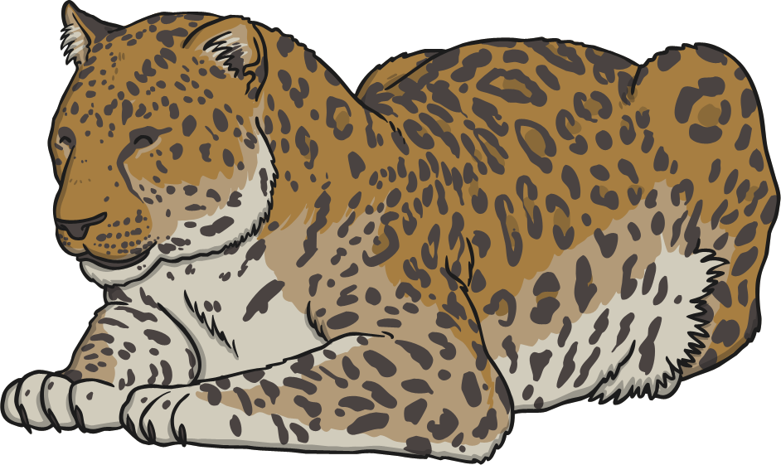
What are Endangered Species?
Endangered means something really in danger of becoming extinct (disappearing altogether).
Species are groups of living things like a type of animal or a type of plant. Species
is the eighth and last in line of the taxonomy ranking. Cheetah, jaguar, lion and lynx are all examples of wild cat species.
Did You Know…?
It is estimated there are a total of 8.7 million
different species on earth. However, only 1.3 million species have been identified.

Slide 3
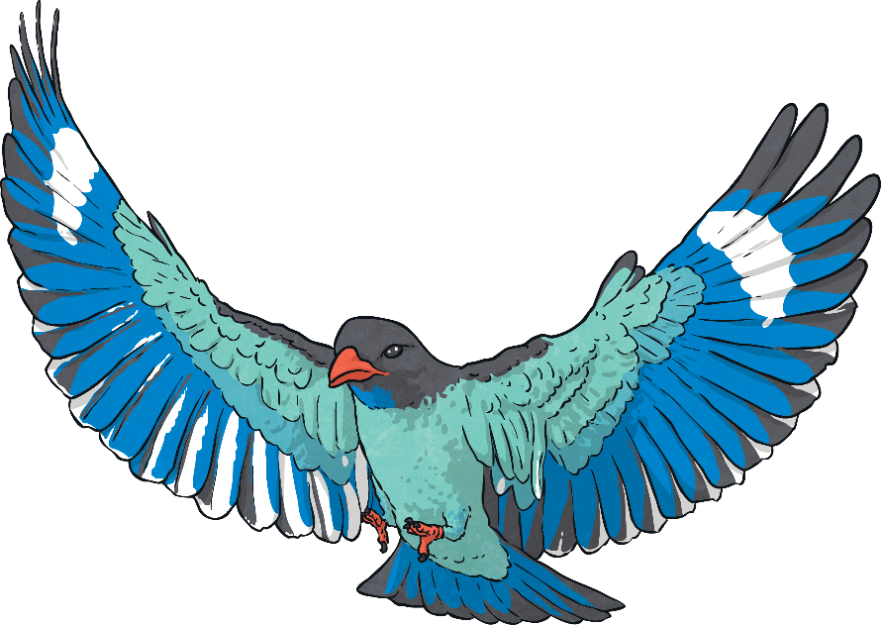
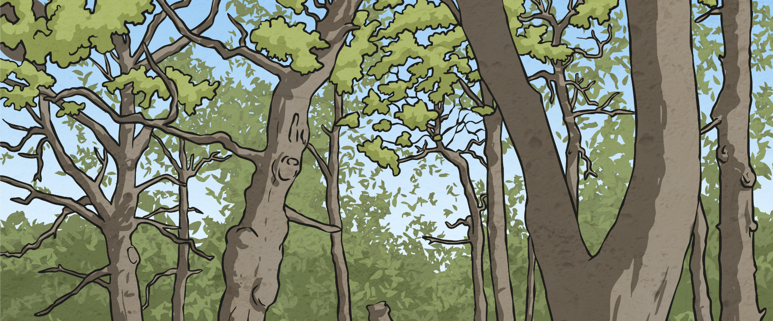
Protect Our Species
Animals and plants are a great gift and essential to the health of our planet. Unfortunately, due to human actions, more and more of these species are at risk of extinction every year.
Climate change, deforestation, pollution, poaching and pesticides are among the many reasons why these precious living things are in danger of disappearing forever.
The rate of extinction can be slowed and many species can recover if there is immediate action.
Did You Know…?
There are currently over 16 000 species threatened with extinction.
Between 200 and 2000 species become extinct every year.

Slide 4
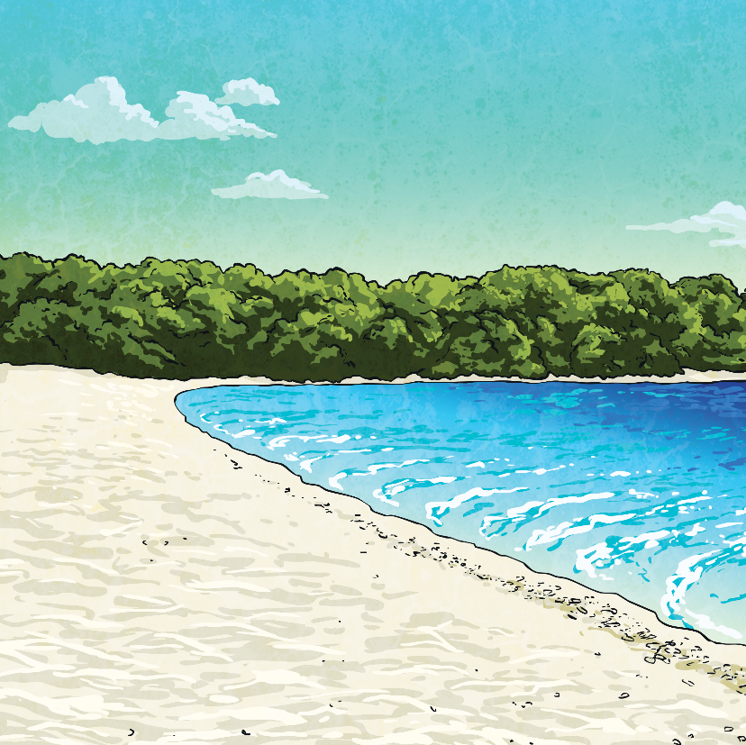
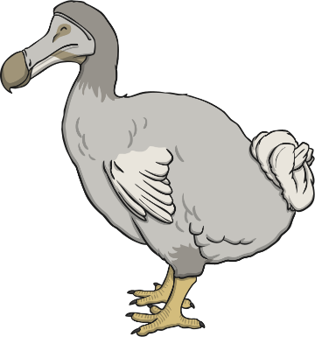
Which Species Are Endangered?
Do you know of any species that are endangered?
Do you know of any species that are extinct?
Sadly, the last sighting of a dodo was in 1662, less than 100 years after it was discovered.
One of the most famous creatures to have become extinct is the dodo.
First discovered in 1598, the dodo was a flightless bird that lived on the island of Mauritius in the Indian Ocean. Soon after, the dodo was hunted by sailors and other species they had brought with them and its habitat was destroyed.
If we are not careful, this will happen to many
of the species treasured around the world today.

Slide 5
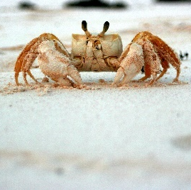
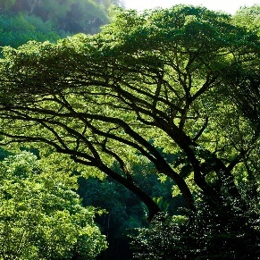
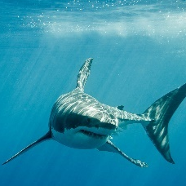
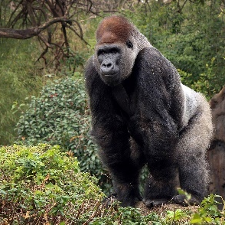
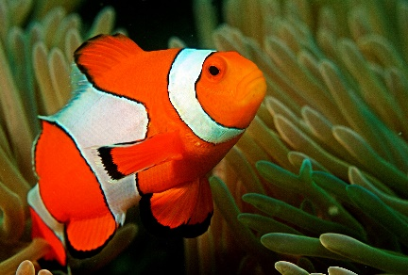
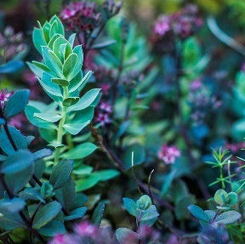
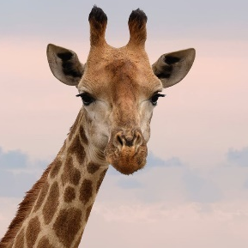
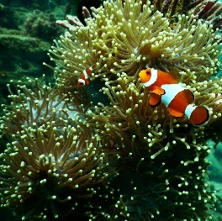
Find Out More…
What can we do to help?
Click on one of the species below and learn about why they are endangered:
Crustaceans
Trees
Birds
Sharks
Sea Turtles
Whales
Great Apes
Fish
Plants
Insects
Giraffes
Coral
Bees
Elephants

Slide 6
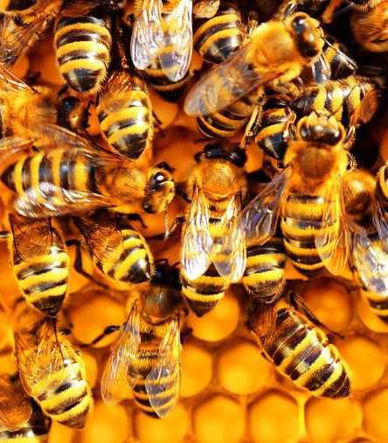
Bees
Bees are amazing creatures that live all around the world, from Europe to Africa and even in the Arctic. They help to pollinate plants and many species rely on bees doing this.
Bees help the reproduction of many species’ food sources, such as nuts and fruit, as well as helping new plants to grow as habitats.
Sadly, around the world, the population of bees is in decline.
This is largely due to:
Loss of habitat
Diseases
Climate change
Use of pesticides which are poisoning the bees
Back

Slide 7
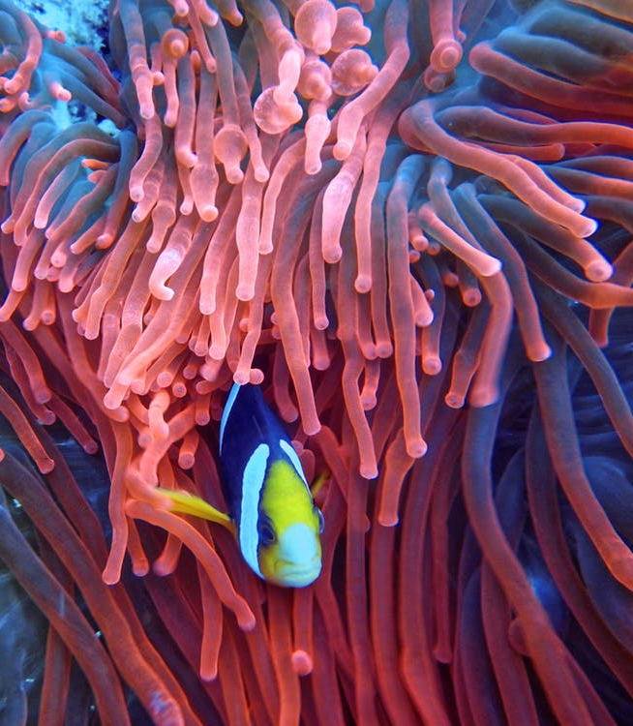
Coral
Corals are among some of the most beautiful species on the planet. Coral reefs can be found in more than 100 countries and are home to more than 25% of all marine life on earth.
25% of coral reefs around the world are already damaged beyond repair and 65% of reefs are under threat.
This is largely due to:
Polluted water
Tourists touching the corals and damaging them
Plastics, fishnets and other litter damaging them
Climate change causing the ocean to become more acidic, which is bleaching and killing corals
Back

Slide 8
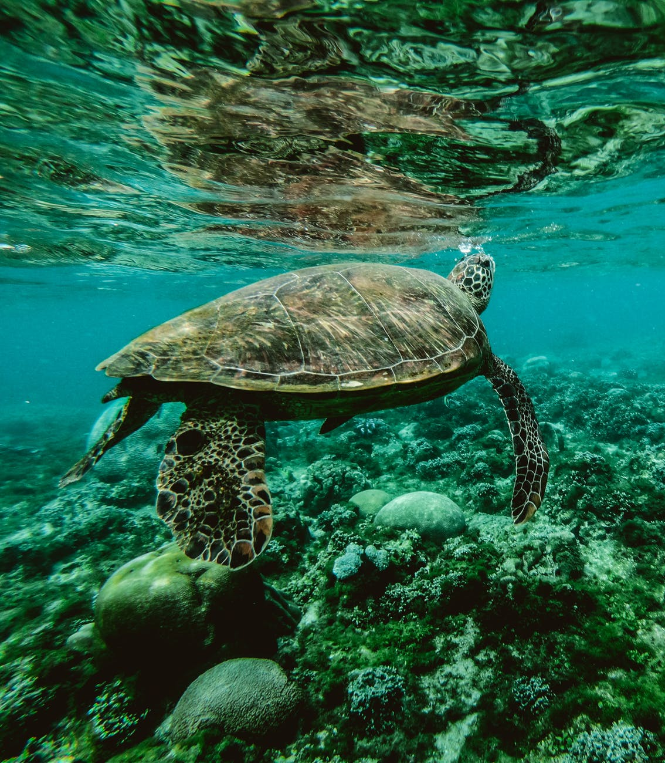
Sea Turtles
Sea Turtles are some of the oldest creatures existing on earth having been here for over 100 millions years and even surviving the dinosaurs!
Sea turtles are found in tropical and subtropical oceans and seas around the world. They are reptiles so they breathe air and use beaches for nesting and feeding.
These amazing animals help with the whole ecosystem of their habitat but they are in danger as numbers dwindle.
This is mainly due to four factors:
Climate change – in particular, global warming meaning a decline in the male population
Plastic pollution
Habitat loss due to coastal development and human beach activity
Getting caught in fishing nets
Back

Slide 9
Crustaceans
Crustaceans belong to the category of animals called arthropods who all have their skeleton on the outside (exoskeletons).
There are over 50 000 species of crustaceans, most living in rivers, seas and oceans, but some also on land. They range in size from 0.1mm to 4.3m!
They are also very important in food chains from eating lots of algae, to providing food for other animals.
Crustaceans really help keep reef ecosystems healthy but they are in danger from a number of threats. These include:
Chemical changes in seas and oceans making them more acidic
Loss of coral reefs which are a key habitat
Overfishing of crustaceans having a knock-on effect on the food chain
Plastic pollution
Back

Slide 10
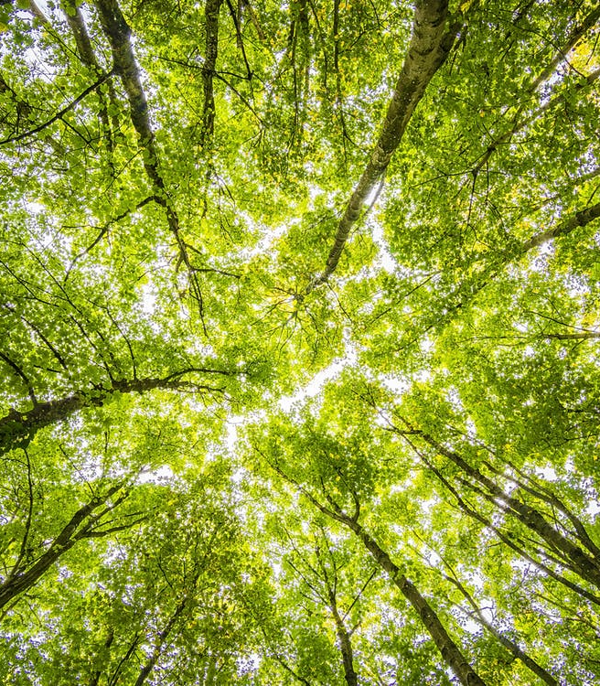
Trees
Trees are known as the ‘Lungs of Earth’ because they take in carbon dioxide and give out oxygen which is vital for human life.
Fewer trees = less oxygen.
Unfortunately, many trees are under threat as urbanisation and farming become more prevalent.
Trees also provide habitats for many animals as well as being beautiful things.
This main threats to trees are:
Deforestation
Climate change – increased carbon dioxide levels make it more difficult for trees to work efficiently to make oxygen
Forest fires
Non-native insects causing damage to trees
Back

Slide 11
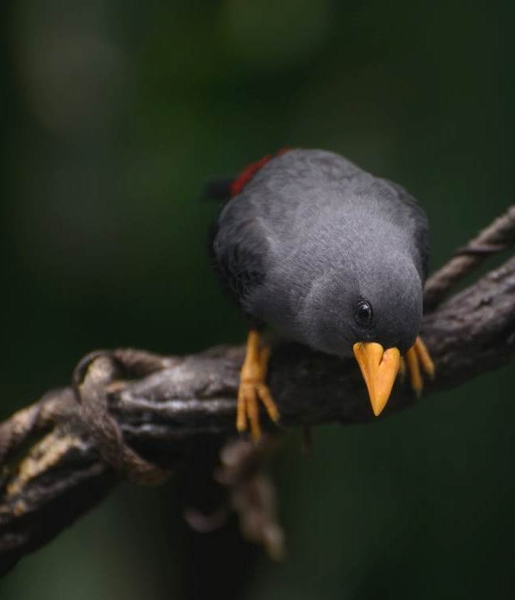
Birds
Amazingly, around 40% of the 11 000 bird species in existence are declining in numbers. Sea bird species in particular are suffering due to human activity.
However, many species are still in grave danger.
There is some hope, as during the past 100 years, 25 species have been brought back from becoming extinct.
This is largely due to:
Plastic pollution
Climate change including rising sea levels
Loss of habitat, farming being one of the biggest threats
Deforestation destroying trees
Other animals preying on birds, such as cats
Illegal pet trades where rare birds are smuggled and sold for a lot of money
Back

Slide 12
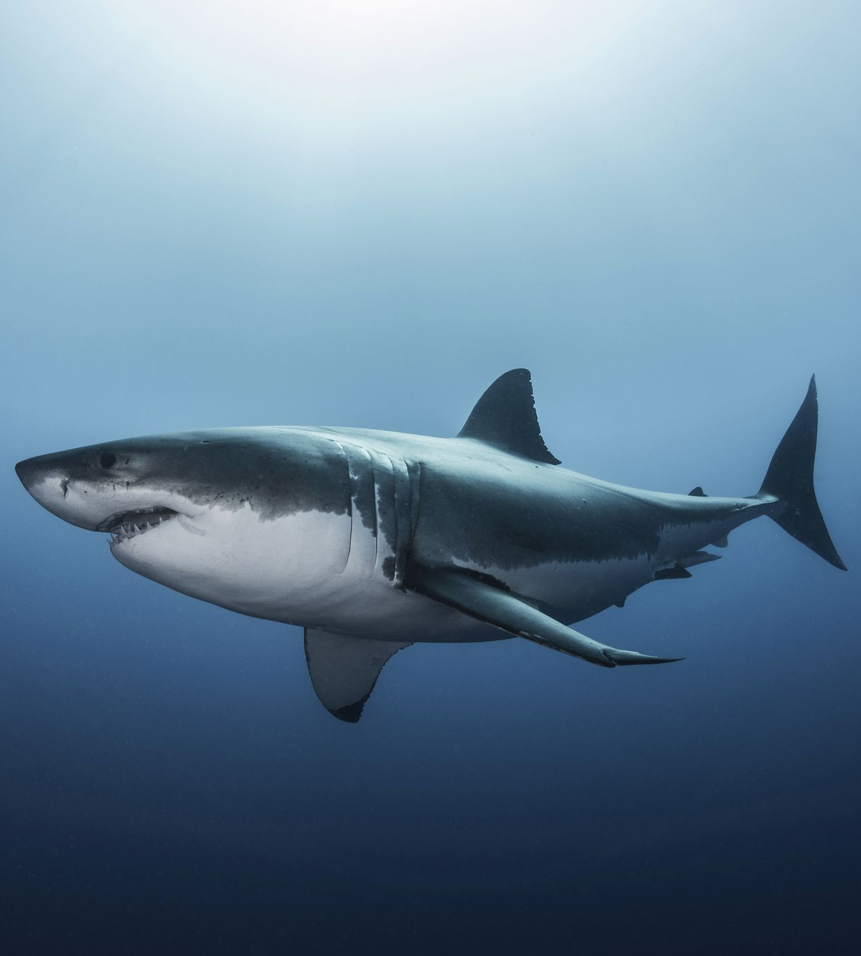
Sharks
It is estimated that sharks have been with us for 400 millions years!
They are the top of the food chain, varying in size from around 15cm to nearly 12m long!
Unfortunately, humans kill over
11 000 sharks per hour compared to sharks killing around 12 people per year.
The main threats to sharks are:
Being hunted for their meat and fins (called ‘finning’)
Climate change making ocean temperatures rise making sharks move areas and having an impact on food sources
Habitat loss linked to climate change and raised acidification in waters
Getting caught in fishing nets
Back

Slide 13
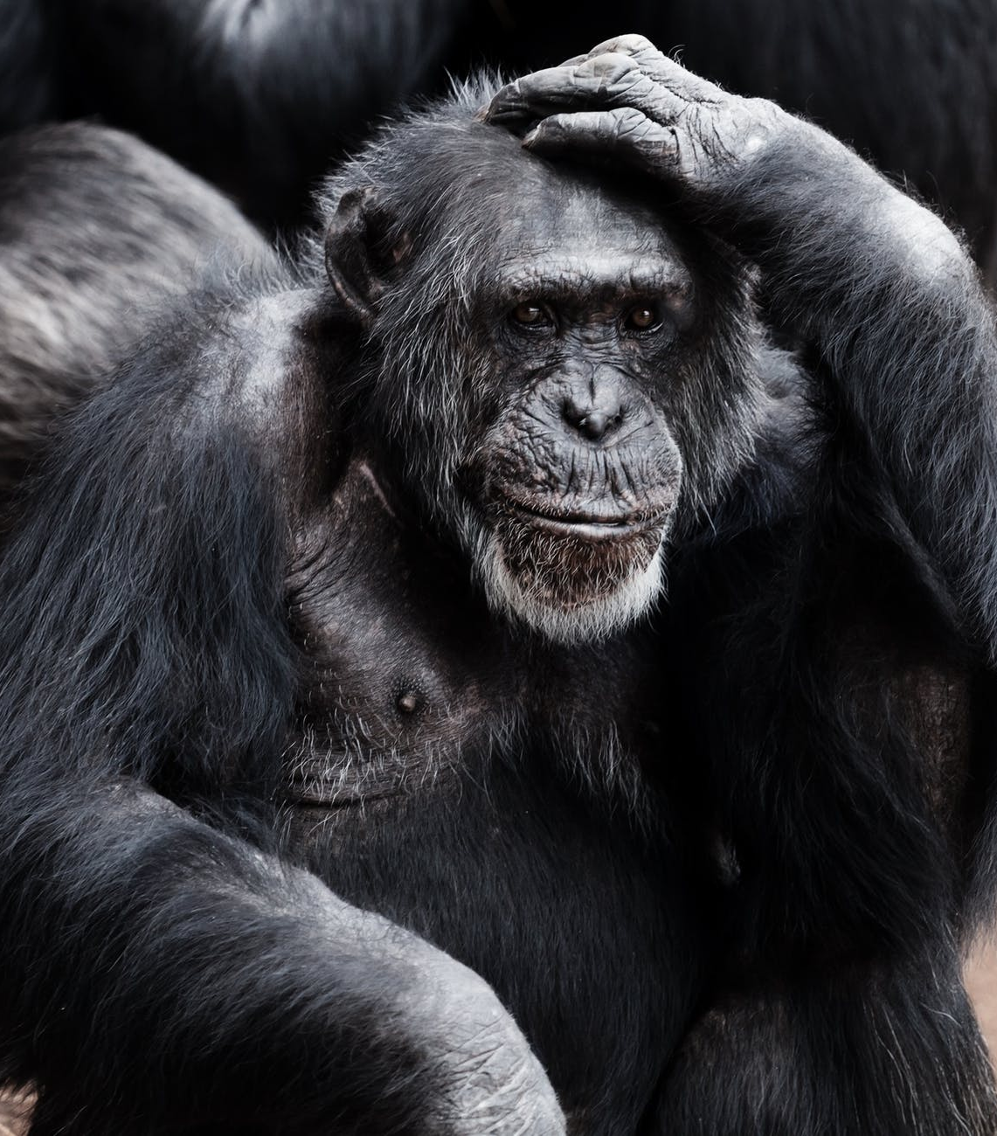
Great Apes
The great apes are four species: gorillas, chimpanzees, bonobos and orangutans. They are found in a their natural habits in Africa, Malaysia and Indonesia and range from just over 1m to just under 2m in height.
Great apes are important in their ecosystems as they are a key player in spreading seeds. They are also big draws for the tourism industry in their areas.
The great ape population is in constant decline but although still endangered, mountain gorillas are making a small comeback. The picture is not so positive for the other species.
Their decline in population is due to:
Habitat loss through urbanisation and farming
Deforestation due to palm oil production
Human activity creeping into their habitats causing competition
Climate change including droughts and forest fires
Illegal capture and trade
Back

Slide 14
Fish
It’s difficult to count, but there are thought to be more than 32 000 species of fish in the world, the smallest being only 0.76cm long!
88% of fish production is for humans to eat, so fishing is big business!
Because fishing is big business, there are a lot of people and communities that rely on having lots of fish, but fish populations are in danger.
This is largely due to:
Climate change affecting ocean temperatures and habitats
Habitat loss for freshwater fish through farming and urbanisation
Overfishing drastically affecting an area of fish and having a knock-on effect on its food chain
Water pollution, including plastics and chemicals
Back

Slide 15
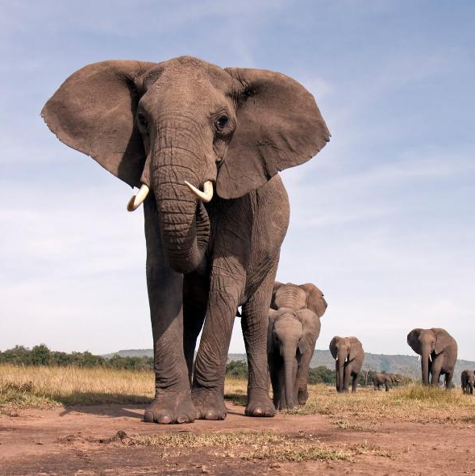
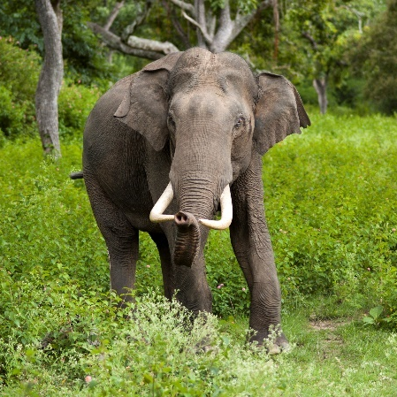
Elephants
Elephants are the world’s largest land animals and one of the most recognisable creatures on the planet.
They are intelligent; able to recognise their own reflections, have complex thoughts and feelings and have even been seen expressing joy at meeting other elephants.
In 2019, elephant populations are dangerously low.
African Elephants
1930 population: 5 – 10 million
2018 population: 500 000
Asian Elephants
1900s population (estimate): 100 000
2018 population: 40 000
Threats to elephants include:
Habitat loss
Climate change causing droughts and poaching
Being hunted for their ivory tusks
Back

Slide 16
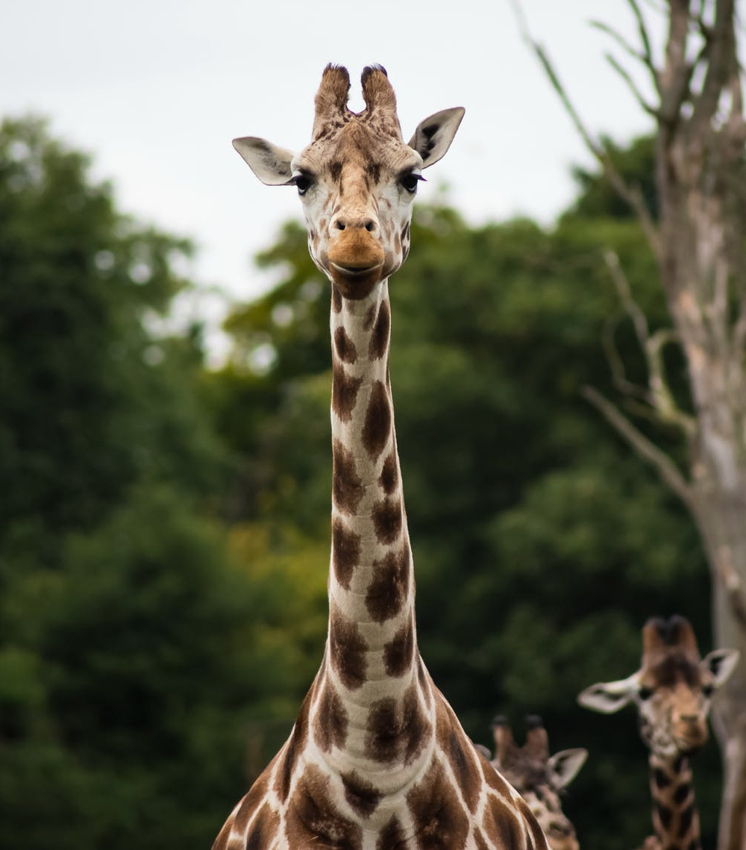
Giraffes
Giraffes are the world’s tallest mammals, standing between 15 and 20 feet tall. They are one of the world’s most iconic species and tourists travel from around the world to see them in their natural habitat.
In 1985, there were 155 000 giraffes in the wild. Today, there are only
80 000. There are now fewer giraffes than elephants in Africa.
Threats to giraffes include:
Habitat loss and climate change - resulting in the decline of the acacia tree, their main food source
Illegal poaching
Trophy hunting
Back

Slide 17
Insects
Insects make up around 80% of all the known species on earth. There are more than 900 000 species of insects that have been identified and scientists believe there may be another 2 million insects yet to be named.
Insects are essential for our planet; they help pollinate plants, are a source of food for thousands of different species and many help to reduce the number of harmful insects that would destroy crops.
Threats to insects include:
Climate change
Habitat loss
Use of pesticides
Invasive species – new species introduced to a different habitat causing significant problems, such as habitat destruction and reduced food availability
Did You Know?
For every human on Earth, there are 200 million insects!
Back

Slide 18
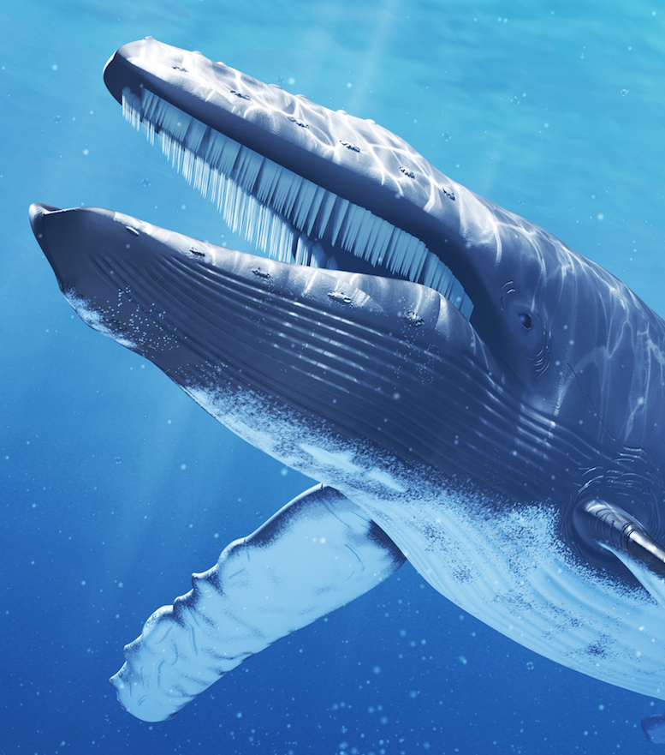
Whales
Whale populations are in steep decline. Over the last 100 years, the Fin whale population has dropped from 720 000 to around 20 000. Other species number only in the hundreds today.
There are 48 known species of whales, including the blue whale, which is the largest animal to have ever existed on earth. They are migratory animals, meaning they often travel thousands of miles to different waters to have their young.
Threats to whales include:
Climate change causing rising sea temperatures
Hunting
Collisions with boats
Fishing (getting caught in nets)
Water pollution
Noise pollution – whales navigate using sound and loud sounds from boats can scare or hurt them
Back

Slide 19
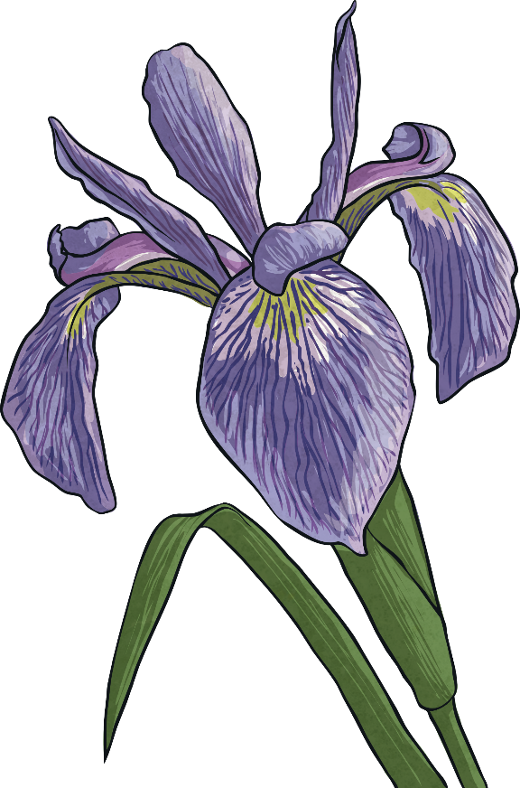
Plants
Whenever people talk about extinction, it is often animals that spring to mind. However, plants are an essential part of our planet’s survival. Losing the plants around us would be devastating for the environment.
Why do you think this is?
Plants absorb carbon dioxide from the air and release oxygen for us and other animals to breathe.
Many living things rely on plants as a source of food.
Plants provide somewhere for animals to live.
Plants help to clean water.
What do you think would happen if there were no plants?
Back

Slide 20
What Can You Do to Help?
Reduce consumption.
Choose green and environmentally sustainable products which
help protect nature. Reuse and recycle as much as you can.
Make sure you switch off lights when not needed and unplug electrical appliances when not in use.
Reduce pollution.
Walk or use a bike when possible. Properly dispose of litter in
waste bins or recycling centres. Perhaps you could join in
with a litter-pick in your area?
Protect habitats.
Make sure your local area is free of litter and that any
waste is properly disposed of to prevent animals getting
hurt. Perhaps you could try and build your own animal habitat, such as a bug hotel or a wormery?

Slide 21
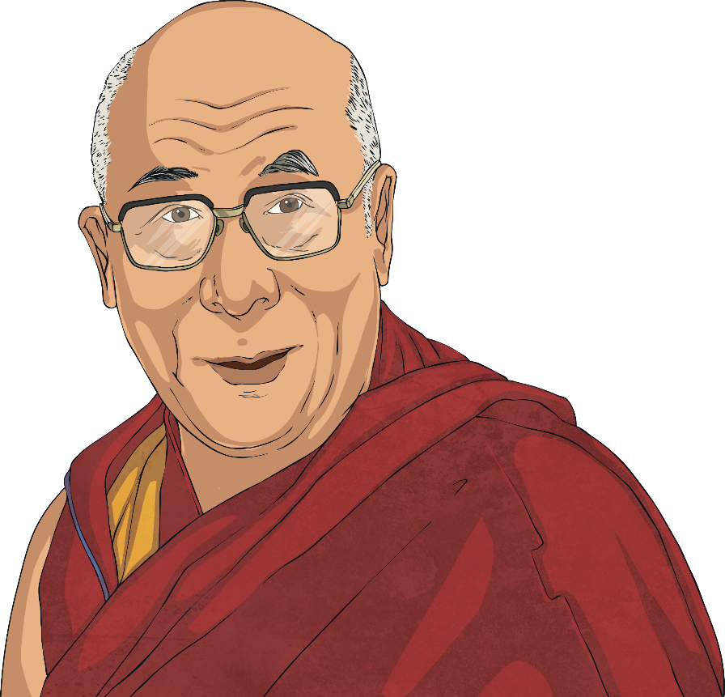
Protect Our Species
There are countless more species threatened with extinction.
They cannot have a hope of recovering unless we take action.
Remember:
Reduce consumption
Reduce pollution
Protect habitats
‘We have a responsibility to look after our planet. It is our only home.’ – Dalai Lama

