Slide 1
LI: identify how smoking can damage parts of the body

Slide 2
Why Is Smoking Dangerous?
Can you think of any reasons why smoking is a dangerous habit?
Cigarette smoke contains lots of harmful chemicals. They react in the opposite way as medicine does in our bodies.
Over time, these poisons can cause damage to the body and cause illnesses.

Slide 3
How Does Smoking Affect the Brain?
When someone smokes, the nicotine in the smoke goes to the brain. The cells in our brains then create adrenaline which can make a person feel relaxed.
However, when this feeling wears off, the person feels like they need to smoke again. This is called a craving and makes smoking addictive.
Smoking can also slow down or cut off the blood supply to the brain. This can cause something called a stroke.

Slide 4
How Does Smoking Affect the Heart and Lungs?
Nicotine from smoke reaches the brain and triggers something called adrenaline. Adrenaline makes the heart beat faster.
Smoking also releases a poisonous gas called carbon monoxide into the bloodstream. This causes some blood vessels to become blocked meaning there is less oxygen than normal flowing through the blood.

Slide 5
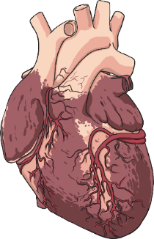
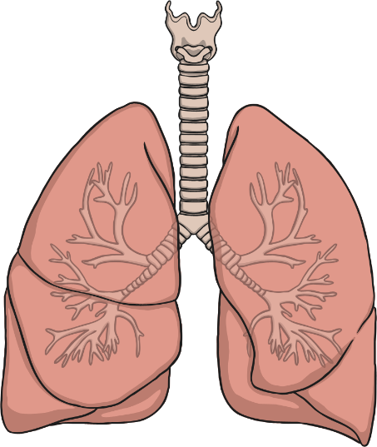
How Does Smoking Affect the Heart and Lungs?
As there is less oxygen in the blood, the heart starts to beat faster to create more oxygen to pump round the body.
This means that the heart is working harder than it normally does (sometimes up to 30% harder).
The longer a person smokes, the more fatty deposits build up in their blood vessels. This can cause problems like heart attacks.
The poisons and smoke in cigarettes also cause problems for the lungs. These problems can be as simple as a chesty cough or as serious as cancer.
Smoking can also cause tar to collect in the lungs, which causes breathing difficulties.

Slide 6
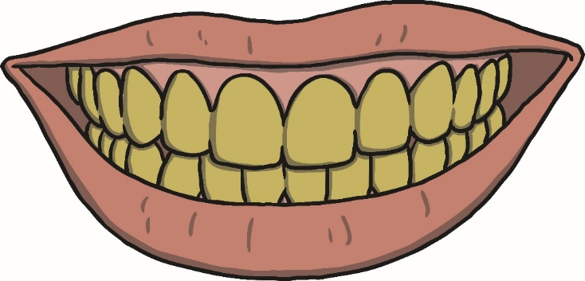
Are There Any Other Effects of Smoking?
Cigarettes also contain a substance called tar.
Tar is a sticky substance that can leave the ends of a person’s fingers, nails and teeth stained yellow.
Chemicals with smoke can also cause the skin to look older.
Smoking can cause ulcers, which can cause problems with digestion in the stomach.

Slide 7
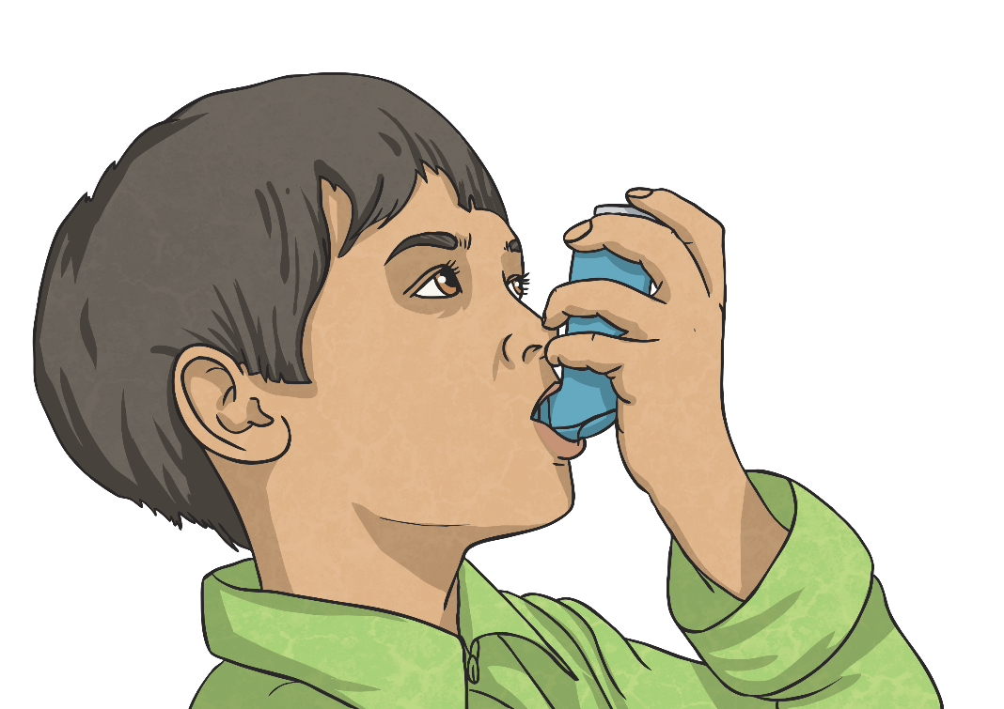
What Is Passive Smoking?
Breathing in smoke from another person’s cigarette can also be damaging. This is called passive smoking.
Passive smoking can even affect pets in a house!
Passive smoking can cause the same sorts of illnesses as actual smoking, especially if you are exposed to cigarette smoke a lot.
In some cases, childhood asthma has been linked to breathing in someone else’s cigarette smoke.

Slide 8
Smoking Is Expensive!
The average packet of 20 cigarettes costs £9.60.
Challenge
Joel smokes 20 cigarettes every day.
How much does he spend in:
A week?
£67.20
Four weeks?
£268.80
A year?
£3494.40

Slide 9
Task 1
Write a short paragraph to answer each of the following questions.
1) In what ways is smoking dangerous for a smoker and for those around them?
2) How can smoking damage your body?

Slide 10
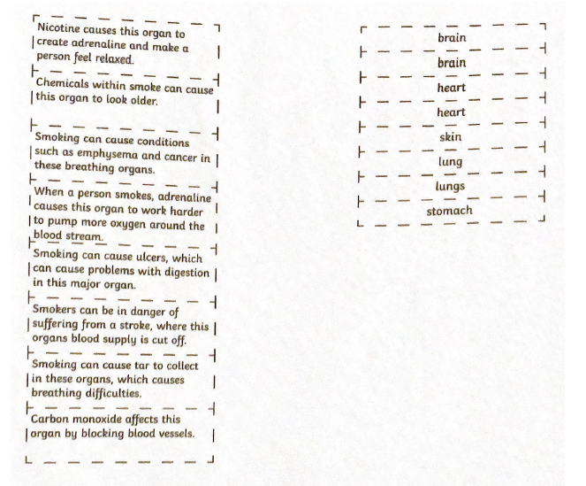
Task 2

