Slide 1
Multiplying and Dividing by 10, 100 and 1000
When I multiply by 10, 100 or 1000 I move the digits to the left.
When I divide by 10, 100 or 1000 I move the digits to the right.

Slide 2
Multiplying by 10, 100, 1000
Copy and complete the sentences below…
When I multiply by 10, I move the digits ___ place to the _______.
When I multiply by 100, I move them ____ places to the ________.
When I multiply by 1000, I move them ____ places to the ________.

Slide 3
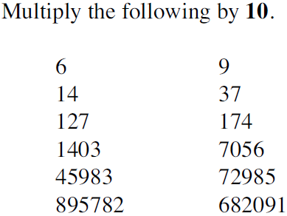
Questions

Slide 4
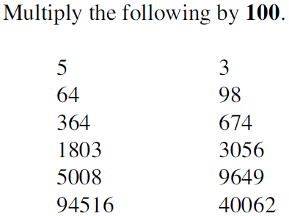
Questions

Slide 5
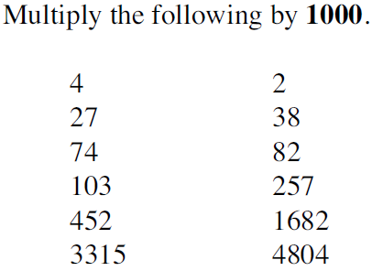
Questions

Slide 6
Dividing by 10, 100, 1000
Copy and complete the sentences below…
When I divide by 10, I move the digits ___ place to the _______.
When I divide by 100, I move them ____ places to the ________.
When I divide by 1000, I move them ____ places to the ________.

Slide 7
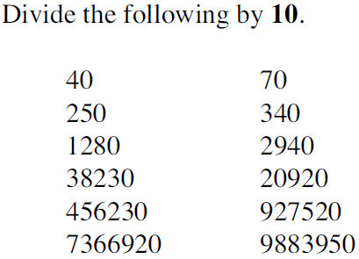
Questions

Slide 8
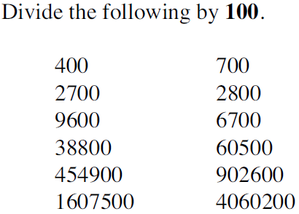
Questions

Slide 9
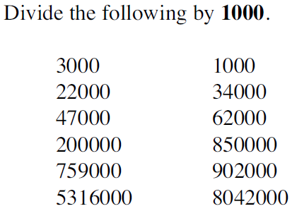
Questions

Slide 10
Questions

