Slide 1
Moving On Up! Primary to Secondary Enhanced Transition Programme

Slide 2
Contents
Session 1
-Contents -Introduction -‘I’m Glad I’m Me’ -Group Rules -How are we feeling (Pre-questionnaire)
Session 2
-RBA Vision and Values -Activity – What would be yours? -Travelling to school -Structure of the school day -Activity – Routine -Uniform -Other staff –Active Schools -School Clubs
Session 3
-Curriculum (Mr Gilchrist video) -Homework -Reading your timetable -RBA House Groups and staff -Respectful Relationships and Anti Bullying (Respectme video) Activity – Blether Boxes
Session 4
-Outdoor session during the ‘Bump Up’ Days in June (different dates for each school)
Session 5
Being prepared Equipment you will need Campus guide Virtual tour Reflection and Evaluation (Post-questionnaire)

Slide 3
Introduction
The time has come for you to make your exciting journey from Primary to Secondary School. Not in the way we might have imagined, but we know to EXPECT THE UNEXPECTED!
Throughout your time at Primary School, you have learned about the tools you need for resilience and coping with change. Now it is time to leave Primary School behind, but don’t worry! You will be taking the important tools you have learned with you as you go off to Secondary School.
Over the transition period you will be supported to help you say goodbye to Primary School and to look forward to starting Secondary School in August. You will always have your tools with you. So, remember to use them to help you whenever you need them.
The activities in this pack are designed for you to be able to prepare to move up. However, remember you have a wide range of people around you for support within your new Secondary School.

Slide 4
I’m Glad I’m Me
No one looks the way I do,
I have noticed that it’s true
No one walks the way I walk,
No one talks the way I talk,
No one says the things I say,
I’m special,
I am Me!
There’s no one else I would rather be!

Slide 5
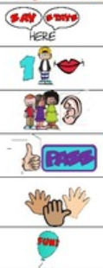
Group Rules
 | What we say here, stays here.
 | One person talks at a time.
 | Everyone listens.
 | It is okay to ‘pass’.
 | We participate!
 | We have fun!
Visual
Rule

Slide 6
How are you feeling?
I am excited about… | I am nervous about… | I am ________ about…
Do any of us feel a similar way about things?
Let’s fill in a questionnaire so we can compare at the end.

Slide 7
Vision and Values
We have worked closely with staff, pupils, parents and our partners in the community to develop a shared vision for our school.
All pupils and staff achieve their full potential
Achievement and success are aspired to, recognised and celebrated for all members of the school community
All members of the school community take pride in being part of the school and its community and work together to improve it
All pupils are encouraged to take responsibility, develop resilience, respect and leadership skills through involvement in the curriculum and wider activities
The highest quality learning and teaching is delivered across the school to encourage enjoyment and enthusiasm for learning
Effective partnerships are developed and supported between pupils, parents staff, and the wider community to support learning and improvement of the school community
We are a Rights Respecting School, and strive to provide a safe and inspiring place for our young people to learn, ensuring they are respected, nurtured and their achievements are recognised. We firmly believe that with rights come responsibility.

Slide 8
Vision and Values Continued
This ethos is embedded in our school values of:
Achievement
Respect, and
Equity.
The school’s core values were formulated by the pupils themselves after wide consultation with staff, parents and the young people in the school. At The Robert Burns Academy, our pupils are our greatest asset and it is our aim to ensure we provide them with opportunities, which allow them to achieve both in school and the wider community. Everything we do is based on respect, and it is our belief that this must be apparent in everything we do. All pupils deserve the same opportunities, and by placing equity at our core, we ensure this is integral to how we work. Our values were developed in consultation with our school community, making them relevant and applicable.
Being driven by our values ensures we achieve the vision of The Robert Burns Academy:
WHERE WE BELONG; WHERE WE REACH OUR POTENTIAL.

Slide 9
Activity Choose 3 points from the Visions and Values that you would consider as the most important and why, if you were the Head Teacher of a big Secondary School.
Answers Below:
1
2
3
Why?

Slide 10
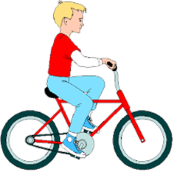
Travelling to School There are lots of different ways that children travel to school. Sometimes how far away or where you live might mean you don’t have as many choices. It is important to know how you are going to travel and how long it will take to get there. You can then work out what time you will need to leave home every school day to make sure you get to school on time and also what time you will get home. The Barony Campus operates a ‘Park and Stride’ approach (click here)
WALK
How many roads do you have to cross?
How long will it take?
Who will you walk with?
Now plan and work out the best way to walk from home to school
RIDE A BIKE
Do you need the school’s permission to ride?
How and where will you keep your bike safe at School?
How long will it take?
Will you be riding with anyone else?

Slide 11
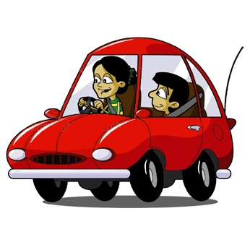
Travelling to School continued.
In a Car/Taxi
Who will drive you to and/or from school?
When will you leave?
How long will it take to drive?
Will anyone else be travelling with you?
Bus
Where is the stop that you will wait for the bus/school bus?
What number bus/buses can you take?
How long does it take?

Slide 12
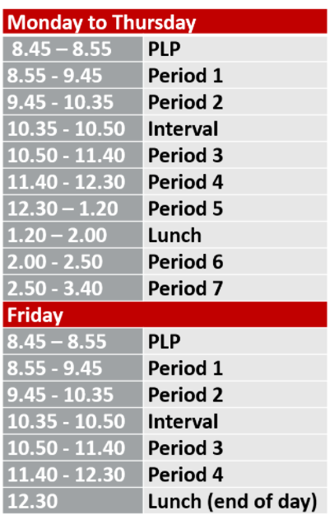
Structure of the School Day
At Secondary School some of the times you will need to remember, like starting, finishing and break times, may well be different to what you are used to.
You will however, still have a morning break, as well as a lunch break.
Here is the Structure of the Robert Burns Academy School Day.
What do you think about how your day will look?

Slide 13
Activity Now think about how long it will take you to get to school and work out the following times. This will help you to make sure you will get there on time every morning:
School starts at …………., so the latest I will have to be there is ……….
It takes me ……… minutes to travel there by……………
I will have to leave home at ……………
I will have to get out of bed at ……………
School finishes at ……………….
I will be home by about ……………..

Slide 14
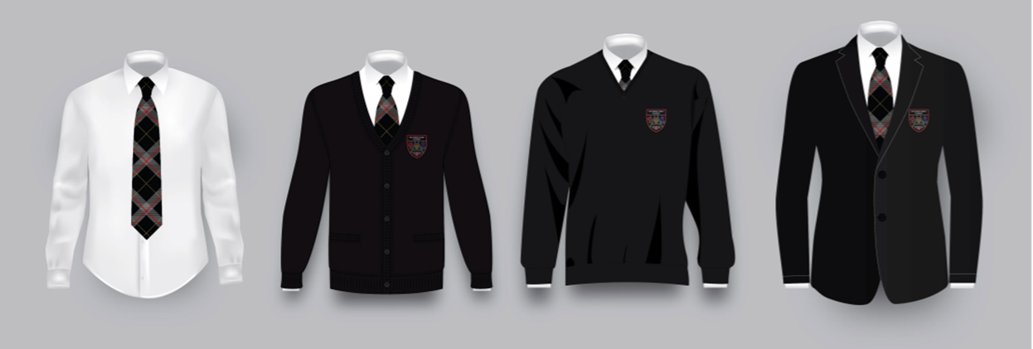
School Uniform When you start at Secondary School it is important that you give a good impression from the beginning by wearing the right clothes.
Acceptable Daily Uniform
White Shirt and School Tie
School Sweatshirt/Jumper
Black Trousers or Skirts
Black Shoes
School Blazer
PE KIT
Polo Shirt/
Shorts, Joggies or Leggings
Black Trainers
Appropriate Swimwear if required
No football strips (even national teams)

Slide 15
Other School Staff
I am Barry Holmes, Auchinleck cluster Active Schools Coordinator. I have been in this role now for 8 years and I really enjoy it! I am responsible for Auchinleck, Catrine, Drongan, Mauchline, Muirkirk, Ochiltree and Sorn primary schools and also have joint responsibility for Robert Burns Academy along with Cumnock Cluster coordinator Scott Guy.
My main roles are to provide opportunities for pupils to take part in extra curricular clubs, and try and encourage those who may not usually attend to get involved. Volunteer recruitment and support. School to club links in the local community via taster sessions and promotion.
The academy has a Leadership Program where we provide young leaders with fantastic opportunities to get involved in training and development as well as practical delivery within school and also in the community at local clubs and holiday clubs.
Holiday programs is a great chance for us to work further with local clubs and also local community associations to create and provide a great program of activity on offer over the holiday periods.

Slide 16
School Clubs Robert Burns Academy is looking to set up lots of School Clubs available that may suit your interests. Information on these clubs will be available when you enter S1. You could be part of a sports team, debate club, art club and so much more! In addition, all information of VC after school and community based sessions can be accessed via the School App. You may wish to enrol as soon as possible for clubs as there will be high interest in clubs available and you might have to be put on a waiting list. Do you attend any clubs at the moment, during or after school?

Slide 17
Curriculum
S1 pupils are timetabled for five periods of Maths and four periods of English.
There are three periods for Social Subjects and four periods for Modern Languages.
The remaining subjects will have either one or two periods in S1: Art, Computing, Business, Home Economics, Music, Technical, Drama and RME.
There will be two periods of P.E and a single period of PSE.
Here’s Head Teacher and Head of Campus Mr Gilchrist to tell you about your Curriculum at Robert Burns Academy…

Slide 18
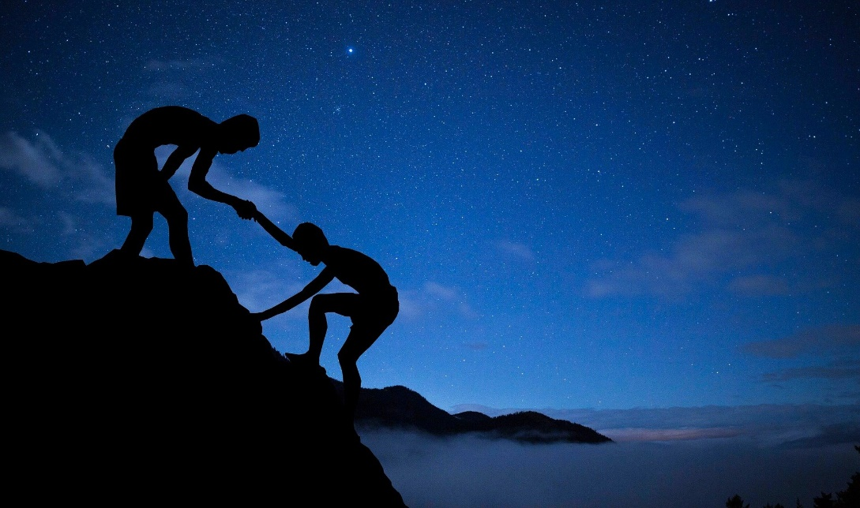
Homework
Your Homework tasks will be allocated to you by you class teacher.
You will be advised of how to access your assignments and support will be available with this. It is important for you keep up to date with your homework and don’t leave it until it builds up.
For most pupils (not just the new ones), there maybe times you feel you need a little more support at Secondary School. It could be you are struggling with your school work or homework. Remember if this happens to you, you are probably not the only one and someone will always be able to help you.
Always ask for assistance.

Slide 19
Timetable

Slide 20
What does it tell you?
1 = S1 or First Year
E = Ellisland (this pupils’ House Group)
3 = Group or set 3
What Year you are in!
BGE = Broad General Education (S1 – S3 will follow this)
Art = Subject for this period
CfE = Curriculum for Excellence (National Curriculum for Scottish Schools)
Ms Nova = Class Teacher
B2-22 = Classroom location (B block, 2nd Floor and Room 22)
Let us look at some of these points a little closer!

Slide 21
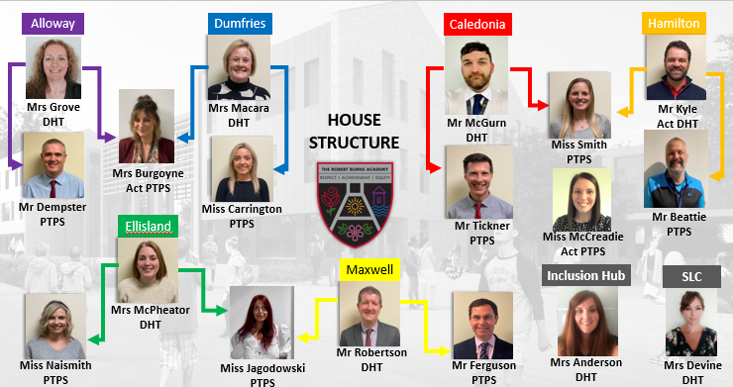
The House System

Slide 22
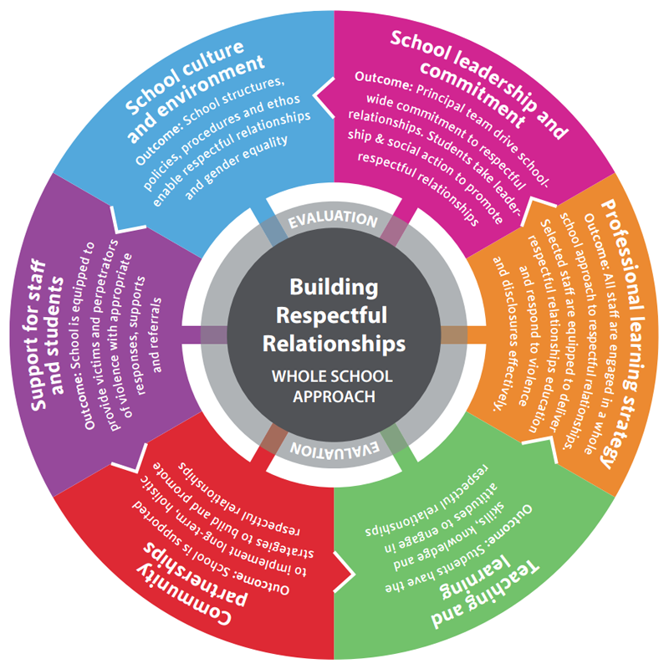
Respectful Relationships and Anti-Bullying
A respectful relationship is based upon mutual trust, honesty, kindness, consideration and fairness, bringing out the best in those involved.
It is our aim for you to have respectful relationships with each other, teachers and staff members at Robert Burns Academy.

Slide 23
Respectful Relationships and Anti-Bullying
Every young person in The Robert Burns Academy should experience an education free from bullying behaviour.
Respect is one of The Robert Burns Academy’s core values and we ensure that all pupils feel respected and included in school.
The Robert Burns Academy is committed to creating an environment that:
Considers bullying behaviour unacceptable
Listens to the views of the young people
Supports those that have displayed and experienced bullying behaviour
Establishes clear procedures for dealing with bullying behaviour
Takes all incidents of bullying behaviour seriously
Upholds our school values of achievement, respect, responsibility, teamwork and equality.

Slide 24
Activity – Blether Boxes
T
What if………………………………………
You are worried about something
What would you do?
Who could help?
What if………………………………..
You have a fall out with your friends
What would you do?
Who could help?
What if…………………………………………….
Your Pastoral Care Teacher or Year Head is not available?
What would you do?
Who could help?
What if……………………………………..
a friend wants you to miss class?
What would you do?
Who could help?
What if…………………………………
Someone is bullying you through social media?
What would you do?
Who could help?
What if……………………………………..
You don’t understand the homework?
What would you do?
Who could help?
What if…………………………………
You don’t feel well in class?
What would you do?
Who could help?
What if………………………………………………………………..
You are struggling with the work in class or classes?
What would you do?
Who could help?
What if…………………………
My alarm doesn’t go off?
What would you do?
Who could help?

Slide 25
Being Prepared
When you start Secondary School, will you need to get out of bed earlier than you do now on School mornings? Ensure you give yourself enough time in the morning to wash, dress and have breakfast. It can feel like a longer day before your lunch break at 1.20pm.
PACKING YOUR SCHOOL BAG – Things you will need
It is a good idea to set aside some time at the end of each day to pack your school bag ready for the following day. Using your timetable and homework diary or planner will help make sure you have everything you will need for each lesson. Using your Timetable, complete a checklist of things you will need to pack each day.
Know your timetable and your subjects for the day. (Take a screenshot on your mobile).
Being prepared in advance results in a positive start to your day.

Slide 26
Equipment I will Need There are some different things you will need to use for different subjects when you start your new school. While in Primary School, most of your equipment may have been provided for you. In Secondary School some of these will be provided by the school and you will need to bring the others yourself. You might already have some of the equipment you will need. Think of some of the new subjects you will be doing in Secondary School take time and make a list of what you will need.
What will I need
Pencils, pens, rulers, erasers, sharpeners.
Which subject/s will I use them in
All subjects will require these

Slide 27
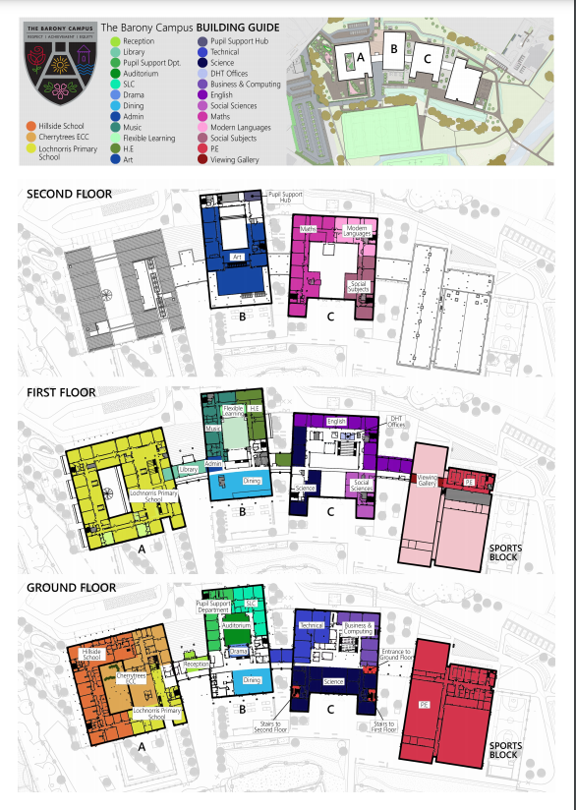
Campus Building Guide
Block A - This block contains Cherry Trees Early Childhood Centre, Lochnorris Primary School and Supported Learning Centre and Hillside ASN centre. In addition to the classrooms, there is a hydrotherapy pool, sensory room and soft play area.
Block B - This block has several shared facilities including Barony Hall, a Community Café, dining halls and an outdoor learning terrace. Secondary departments including Support for Learning, Inclusion Hub, Supported Learning Centre, Drama, Music, Home Economics and Art.

Slide 28
Campus Building Guide
Block C - Shared facilities include a STEM learning plaza and 4D immersive cinema. Secondary departments will include Design & Technology, IT, Science, Social Subjects, Modern Languages, Maths and English.
Sports and Leisure Block - There are four sports halls with associated changing rooms. The outdoor sports facilities include two synthetic pitches and a new 400m all-weather four-lane running track.
Most of your classes will be in C Block, You will have support to navigate the Campus from Senior pupils during the first few days!

Slide 29
Reflection and Evaluation
Full Group Reflection and Evaluation.
Useful Links:
You can find the School Handbook here
Passport to the Barony Campus here
The Robert Burns Academy School Blog here

