Slide 1
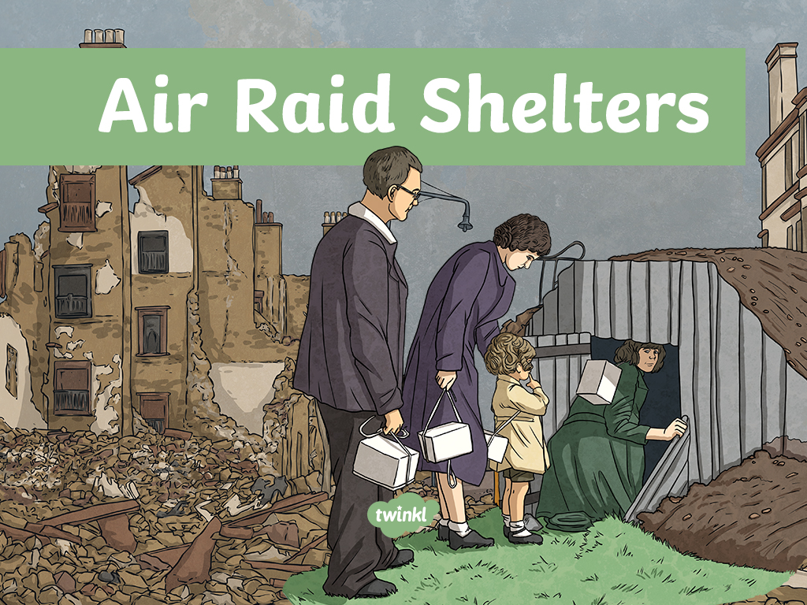

Slide 2
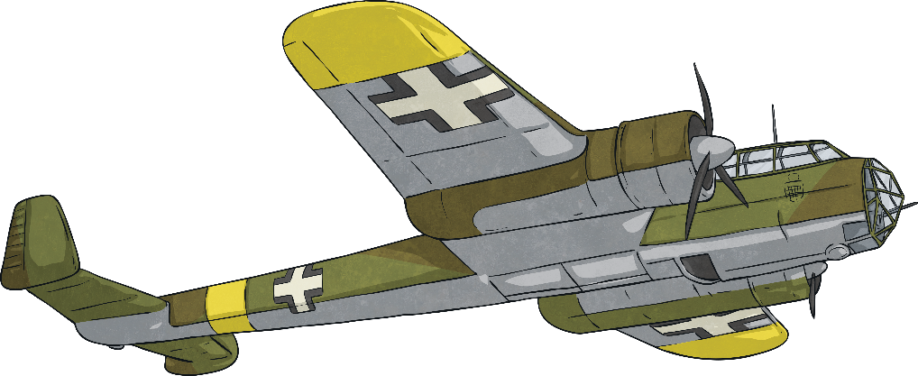

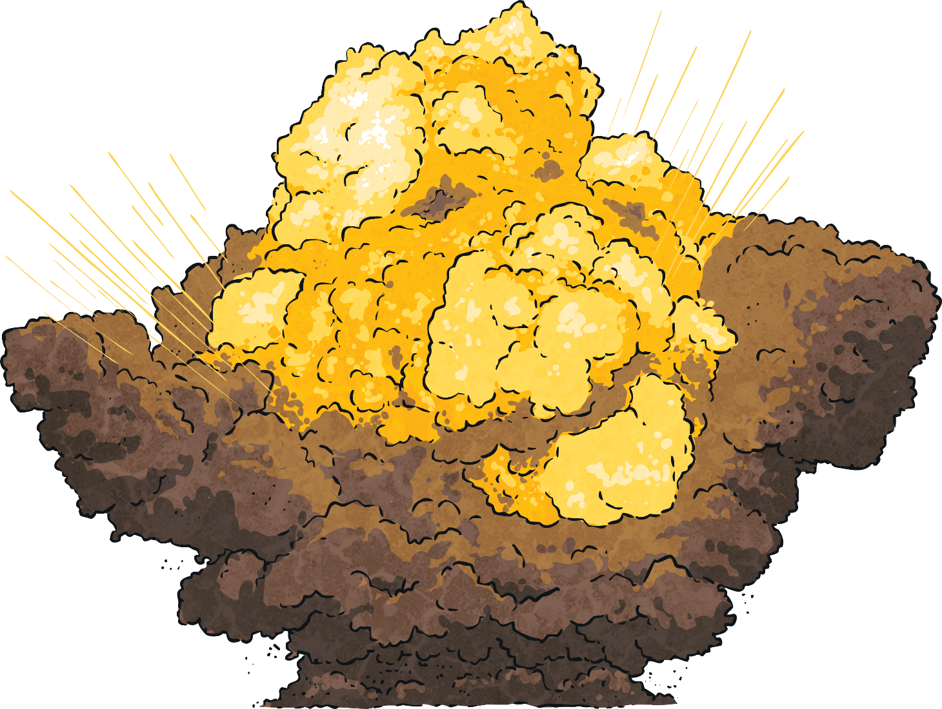

Air Raids
During the Second World War, enemy aircraft dropped bombs on Britain in an effort to destroy ports, industrial areas and major cities.
The Germans wanted to damage these areas to make it difficult for the British to transport weapons.
They also wanted to break the British morale and scare them into defeat.
The first air raid took place on 7th September 1940 in London, killing 2000 people in one night.

Slide 3

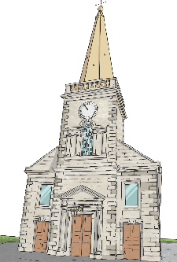
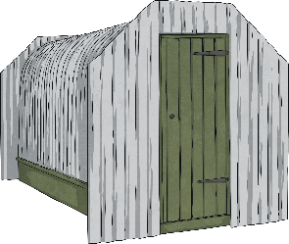
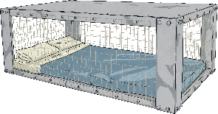
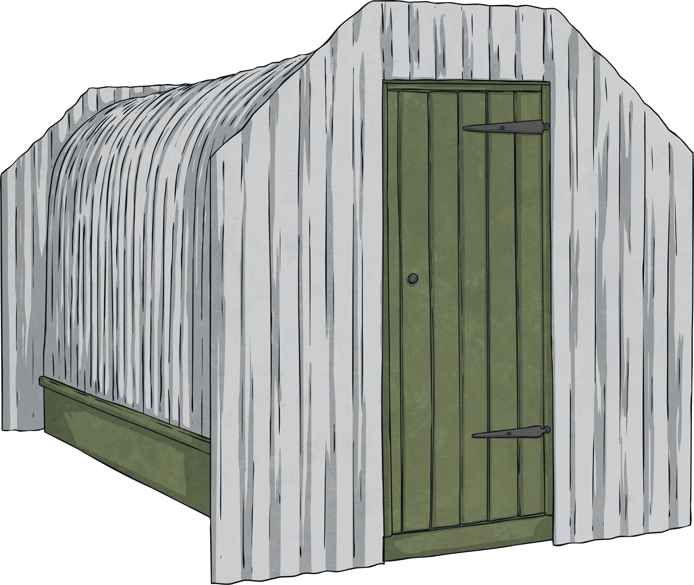
Air Raid Shelters
Air raid shelters were created so people could try to protect themselves from the night-time bombings.
When the air raid siren sounded, people would go to various shelters or places in their home to protect themselves. Listen to the air raid siren.
There were three main types of shelters used in the Second World War.
They were:
Communal
Air Raid
Shelters
Anderson Shelter
Morrison Shelter

Slide 4
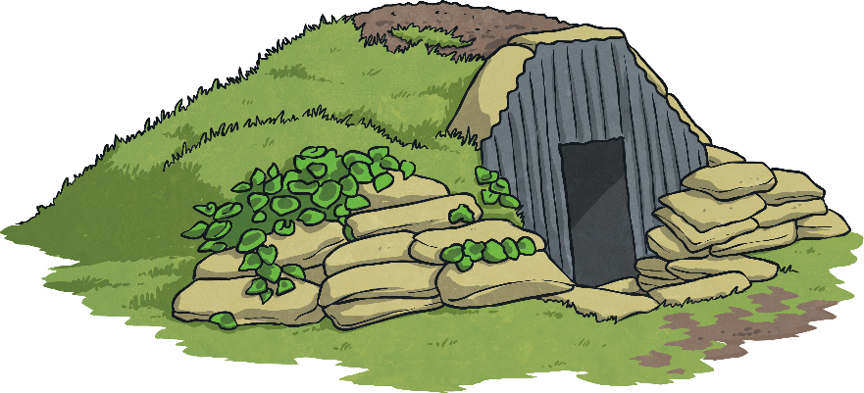
Anderson Shelters
These would be half buried in the ground and earth was heaped on top to protect it from bomb blasts.
They would be built in back gardens for those who could afford them and had space.
Anderson shelters were given to anyone earning less than £5 a week by the government.
For men earning more than
that, they could be bought
for £7.
By September 1939, over 1.5 million Anderson shelters had been built in gardens.
Anderson Shelters were named after Sir John Anderson.
These were made out of corrugated iron sheets which were bolted together. There were steel plates at either end.

Slide 5
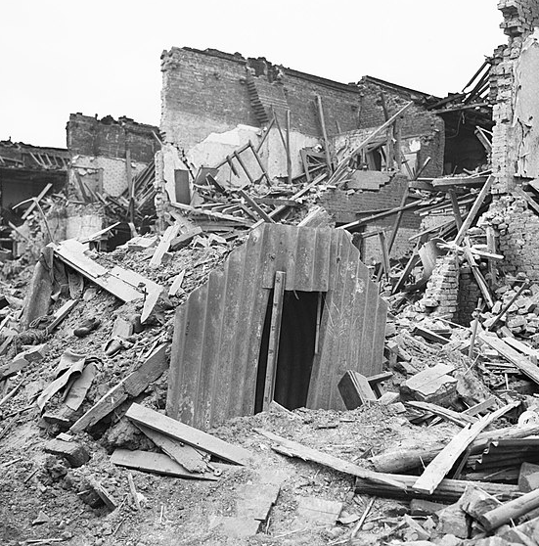
Anderson Shelters
Anderson shelter Latham Street, London 1941. Three people sheltering inside were unharmed when a bomb landed a few yards from it.

Slide 6
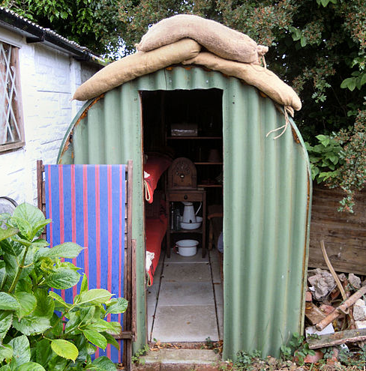
Inside an Anderson Shelter
Inside an Anderson Shelter
Anderson shelters measured 1.95 metres by 1.35 metres.
Inside, there were usually benches or beds along one or two of the walls.
It was usually dark and damp – some of them even flooded.
It would be difficult to sleep in them because of the noise of the bombs.

Slide 7
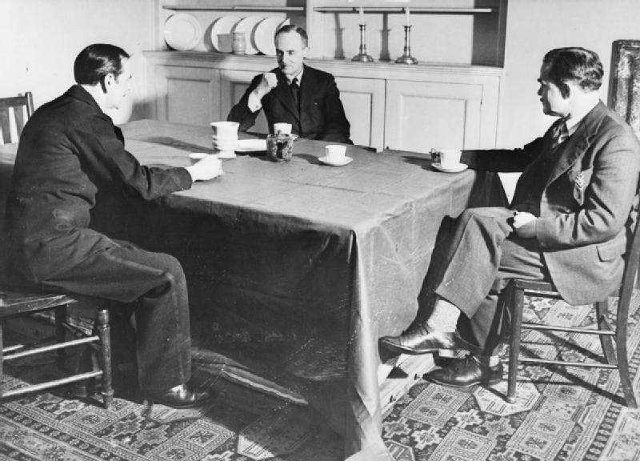
Morrison Shelter
In March 1941, The Morrison Shelter was introduced.
This was an alternative to the Anderson shelter that could be used inside the home.
It could be used as a table during the day.
A thin padded mattress was located in the base for people to sleep on.

Slide 8
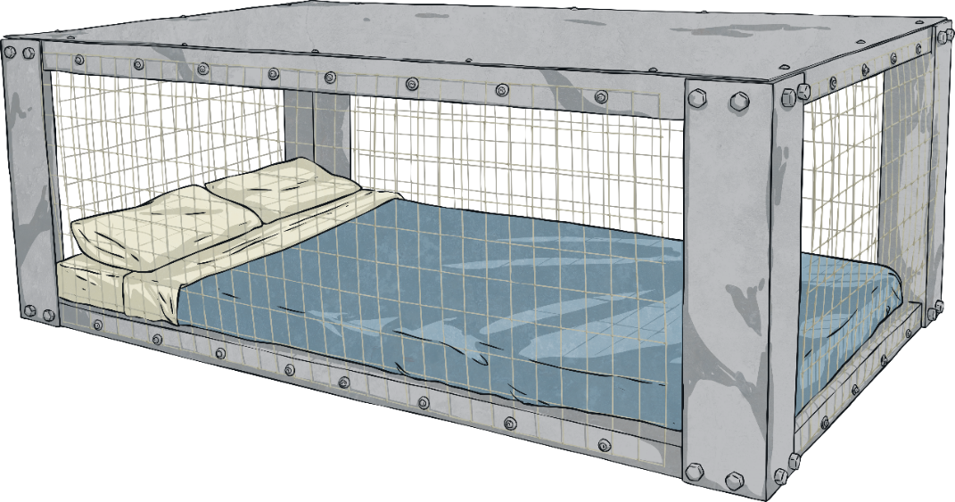
Morrison Shelter
The Morrison shelter was made of heavy steel with wire on all four sides.
They measured 2 metres by 1.2 metres and were 75cm high.
Families would sleep in these, instead of their beds, when air raids were frequent.
One of the wire sides lifted up for people to get inside.

Slide 9
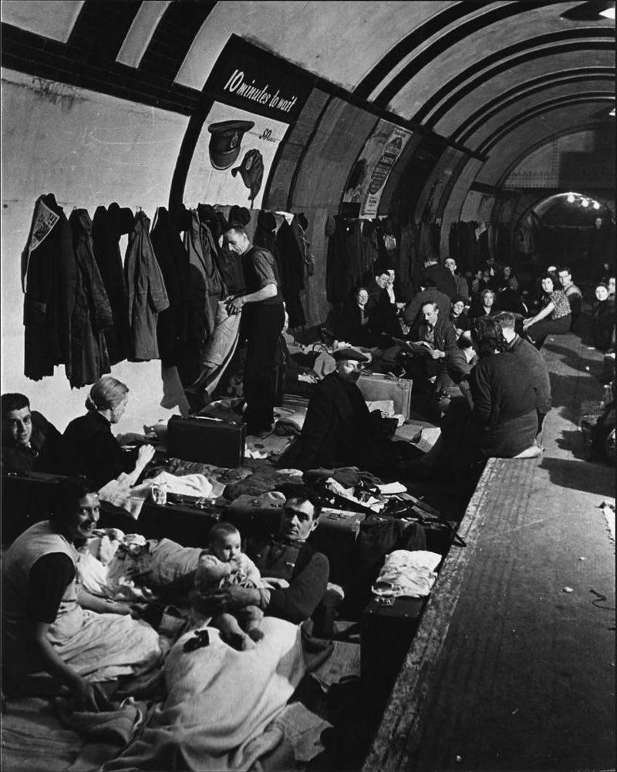
Communal Shelters
By the end of 1940, people were encouraged to use shelters that were under the ground as this offered better protection against bomb blasts.
In some parts of Britain, caves were used.
In London, the underground was used as a shelter.
On the busiest night in 1940, 177,000 people slept on the underground’s platforms.

Slide 10
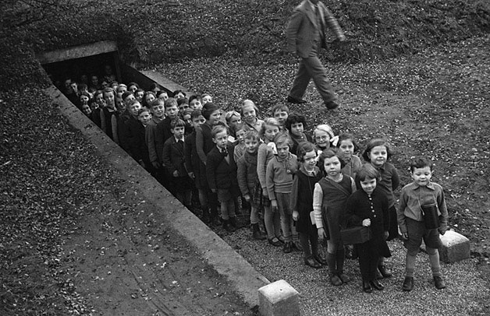
School Shelters
In some schools, shelters were dug into the school grounds.
These were narrow damp passages with concrete steps and walls.
In other schools, areas had been reinforced, such as cloak rooms, and children would gather in those areas when the sirens wailed.
Some children only had their desks to hide under.
Unbelievably, lessons would continue in the shelters.

