Slide 1

Lochnorris Primary
Home Learning Month: May Class: P2F
Spelling Use the May spelling menu tasks to practise your spelling each week. | Reading Log into Bug Club and read one book per week. | Numeracy Play games on Splashlearn and Topmarks to practise your times tables.
Writing Make up your own story. Who are the main characters? What problem do they have? How to they fix it? | Art Colour in your Spring picture and return before the end of May. | Reading Read one of your favourite books at home. Identify what the problem was and how did the character(s) overcome it?
Numeracy Complete the subtraction worksheet | Topic Draw a picture of your favourite toy. Label the picture and write a sentence about it. | Health & Well-being Go on a spring walk. Try and spot different types of flowers. Can you name them?

Slide 2
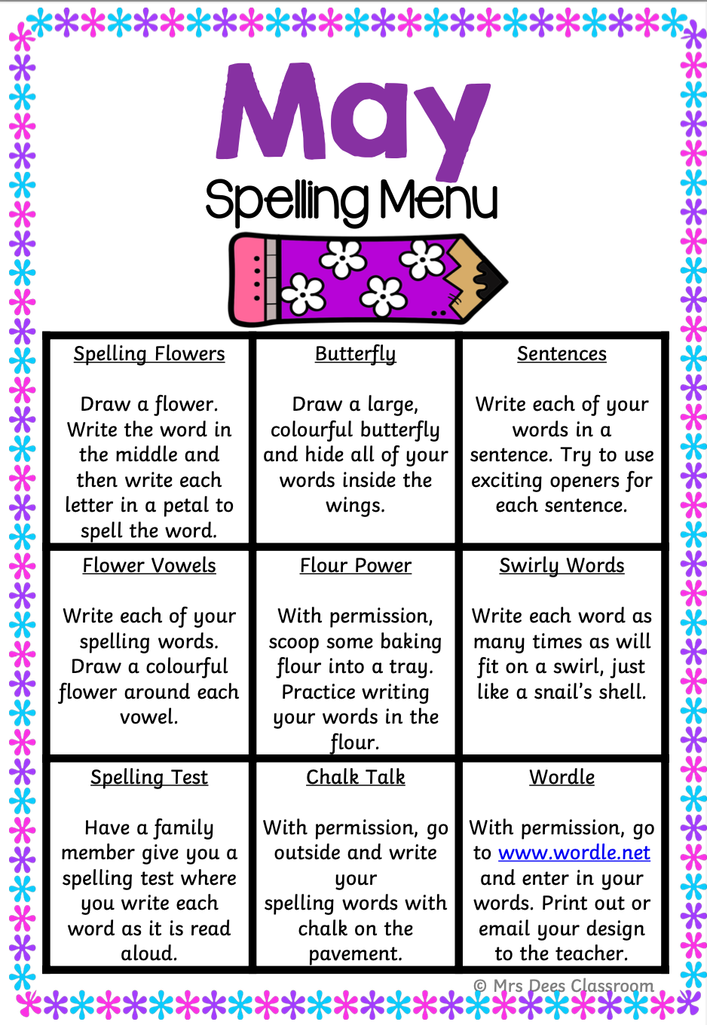
Spelling Words – May
Week 1
pause because sauce haunt
haunted Paul dinosaur
Common Words
little because
Week 2
kind find mind blind
child wild wind mild
Common Words
kind find
Week 3
Repeat Week 1 and 2

Slide 3
Spelling Words – May
Week 1
ship shop fish
brush shin shell
Week 2
chop chap chill
cheek much chick
Week 3
thin bath thud
moth path with

