Slide 1

Lochnorris Primary
Home Learning Month: March Class: P2
Spelling Use the March spelling menu tasks to practise your spelling each week. | Reading Log into Bug Club and read one book per week. | Numeracy Play games on Topmarks to practise your 2, 5 and 10 times tables and division facts.
Health & Well-being If possible, take a trip to the seaside. Take lots of pictures and let us know what you see! | Art Draw a picture of your favourite sea creature. Write a few sentences to describe it. | Reading Read a book with someone at home. Make a new front cover for the book.
Numeracy This term we are learning about money. Complete the money worksheet. | Topic For our Class Led Assembly (23rd April) please make a lighthouse using materials you have at home. Due: 20/04/26 | Art Complete the Easter colouring sheet. There is a prize for the best one!

Slide 2
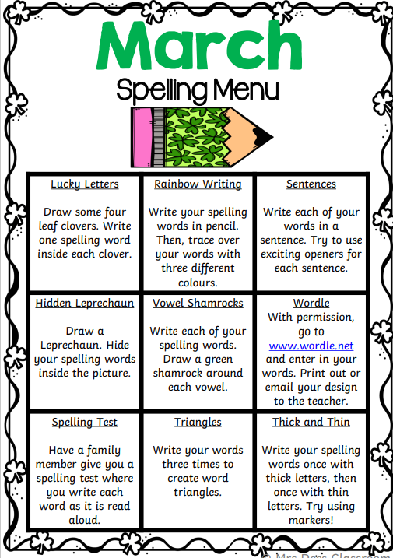
Spelling Words – March
Week 1 (u_e sound)
cube tube tune
rule mute flute
Common words
use could would
Week 2 (ew sound)
new few dew
stew flew crew
Common words
new who friend
Week 3 (ue sound)
blue glue clue
true value due
Common words
best better where

Slide 3
Spelling Words – March
Week 1 (b)
bat bin bib but
Common Words
we he
__________________________________
Week 2 (d)
dog dot dim dip
Common Words
for on of
__________________________________
Week 3 (u)
up fun mud cup
Common Words
my can ask

