Slide 1

Lochnorris Primary
Home Learning Month: February Class: P2
Spelling Use the February spelling menu tasks to practise your spelling each week. | Reading Log into Bug Club and read one book per week. | Numeracy Log into Numbots and make your way through the levels to upgrade your robot.
Health & Well-being Keep your room tidy for the whole months - it’s only a short one! | Challenge Learn to tie your own shoelaces if you can’t already do this. | Reading Read a book with someone at home. Summarise the story. What were the most important parts?
Numeracy This term we are learning about fractions. Cut up some fruit into halves and quarters (with an adult) | Topic Our new topic is The Caribbean. Tell your adults at home what you have been learning | Health and Well-being This term we are focusing on food and health. Make a fruit kebab with your halves and quarters

Slide 2
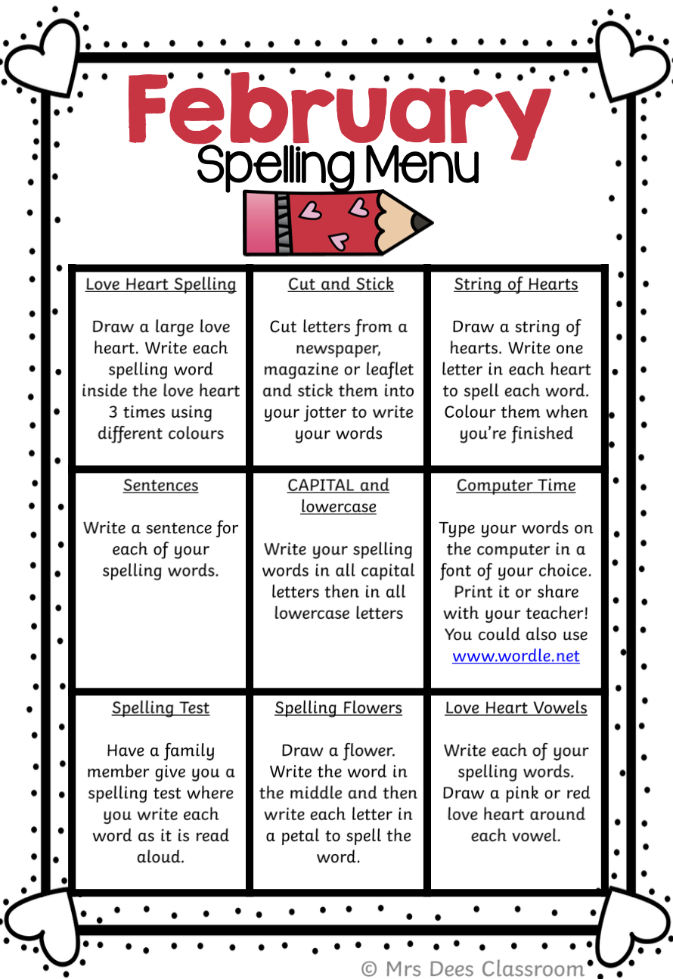
Spelling Words – January
Week 1 (o_e sound)
bone cone phone
home nose joke
Common words
more open
Week 2 (a_e sound)
make take bake
game name made
Common words
gave
Week 3 (e-e sound)
here eve theme
these phoneme delete
Common words
much

Slide 3
Spelling Words – November
Week 1 (h)
had hat him hit
Common Words
we he
__________________________________
Week 2 (l)
lap log let land
Common Words
for on of
__________________________________
Week 3 (f)
fan fit far fun
Common Words
my can ask

