Slide 1

Lochnorris Primary
Home Learning Month: January Class: P2
Spelling Use the January spelling menu tasks to practise your spelling each week. | Reading Log into Bug Club and read one book per week. | Numeracy Log onto Numbots and see if you can get to a new level.
Health & Well-being With and adult, go outside and take some pictures of different signs of winter | Art Draw a winter scene. Use different images as inspiration or follow Art Hub for Kids | Reading Read a book with someone at home. Who was your favourite character? Draw and label them.
Spelling Try some games on phonicsandstuff.com | Topic Our new topic is The Caribbean. Find out some information about one of the islands. | Music and Poetry Practise your Scots Poem and song at home.

Slide 2
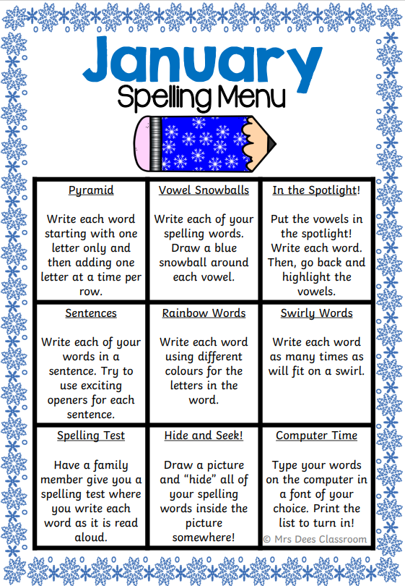
Spelling Words – November
Week 1 – 12.01.26 (igh recap)
light fight sight
night tight bright
Common Words
don’t can’t
__________________________________
Week 2 – 19.01.26 (y as in fly)
dry spy sky
shy flying fry
Common Words
fly try why
__________________________________
Week 3 – 26.01.26 (i_e)
five bike line
side hide like
Common Words
time

Slide 3
Spelling Words – November
Week 1 – 12.01.26 (ee)
seen bee tree
sheep green deep
Common Words
see keep
__________________________________
Week 2 – 19.01.26 (oo)
book cook moon
spoon pool cool
Common Words
look come some
__________________________________
Week 3 – 26.01.26 (ck)
back pack sick
pick neck stick
Common Words
got if came

