Slide 1

Lochnorris Primary
Home Learning Month: October Class: P2
Spelling Use the September spelling menu tasks to practise your spelling each week. | Reading Log into Bug Club and read one book per week. | Numeracy Play games on Topmarks to play Coconut Odd and Even game
Handwriting Practise your letter formation using the worksheet provided. | Art Draw a picture of you in your Halloween costume or carve a pumpkin with an adult. | Reading Bring in your favourite book from home and tell the class all about it.
Numeracy Order these numbers from smallest to biggest 5 7 1 13 21 9 15 | Topic Design your own Superhero and give them a name. | Numeracy Practise your number bonds to 10

Slide 2
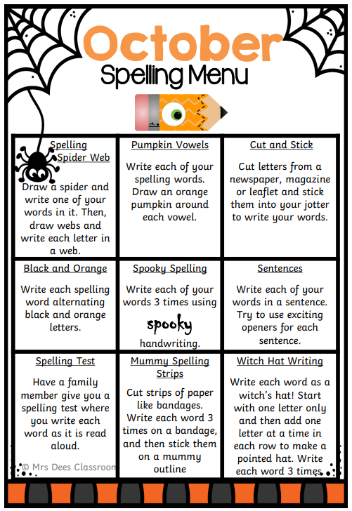
Spelling Words – October
Week 1 - 06.10.25 (y)
funny happy bunny
baby carry sunny
Common Words
any only
__________________________________
Week 2 - 20.10.25 (ss)
dress grass boss
class kiss mess
Common Words
I’m
__________________________________
Week 3 - 27.10.15 (ll)
tell well bell
fell sell hill
Common Words
call small

Slide 3
Spelling Words – October
Week 1 - 06.10.25 (j, v, y)
jug jam van vet
yes yum
Common Words
us have you was
__________________________________
Week 2 - 20.10.25 (z, qu, x)
zip zap quit queen
fox box
Common Words
him to do so
__________________________________
Week 3 - 27.10.15 (sh)
ship shop fish
wish dish shed
Common Words
go no

