Slide 1

Lochnorris Primary
Home Learning Month: September Class: P2
Spelling Use the September spelling menu tasks to practise your spelling each week. | Reading Log into Bug Club and read one book per week. | Numeracy Play games on Topmarks to play Place Value Basketball
Health & Well-being With and adult, go outside and take some pictures of different signs of autumn. | Art Draw an autumn scene. Use different images as inspiration or follow Art Hub for Kids | Reading Draw a picture of a different ending to one of your Bug Club books.
Maths Go on a shape hunt around your house. What 2D and 3D shapes can you find? | Topic Our new topic is Superheroes. Tell your adult what you have been learning. | Numeracy Practise counting n 2s, 5s and 10s to 100.

Slide 2
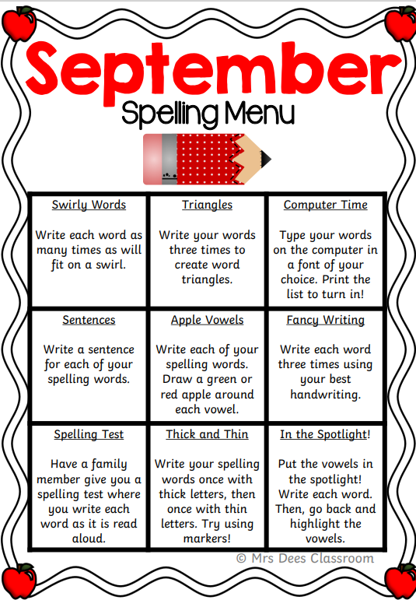
Spelling Words – September
Week 1 (ng, wh and ph sounds)
ring wheel phone
sing whip photo
Common Words
from his they when what
one
Week 2 (ee, oo and ck sounds)
tree book back
bee cook sack
Common Words
see keep look come some
got if came
Week 3 (ai, oy and oa sounds)
train toy boat
tail boy coat
Common Words
off into like all here
there were

