Slide 1
Lochnorris Primary
Home Learning Month: May Class: P4/5
Spelling Use the May spelling menu tasks to practise your spelling each week. | Reading Log into Bug Club and read one book per week. | Numeracy Play games on Splashlearn and Topmarks to practise your times tables.
Writing Make up your own story. Who are the main characters? What problem do they have? How to they fix it? | Art Colour in your Spring picture and return before the end of May. | Reading Read one of your favourite books at home. Identify what the problem was and how did the character(s) overcome it?
Numeracy Complete the money worksheet | Topic Draw a picture of your favourite animal. Label the picture and write at least 5 facts. | Health & Well-being Go on a spring walk. Try and spot different types of flowers. Can you name them?

Slide 2
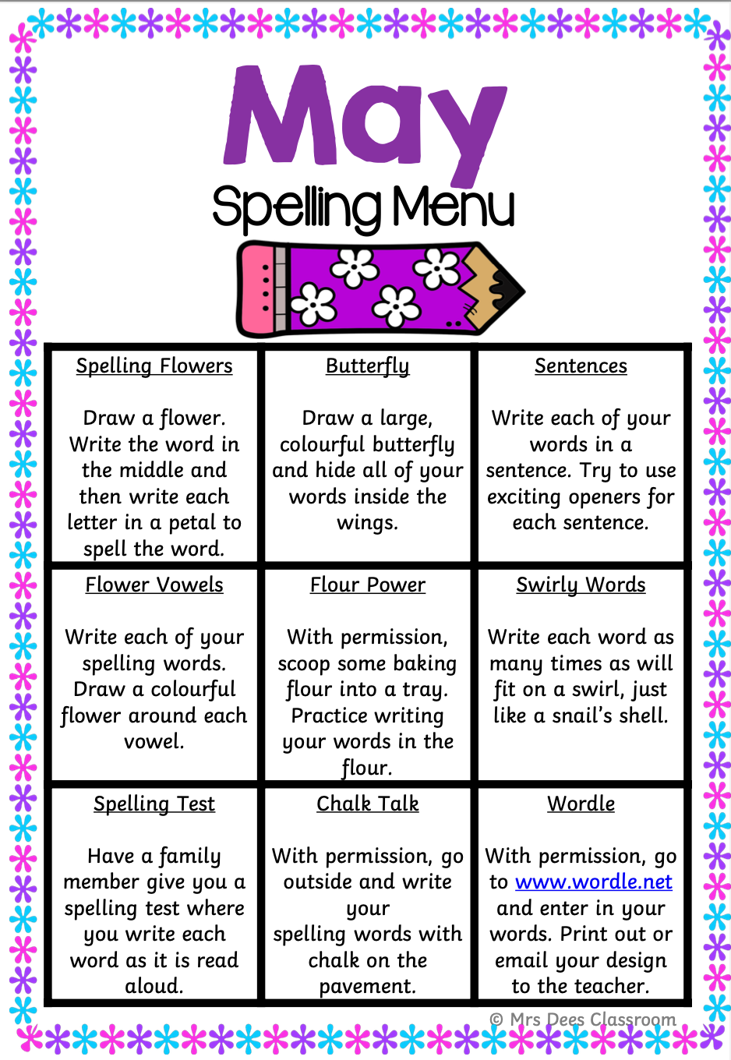
Better Bees Spelling Words – May
Week 1
put pull push bush full bully
different light sentence stop
Week 2
bread head deaf tried cried pull
push bully together buy eye
Week 3
itch witch ditch stitch catch hatch
watch another time windy
Week 4
nurse purse mouse house horse please
cheese back bird add between world
Week 5
have give live leave move sleeve
own small something

Slide 3
Busy Bees Spelling Words – May
Week 1
screamed seem bought whole opened
leaves gone television mice mouse
squirrel wonderful without spelling greater
Week 2
clothes alone those toast goal
coach slowly throw shadow sew
sewing doe foe toe
Week 3
Kilmarnock Ayr Glasgow Cumnock Edinburgh
London Irvine Clyde Ayrshire city
village town castle here local
Week 4
school football booklet June flute clue
rule blew drew flew blue untrue
Week 5
ate better scary police white purple
yellow tries tries turned wanted piece
peace arrive high

