Slide 1
Lochnorris Primary
Home Learning Month: February Class: P4/5
Spelling Use the February spelling menu tasks to practise your spelling each week. | Reading Log into Bug Club and read one book per week. | Numeracy Play games on Splashlearn and Topmarks to practise your times tables.
Health & Well-being This term, we are learning about healthy foods. Record a food diary for one week. | Art Use some chalk and draw some pictures and patterns on the ground. Upload photos to Teams, if you can. | Reading Read a book with someone at home. Summarise the story. What were the most important parts?
Numeracy Compete the Fractions worksheet. | Topic For our Romans topic, please make a shield or sword for our assembly. Details to follow. | Health & Well-being Keep your room tidy for the whole months - it’s only a short one!

Slide 2
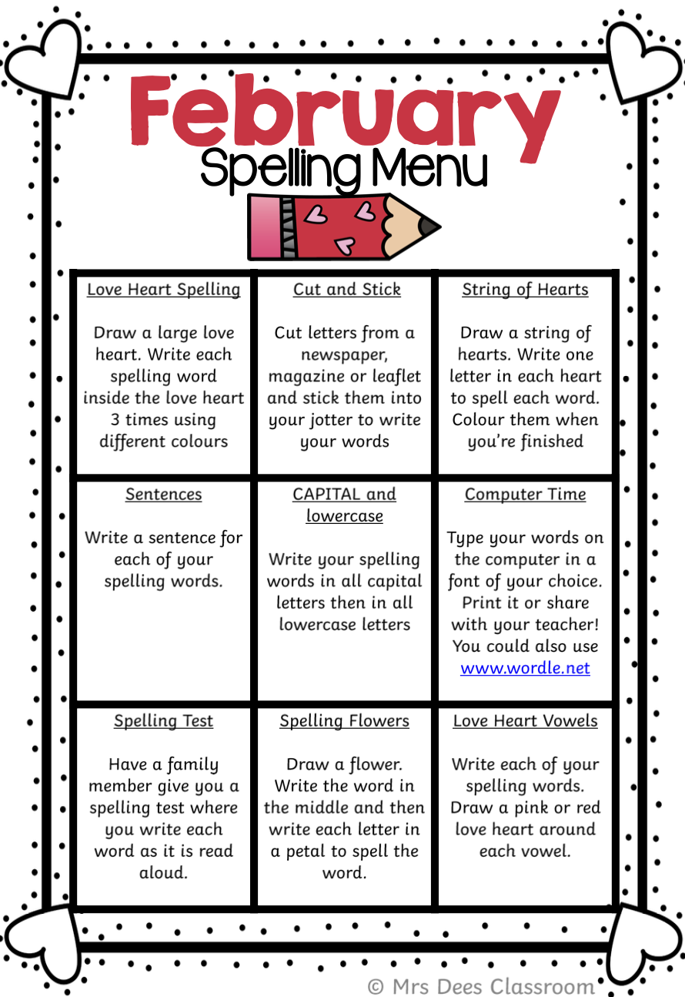
Better Bees Spelling Words – February
Week 1
hawk whale dolphin
yawn whip trophy
claw whisper photo
seesaw wheat graph
Week 2
blew potatoes haunt
chew tiptoe launch
threw tomatoes pause
flew goes August
Week 3 and 4
Split Phonemes: a_e e_e i_e o_e u_e
gate delete pipe
cake even bike
spade Steve slide
phone flute
rose cube
rope perfume

Slide 3
Busy Bees Spelling Words – February
Week 1 & 2
January February March April
May June July August
September October November
December quickly important
mumbled
Week 3
dress deaf were friend
chest feather said any
spent spread again many
Week 4
fresh meadow friendly against
expect treasure. friendship anyone
wedding measure anything
anybody

